Slide 1
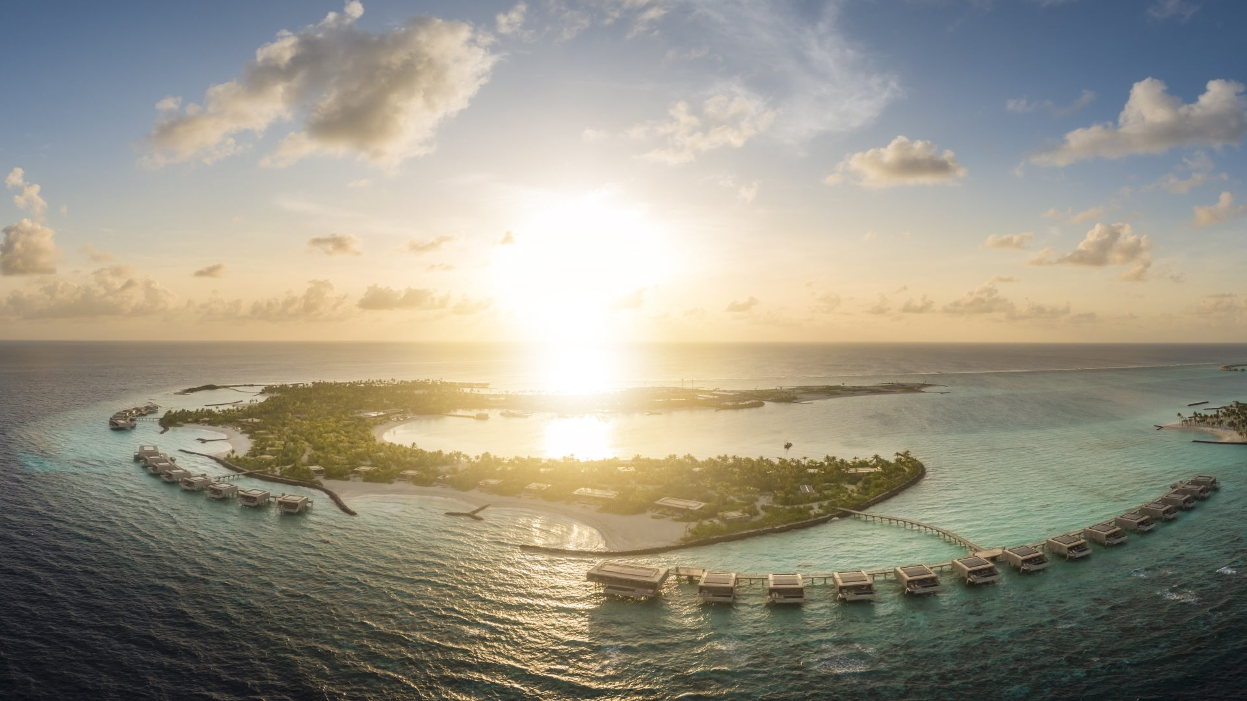

Slide 2
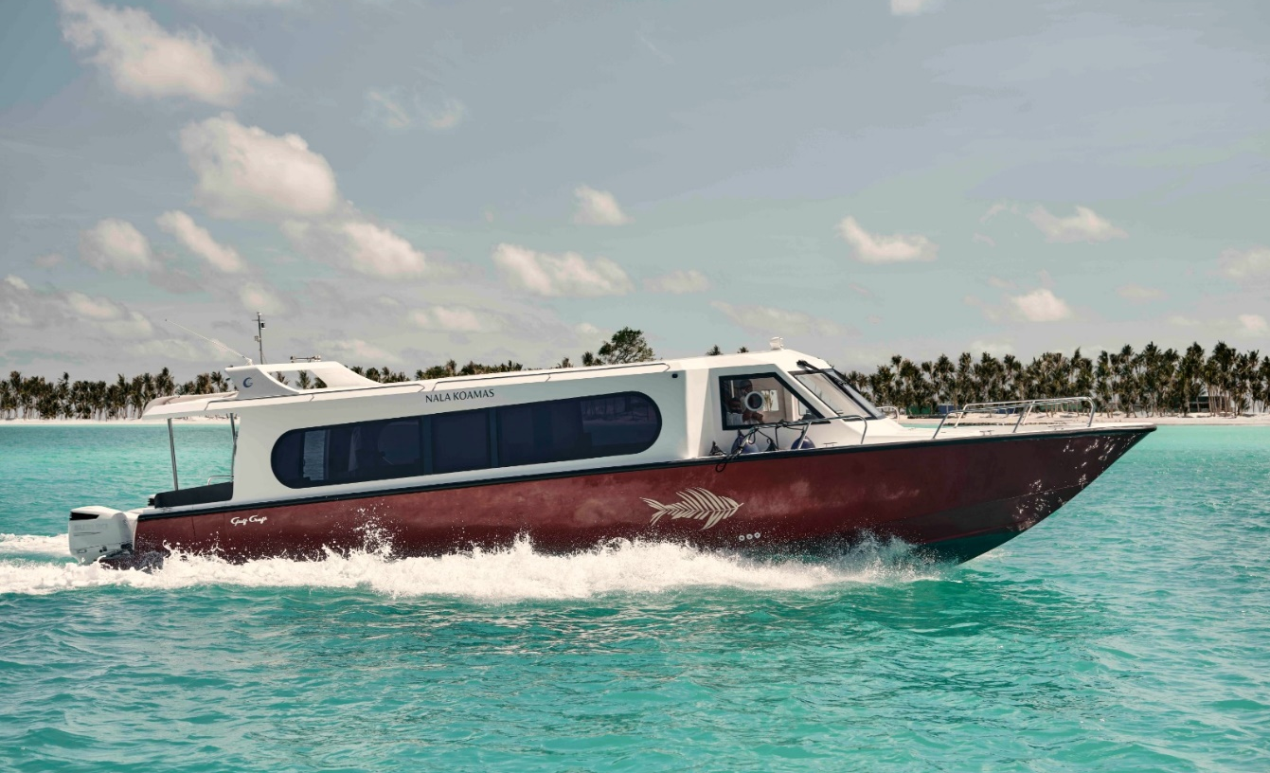
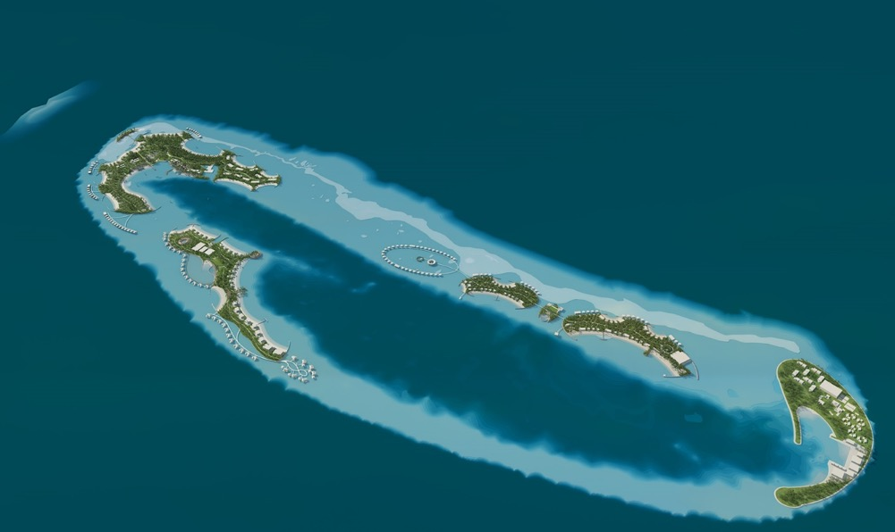
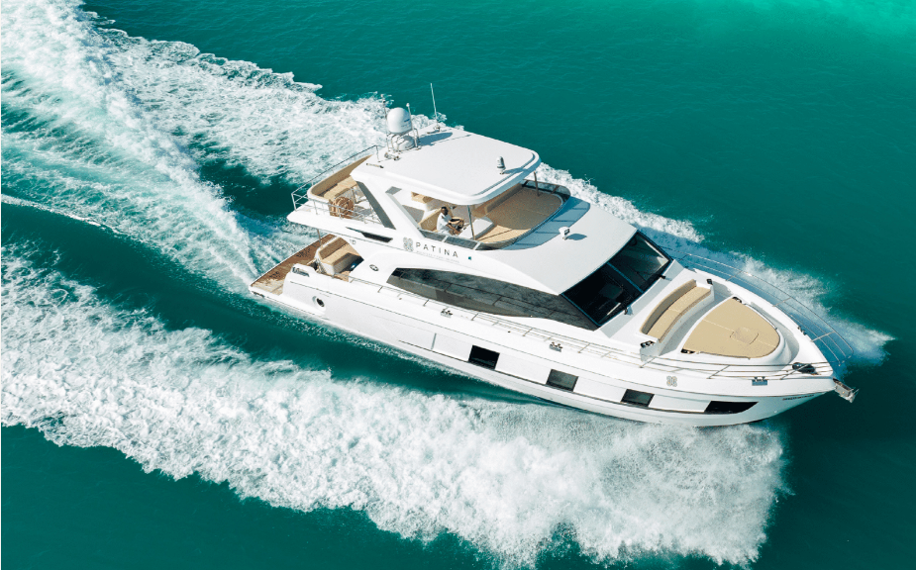
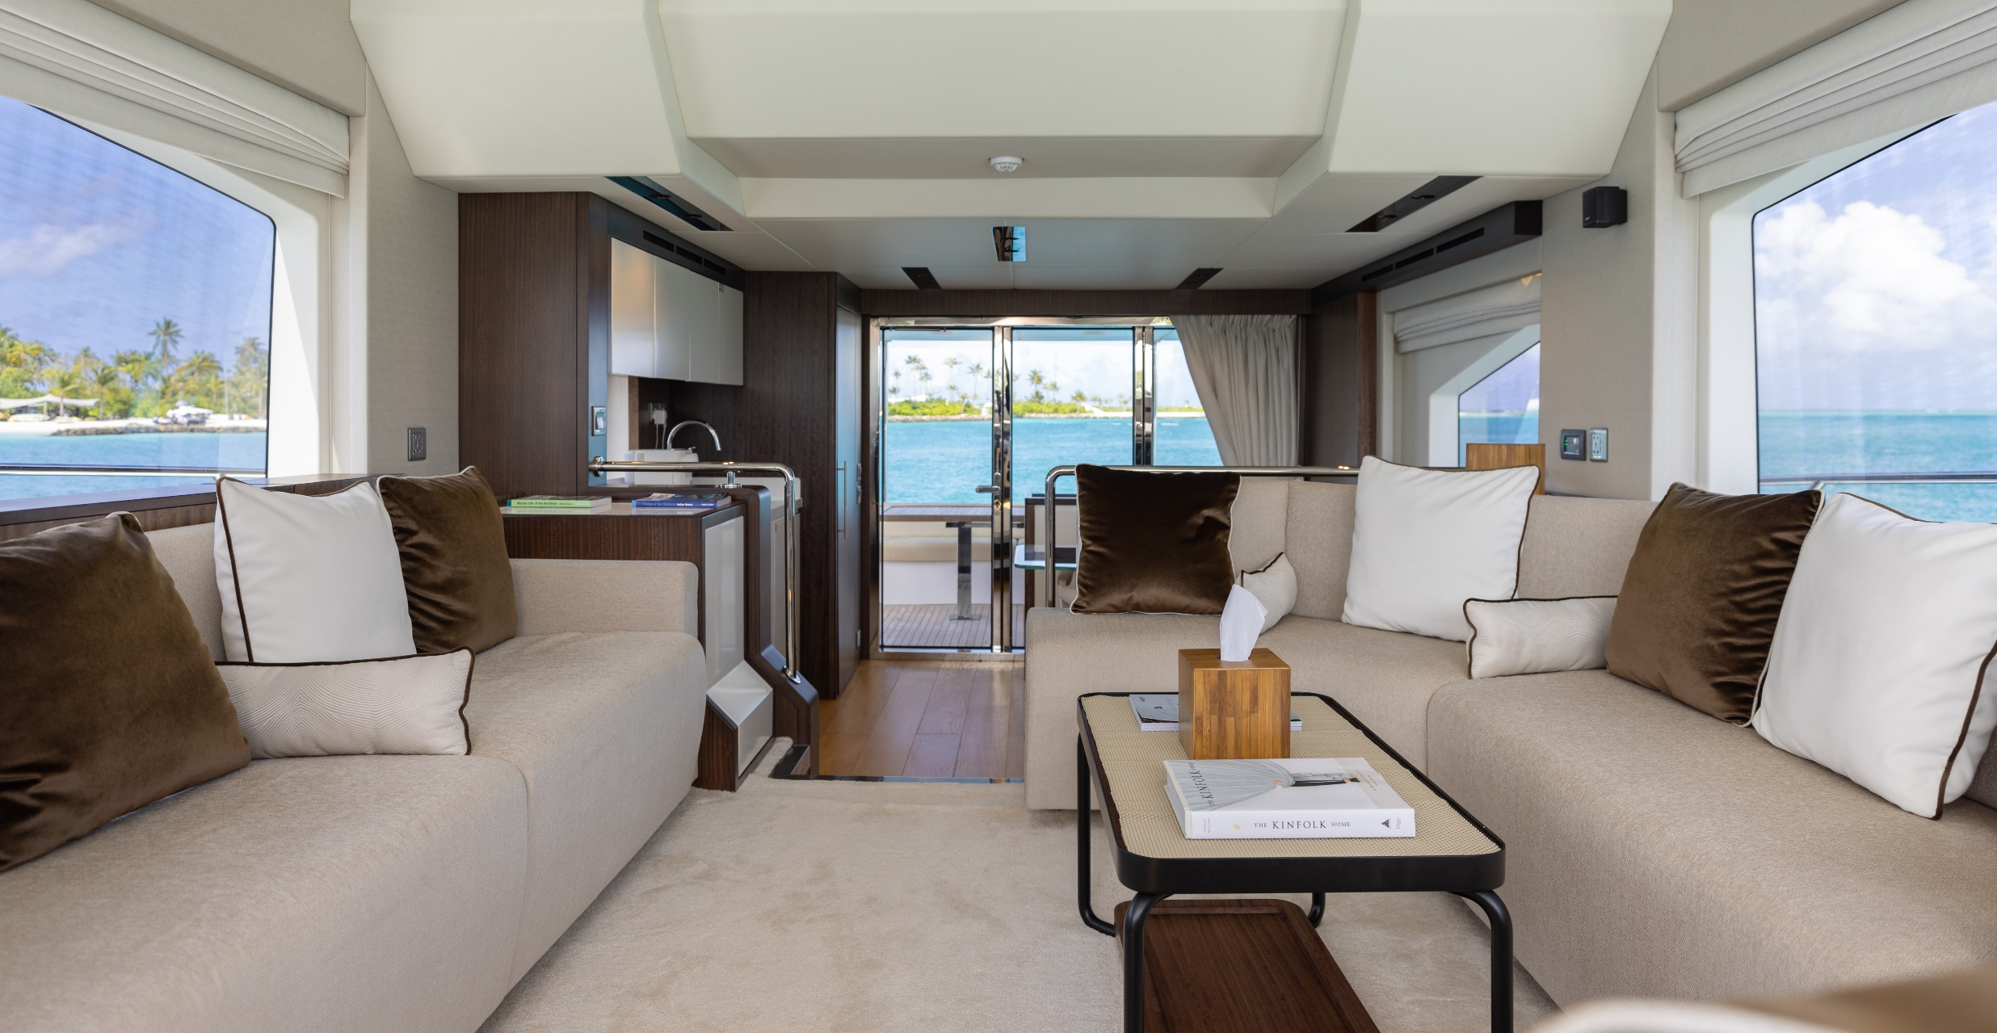
THE ARRIVAL EXPERIENCE
Transfers from Velana International Airport
Seaplane 15 minutes
Luxury speedboat 45 minutes
Luxury yacht 75 minutes

Slide 3
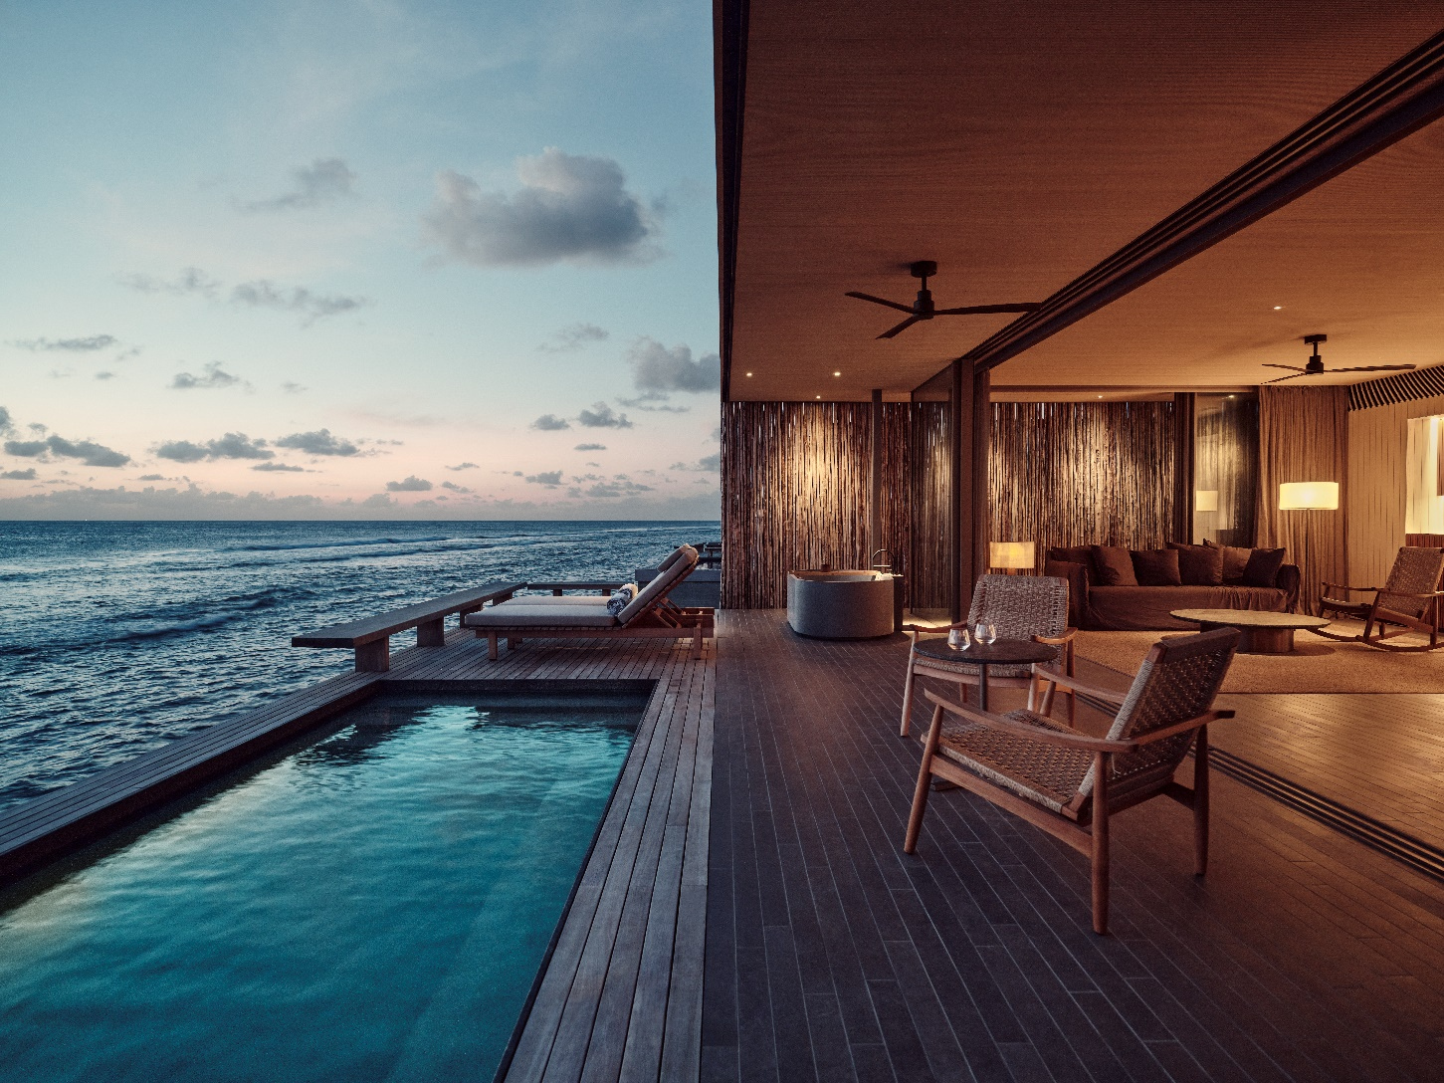
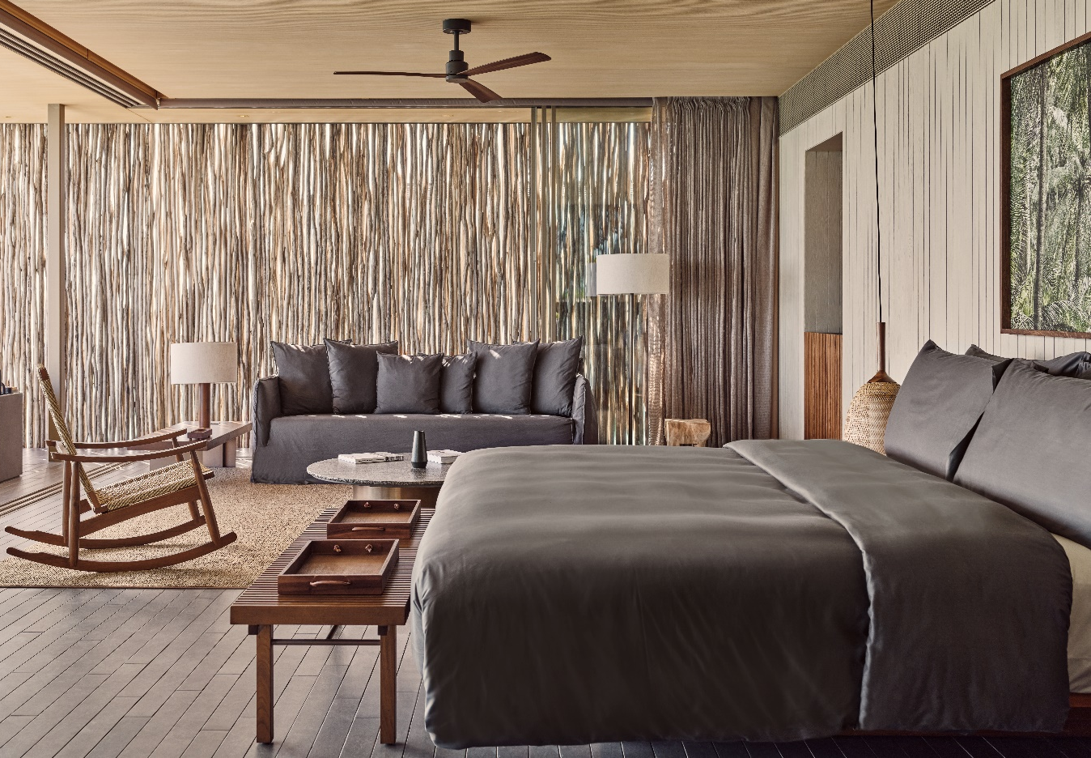
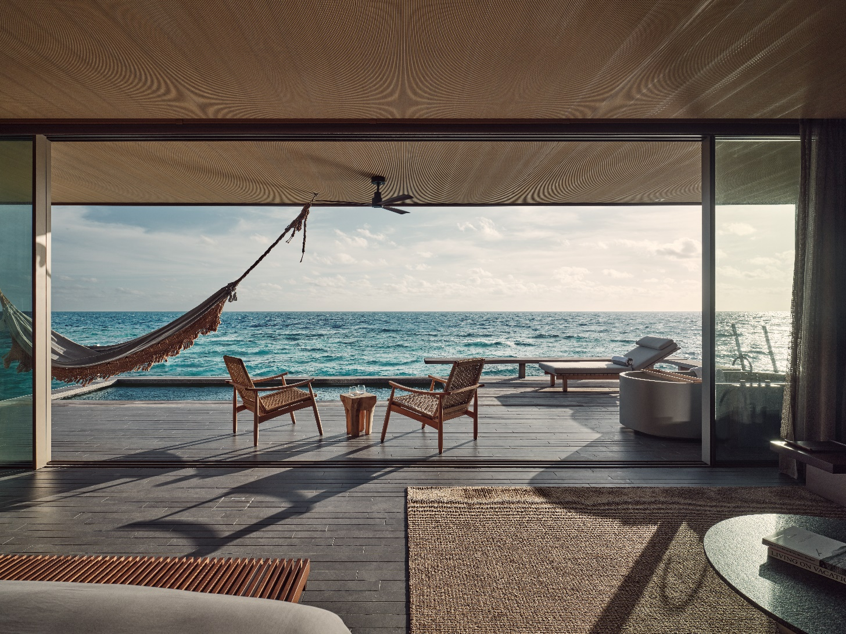
ONE BEDROOM WATER POOL VILLA
34 Keys
26 Keys with a Sunset View
170 sqm / 1,830 sqft
Pool 6.2 X 2.2 m
Notes:
ONE BEDROOM WATER POOL VILLA
Floor-to-ceiling panoramic glazing slides back to open up these one-bedroom villas sitting out over the turquoise ocean at one with our resident marine life. The private deck’s horizon views are interrupted by nothing other than the gentle ripples of the lagoon. Inside this private water villa in Maldives, bedroom, bathroom and lounge are honed from natural materials that live in absolute harmony with our remarkable location.
One-bedroom villas that seem to float over the water with a spacious outdoor deck and private 6.2m pool.
OCCUPANCY
Sleeps three (two adults and one child)
BED
King or Twin beds available. Please state your preference while booking. Child’s bed or crib available on request.
Pool depth 1.7m

Slide 4
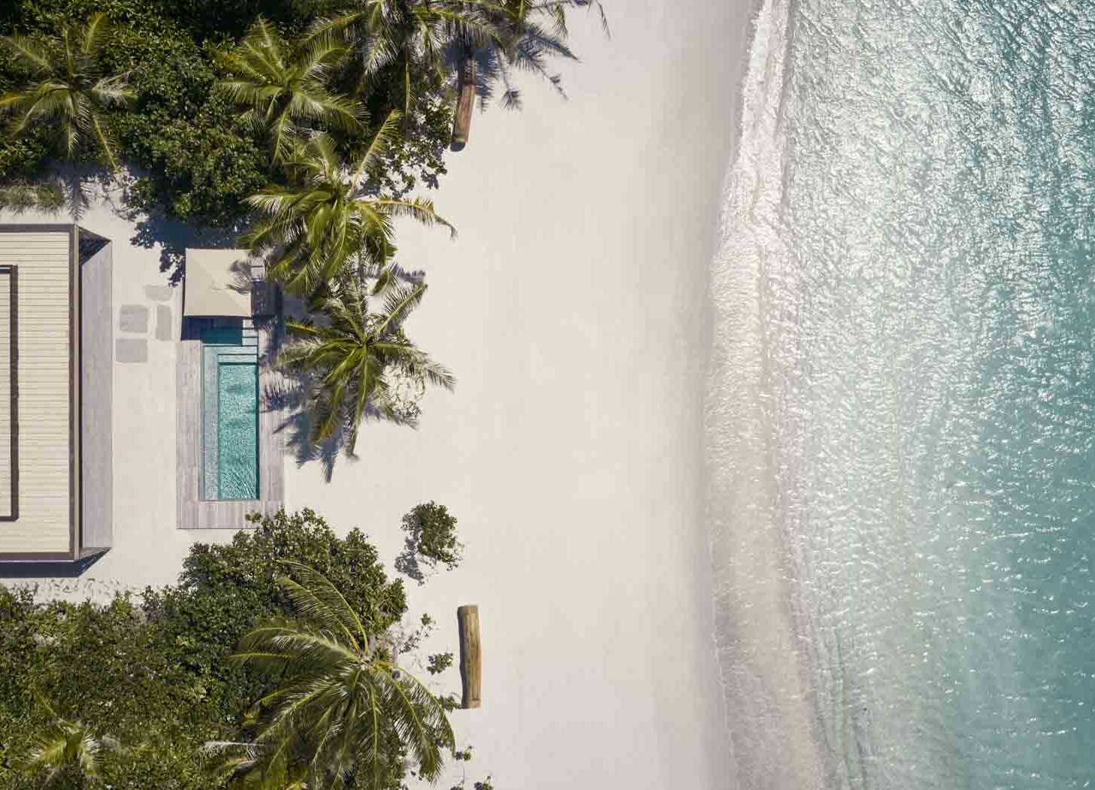
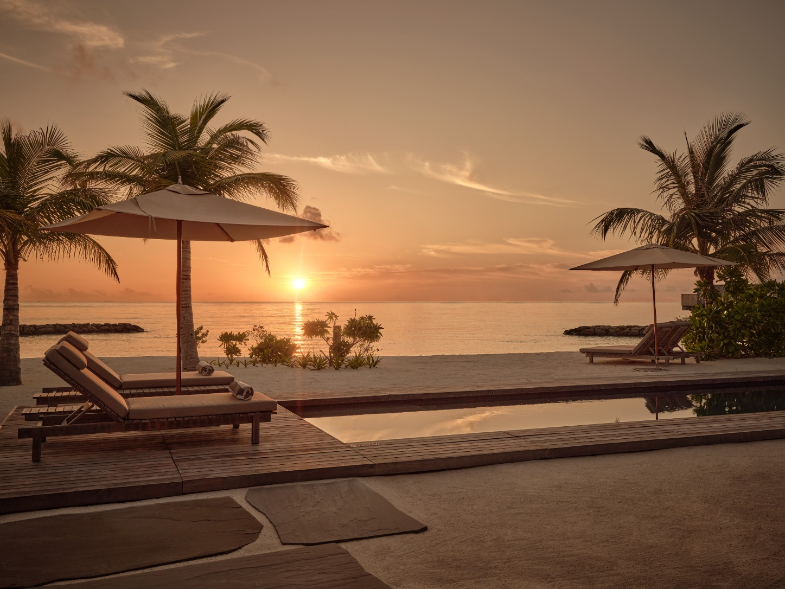
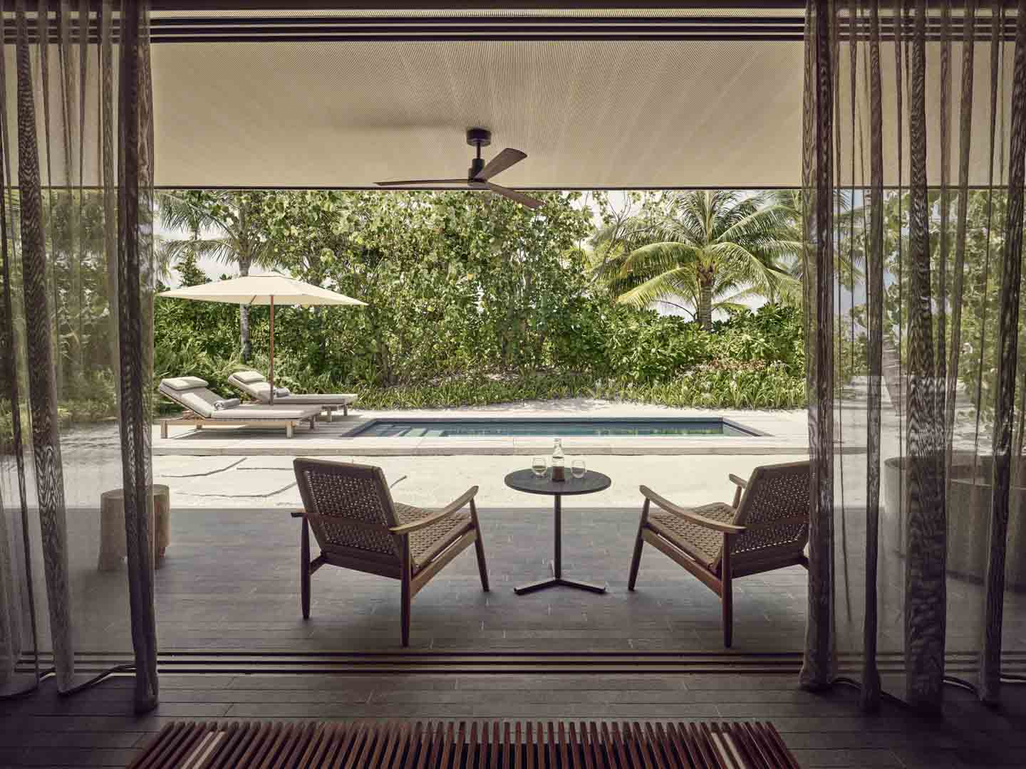
ONE BEDROOM BEACH POOL VILLA
44 Keys
9 Keys with a Sunset View
240 sqm / 2,583 sqft
Pool 6.2 X 2.2 m
Notes:
ONE BEDROOM WATER POOL VILLA
Floor-to-ceiling panoramic glazing slides back to open up these one-bedroom villas sitting out over the turquoise ocean at one with our resident marine life. The private deck’s horizon views are interrupted by nothing other than the gentle ripples of the lagoon. Inside this private water villa in Maldives, bedroom, bathroom and lounge are honed from natural materials that live in absolute harmony with our remarkable location.
One-bedroom villas that seem to float over the water with a spacious outdoor deck and private 6.2m pool.
OCCUPANCY
Sleeps three (two adults and one child)
BED
King or Twin beds available. Please state your preference while booking. Child’s bed or crib available on request.
Pool depth 1.7m

Slide 5
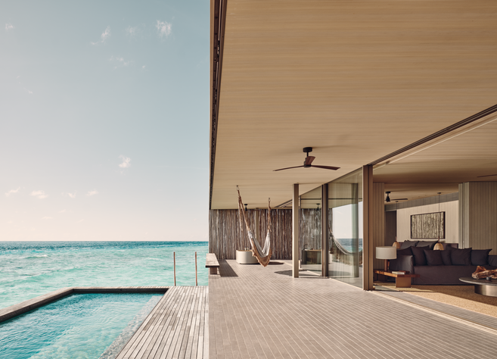
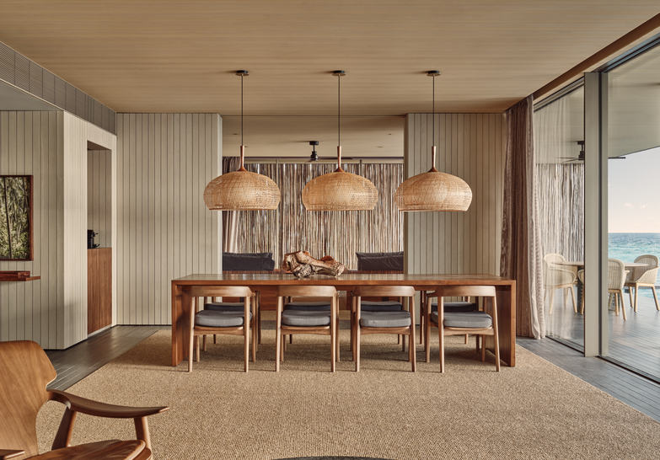
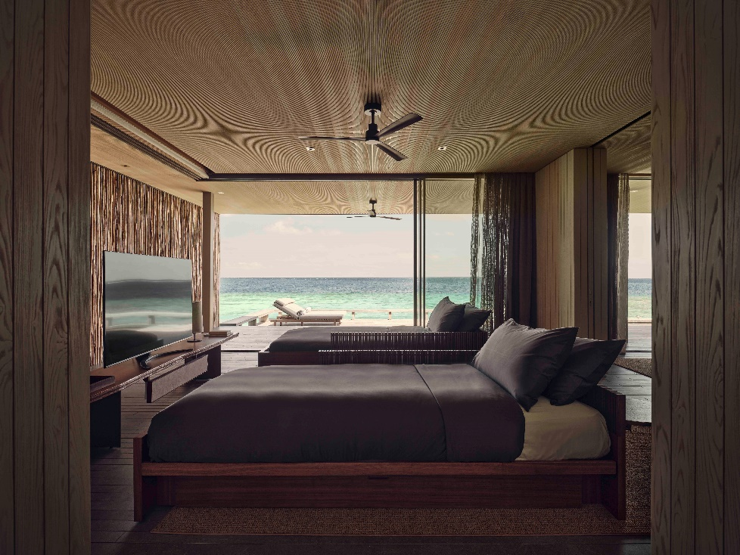
TWO BEDROOM WATER POOL VILLA
1Room 1: 1 King bed
Room 2: 2 Single beds
405 sqm / 4,359 sqft
Pool 9.6 X 3 m
4 Keys
3 Keys with a Sunset View
Notes:
ONE BEDROOM WATER POOL VILLA
Floor-to-ceiling panoramic glazing slides back to open up these one-bedroom villas sitting out over the turquoise ocean at one with our resident marine life. The private deck’s horizon views are interrupted by nothing other than the gentle ripples of the lagoon. Inside this private water villa in Maldives, bedroom, bathroom and lounge are honed from natural materials that live in absolute harmony with our remarkable location.
One-bedroom villas that seem to float over the water with a spacious outdoor deck and private 6.2m pool.
OCCUPANCY
Sleeps three (two adults and one child)
BED
King or Twin beds available. Please state your preference while booking. Child’s bed or crib available on request.
Pool depth 1.7m

Slide 6
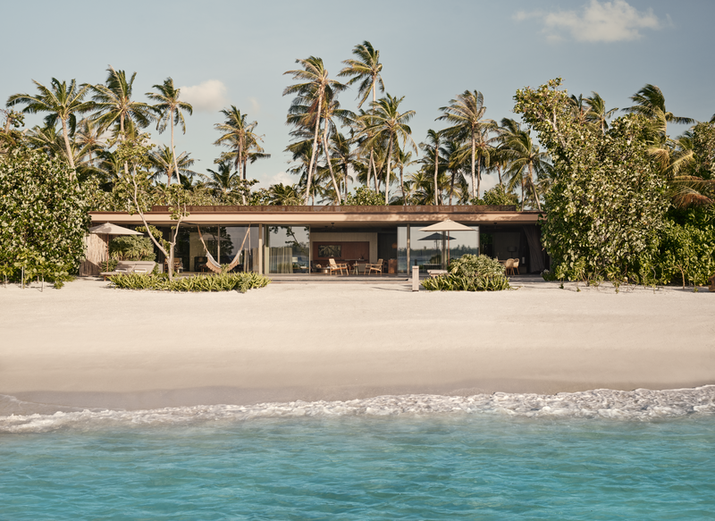
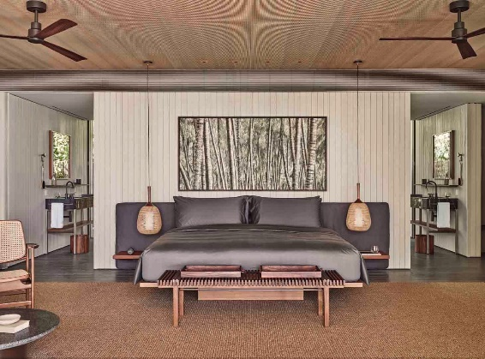
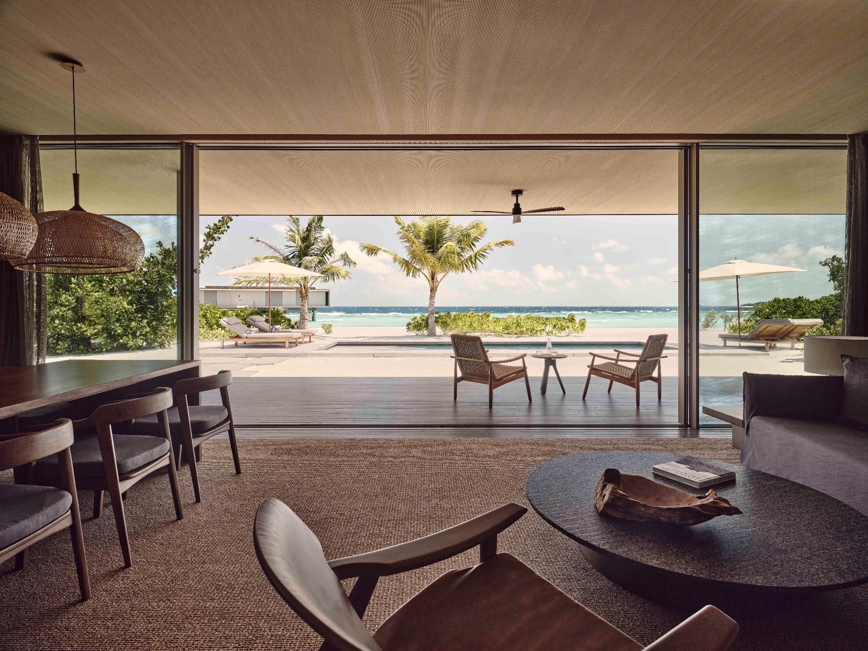
TWO BEDROOM BEACH POOL VILLA
1Room 1: 1 King bed
Room 2: 2 Single beds
600 sqm / 4,359 sqft
Pool 9.6 X 3 m
7 Keys
2 Keys with a Sunset View
Notes:
ONE BEDROOM WATER POOL VILLA
Floor-to-ceiling panoramic glazing slides back to open up these one-bedroom villas sitting out over the turquoise ocean at one with our resident marine life. The private deck’s horizon views are interrupted by nothing other than the gentle ripples of the lagoon. Inside this private water villa in Maldives, bedroom, bathroom and lounge are honed from natural materials that live in absolute harmony with our remarkable location.
One-bedroom villas that seem to float over the water with a spacious outdoor deck and private 6.2m pool.
OCCUPANCY
Sleeps three (two adults and one child)
BED
King or Twin beds available. Please state your preference while booking. Child’s bed or crib available on request.
Pool depth 1.7m

Slide 7
THE BEACH HOUSE COLLECTION
Notes:
Consisting of 7 villas total, The Beach Collection affords the freedom of what feels like a private island.

Slide 8
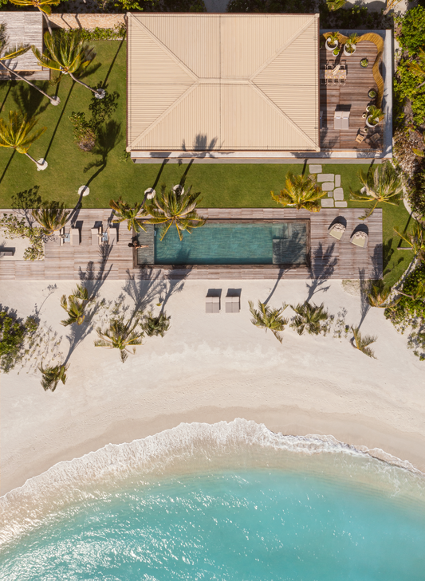
THE
BEACH HOUSE
1 Key
3 Bedrooms Beach House
1800 sqm / 19,375 sqft
Pool: 21 X 6 m
Notes:
Luxuriously spread over two storeys, our three-bedroom Beach House is the very definition of contemporary living as envisioned by award-winning Brazilian architect Marcio Kogan. Reclaim your day with stretches of room for wellness activities; or indulge in the very best of our culinary finesse with a spacious bar and kitchen to host as your own. All within a private, cosy enclave that is a mere stone’s throw from all that makes Patina special.
Two-storey, three-bedroom Beach House set within the lush green of an enormous tropical garden, 21-meter outdoor pool complete with deckchairs.
Ground floor houses an open-concept bar and dining space. The second floor features a large outdoor dining deck.
Outdoor campfire space with expansive covered entertainment area
Triple glazed floor-to-ceiling windows to minimise noise and increase privacy
Custom design furniture by MK27 and Norm Architects
OCCUPANCY
Sleeps nine (six adults and three children)
BED
One King bed + One Queen bed + Two Single beds + Three Kid’s beds or cots available on request
VIEW
Garden, beach and ocean views
Roof terrace

Slide 9
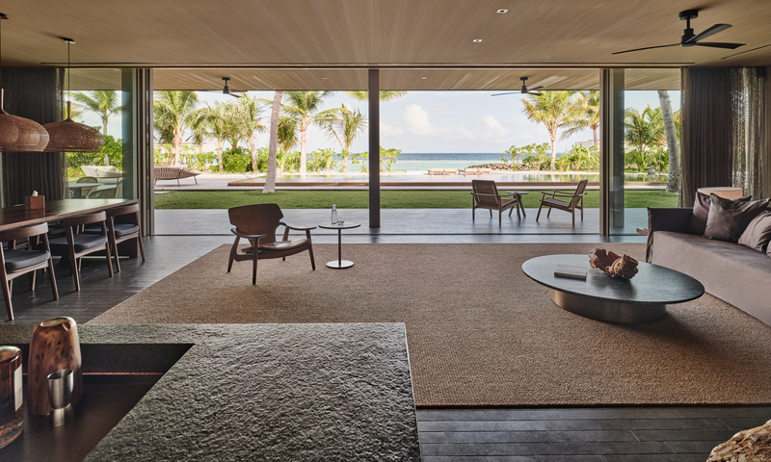
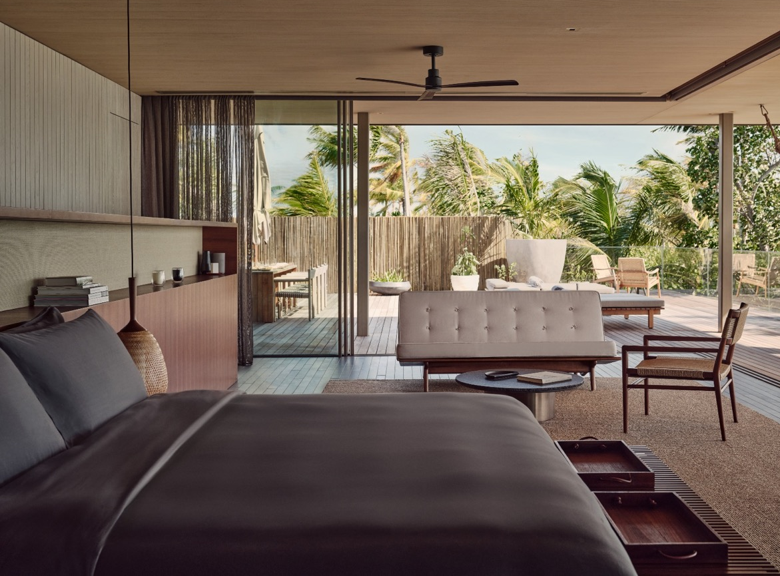
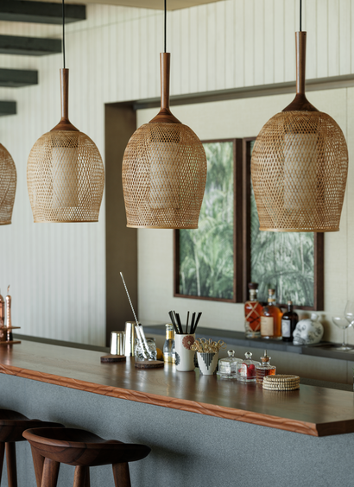
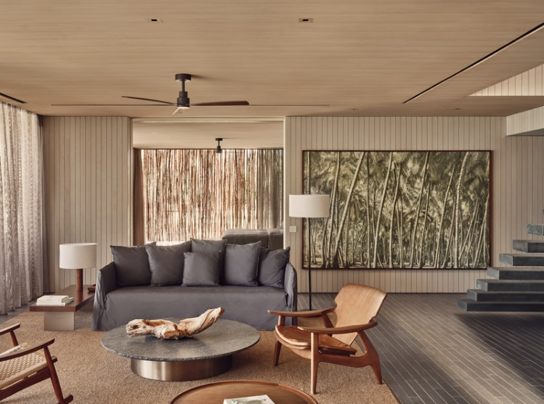
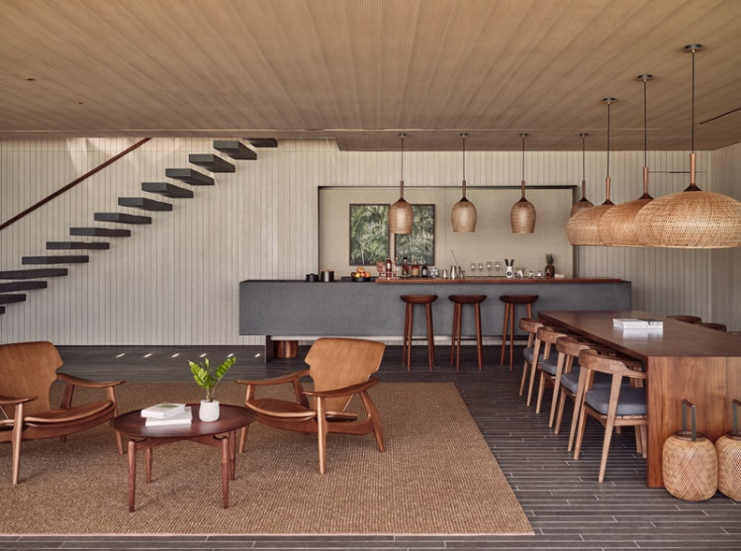
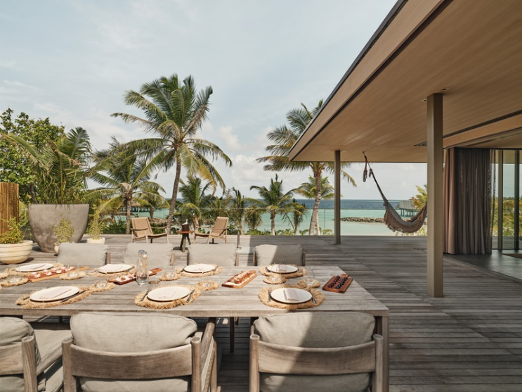
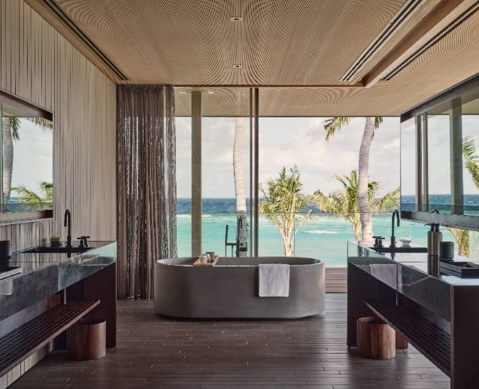
THE BEACH HOUSE
Notes:
Multiple gathering and entertainment spaces gives The Beach House a dual essence, a private sanctuary as well as a communal space.

Slide 10
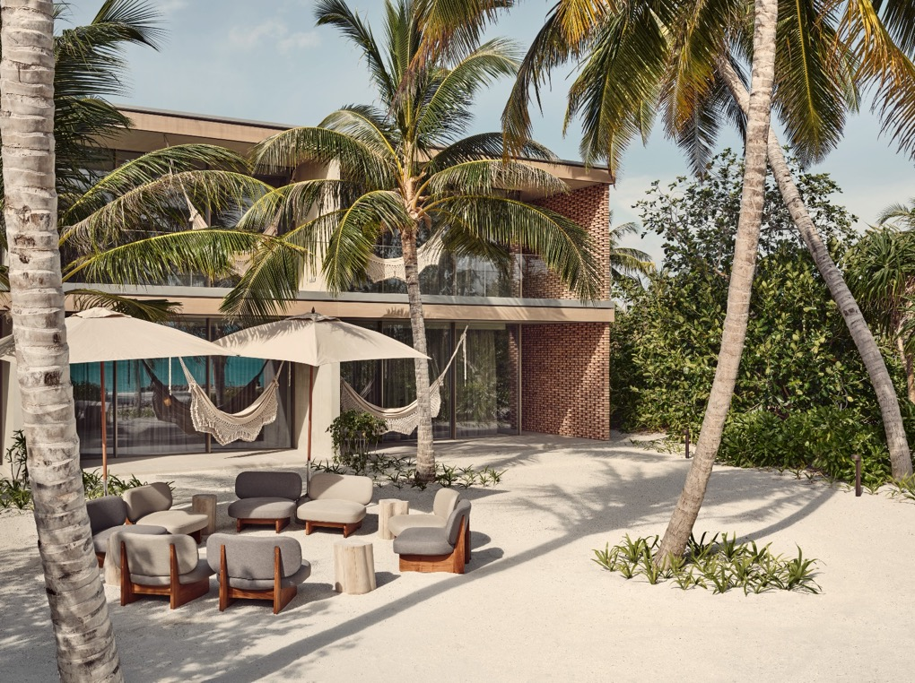
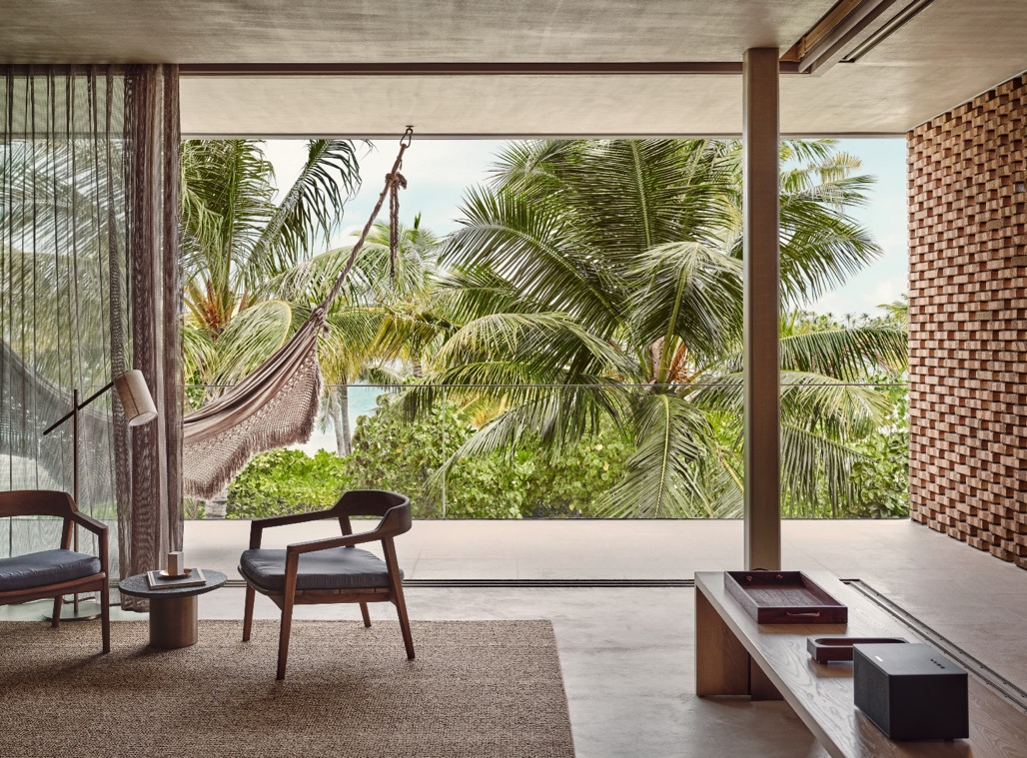
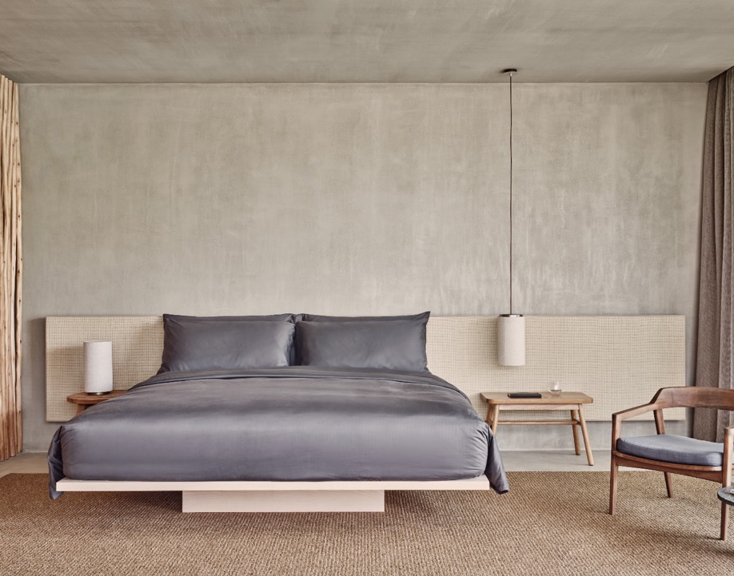
THE FARI STUDIOS
20 Keys
60 sqm / 200sqft
Notes:
Overlooking native tropical greenery and turquoise lagoon, the soulful resonance of natural textures inspires our studios’ design. Proximity to the island’s social hub, Fari Marina Village, gives these studios a dual essence. They are both sanctuary and at the centre of it all. Great alternative for MICE, families with grown-up teens, support staff for celebrities and royals, etc.

Slide 11
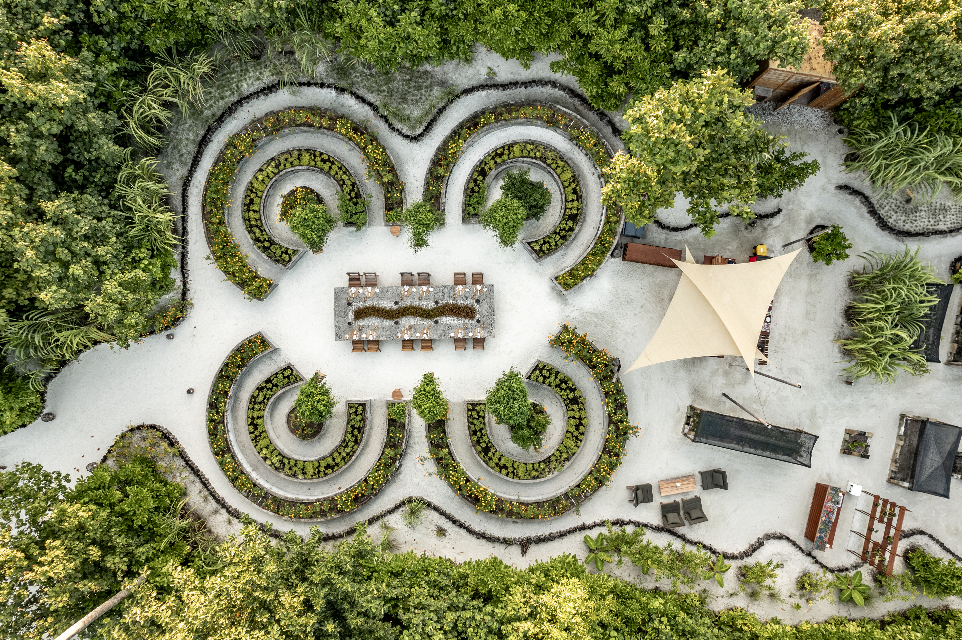
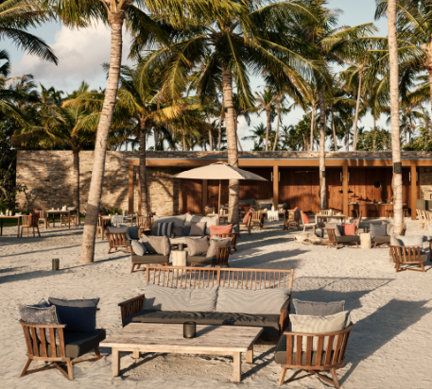
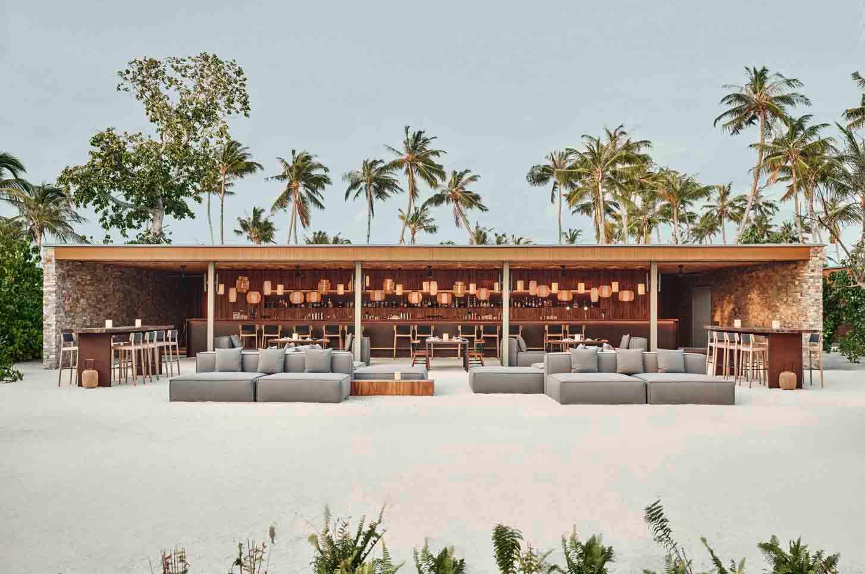
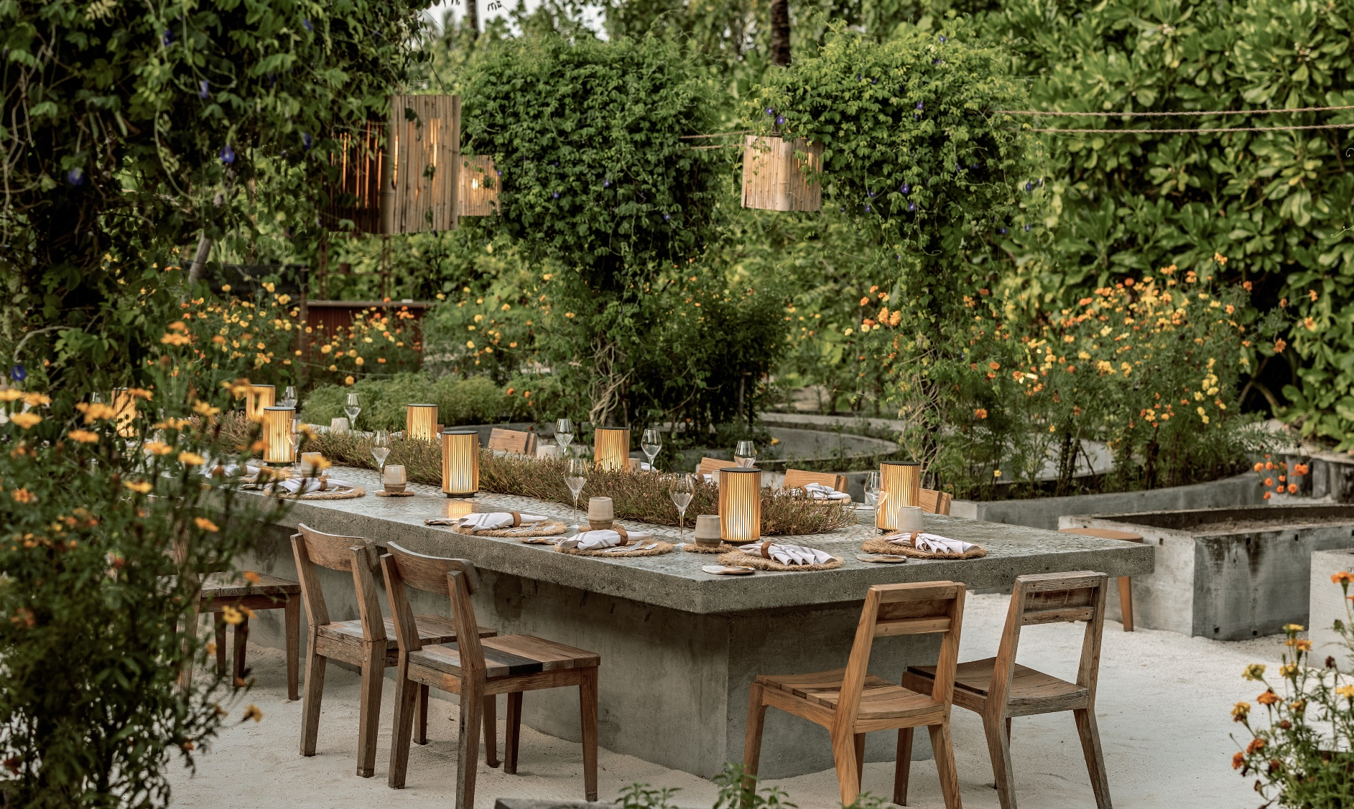
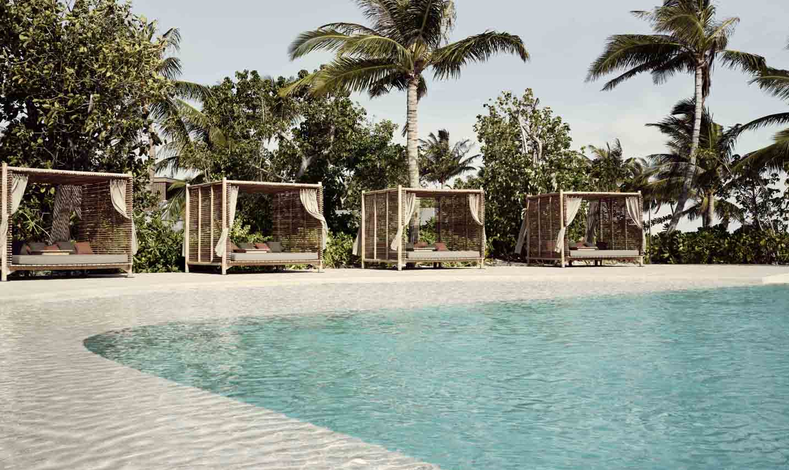
DINING AT PATINA
ROOTS
HELIOS
FARI BEACH CLUB
Notes:
Overlooking native tropical greenery and turquoise lagoon, the soulful resonance of natural textures inspires our studios’ design. Proximity to the island’s social hub, Fari Marina Village, gives these studios a dual essence. They are both sanctuary and at the centre of it all. Great alternative for MICE, families with grown-up teens, support staff for celebrities and royals, etc.
ROOTS
Inspired by slow food philosophies where pure, seasonal ingredients are valued, Roots aligns with nature to deliver delightful dishes that are good for your body, soul and our planet
CUISINE - Modern Plant-Based
FARI BEACH CLUB
Spinning a thread of artistry to draw serendipitous connections, Fari Beach Club is an audacious redefinition of beachfront entertainment paired with a daring dining experience that equally subverts and delights. It offers a stunning beach bar in Maldives to unwind in.
CUISINE – International
BRASA
Drawing inspiration from cuisine found within the remote corners of Patagonia, Brasa’s spirit of cooking embraces the temperament of open-fire cooking and nature’s given kitchen.
CUISINE - Patagonian Steak House

Slide 12
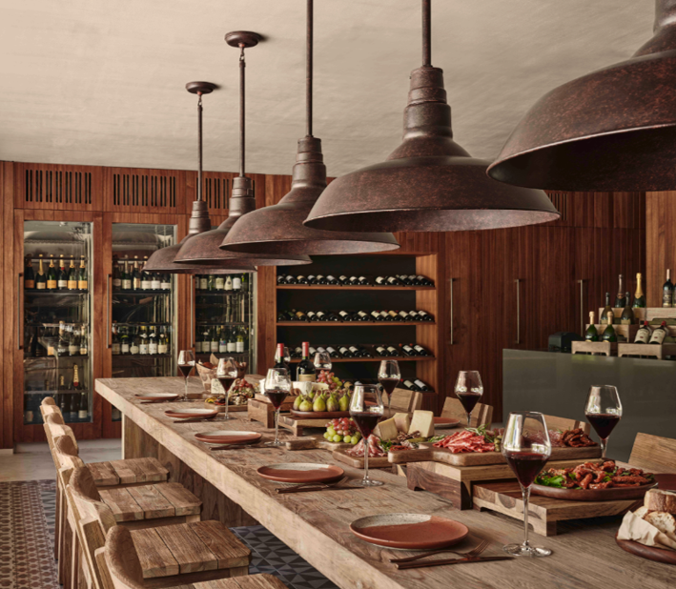
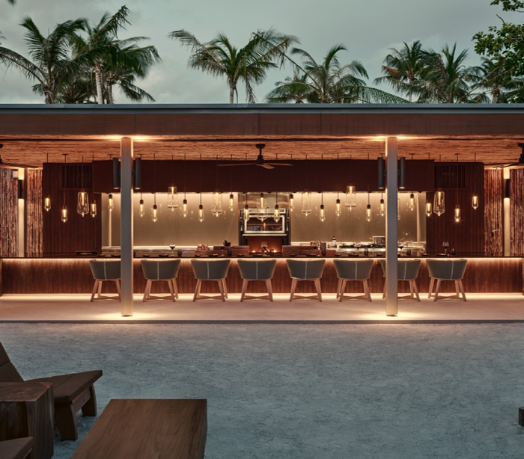
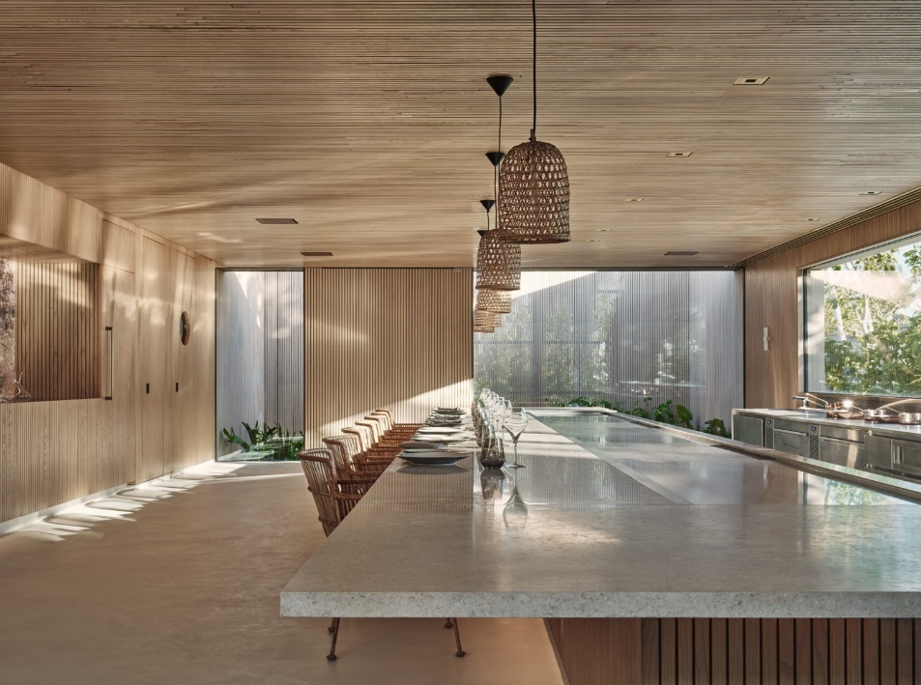
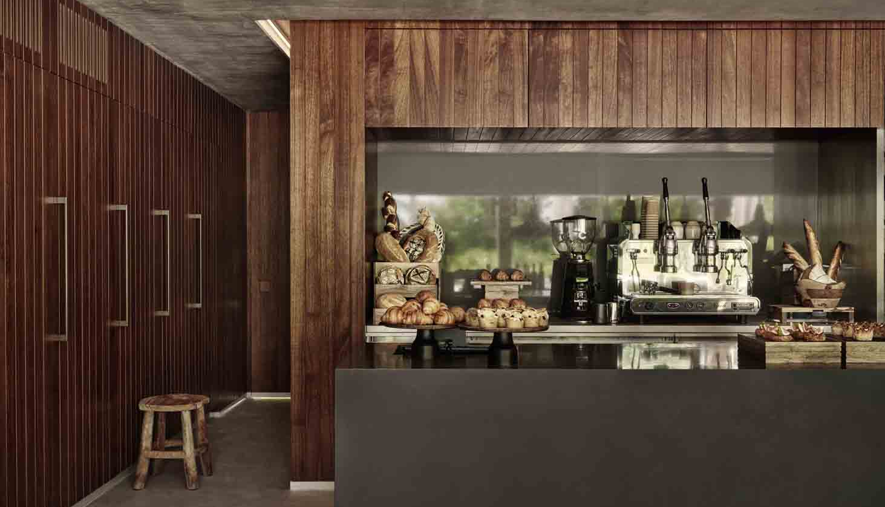
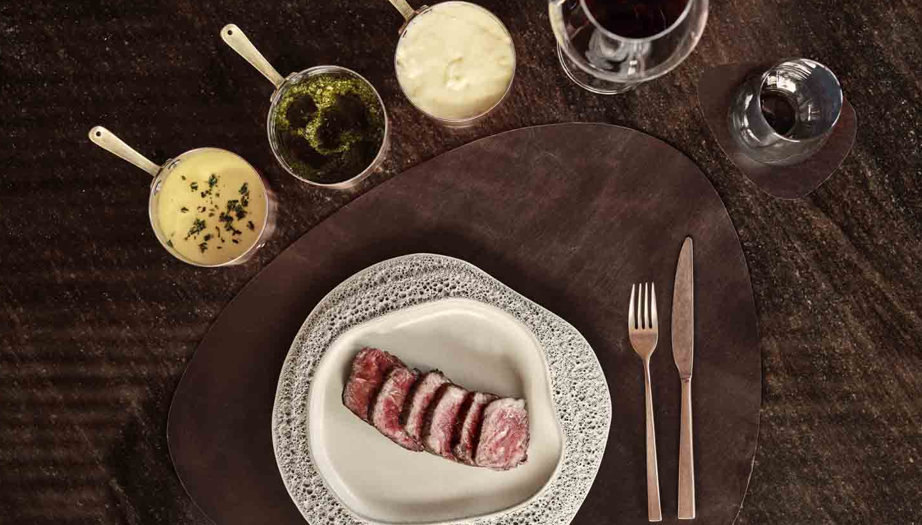
DINING AT PATINA
FARINE
BRASA
KŌEN
Notes:
Overlooking native tropical greenery and turquoise lagoon, the soulful resonance of natural textures inspires our studios’ design. Proximity to the island’s social hub, Fari Marina Village, gives these studios a dual essence. They are both sanctuary and at the centre of it all. Great alternative for MICE, families with grown-up teens, support staff for celebrities and royals, etc.
FARINE
A contemporary European bistro serves freshly baked artisan breads, Italian style antipasti of cured meats and cheeses, and hearty main courses for those looking for easy casual eating.
CUISINE - Italian semi-buffet
HELIOS
A seamless fusion of Maldives dining essentials with our exquisite Mediterranean cuisine in the Maldives helps create Helios. Embrace the timeless cuisine of the Mediterranean and an ever-changing landscape of the freshest ingredients we love.
CUISINE - Aegean / Greek Cuisine
KOEN
Japanese cuisine in the Maldives redefined; A harmonious abstraction of ritual, senses and ideas, an evening of sophisticated encounters await you at Kōen – where Japanese culinary arts intertwine with Scandinavian prominence on premium ingredients, creating some of the best food in the Maldives.
CUISINE - Modern Japanese & Nordic

Slide 13
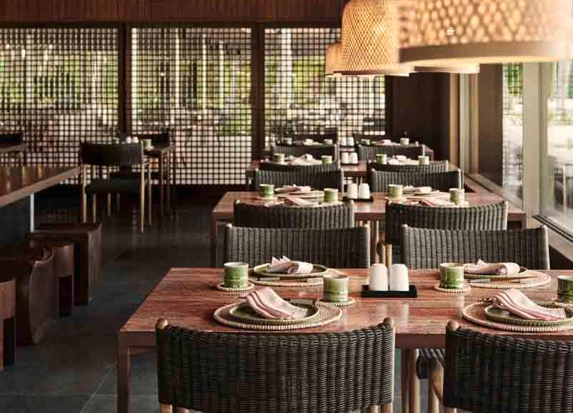
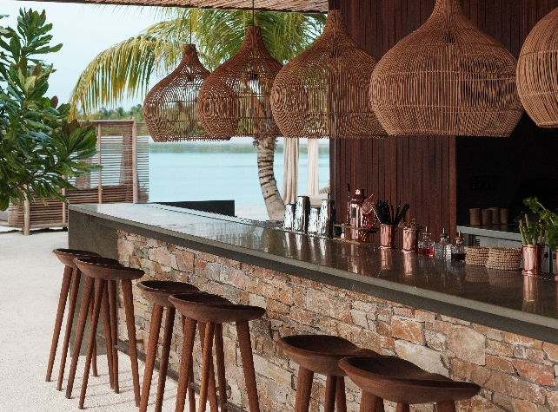
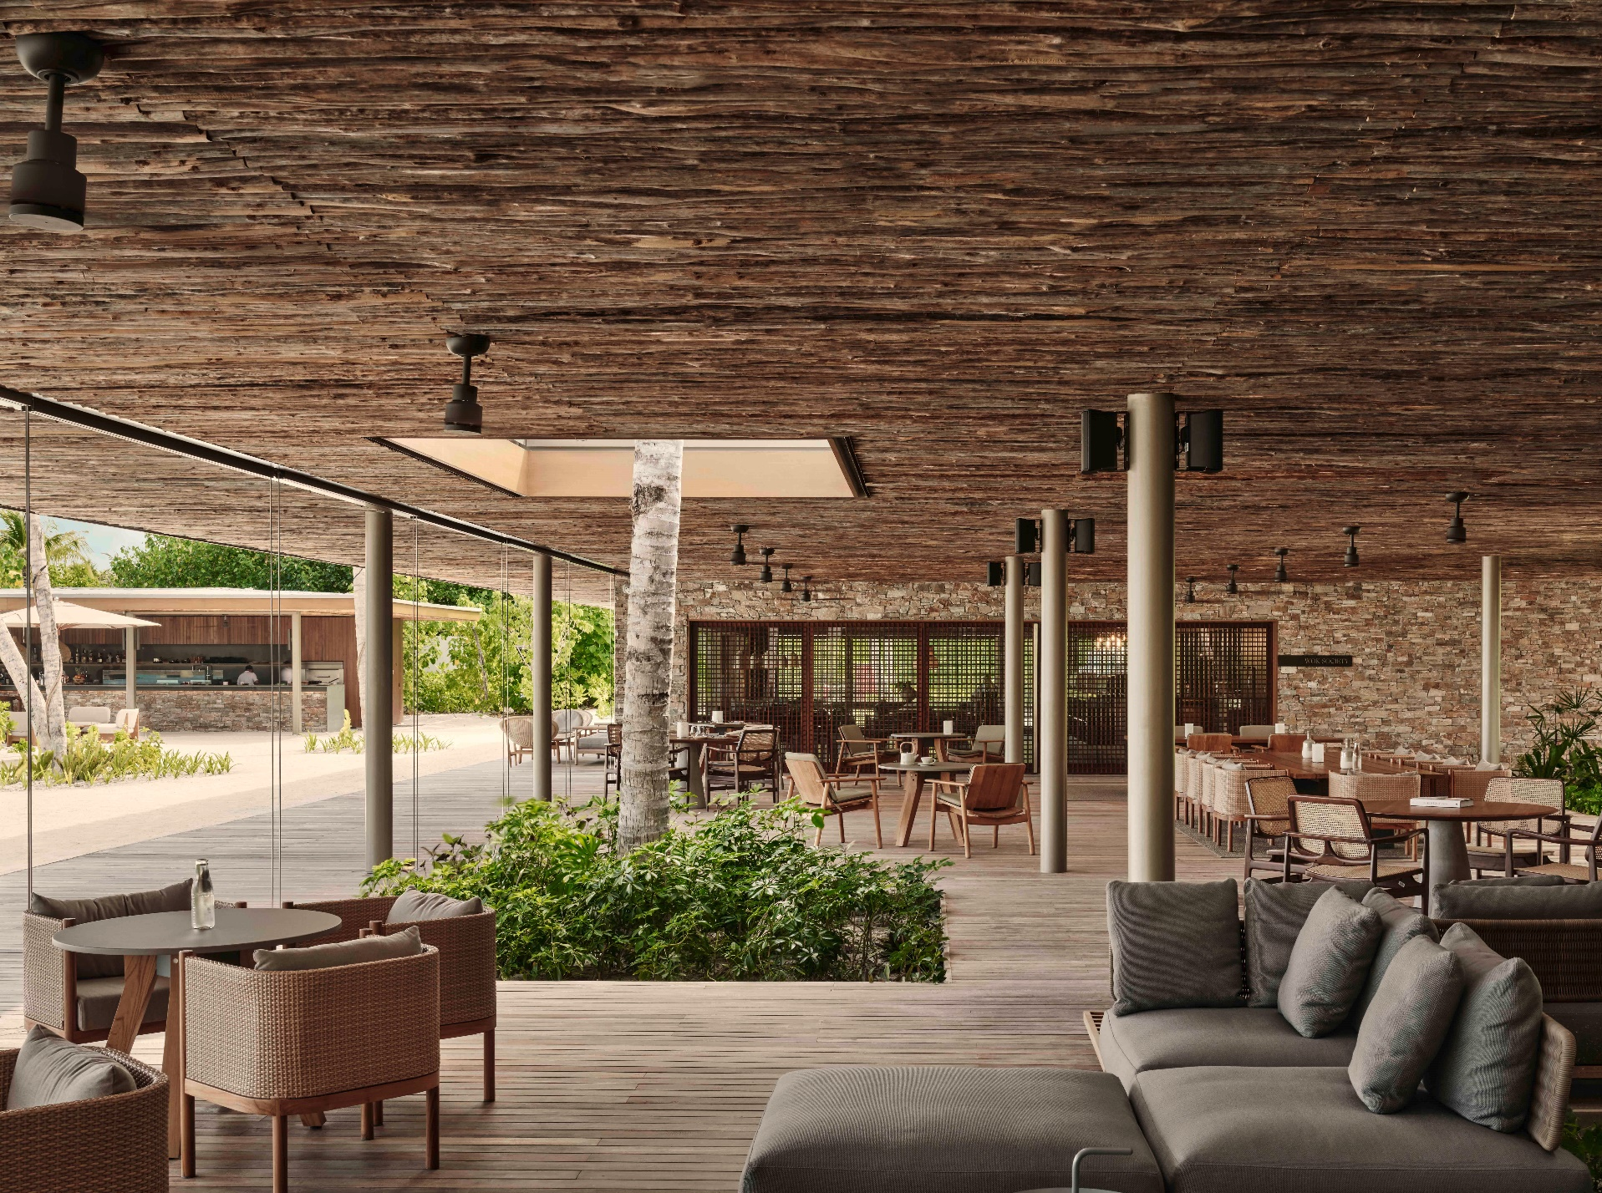
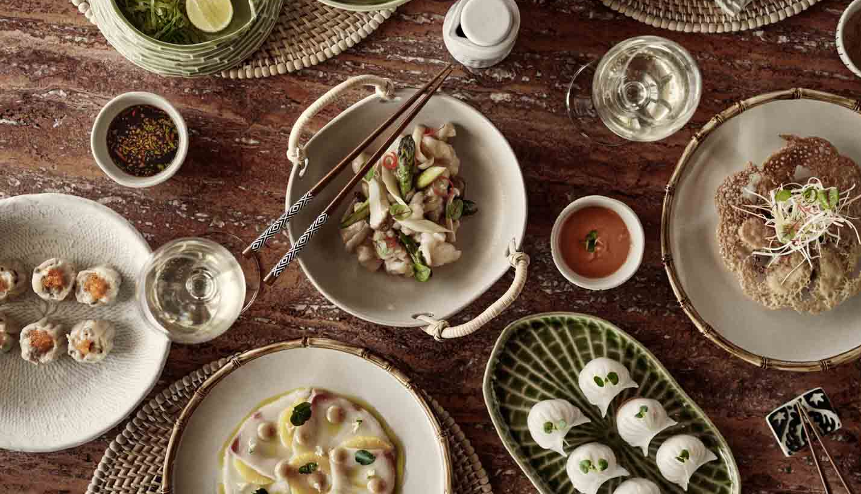
DINING AT PATINA
WOK SOCIETY
VELI BAR
PORTICO
Notes:
Overlooking native tropical greenery and turquoise lagoon, the soulful resonance of natural textures inspires our studios’ design. Proximity to the island’s social hub, Fari Marina Village, gives these studios a dual essence. They are both sanctuary and at the centre of it all. Great alternative for MICE, families with grown-up teens, support staff for celebrities and royals, etc.
FARINE
A contemporary European bistro serves freshly baked artisan breads, Italian style antipasti of cured meats and cheeses, and hearty main courses for those looking for easy casual eating.
CUISINE - Italian semi-buffet
HELIOS
A seamless fusion of Maldives dining essentials with our exquisite Mediterranean cuisine in the Maldives helps create Helios. Embrace the timeless cuisine of the Mediterranean and an ever-changing landscape of the freshest ingredients we love.
CUISINE - Aegean / Greek Cuisine
KOEN
Japanese cuisine in the Maldives redefined; A harmonious abstraction of ritual, senses and ideas, an evening of sophisticated encounters await you at Kōen – where Japanese culinary arts intertwine with Scandinavian prominence on premium ingredients, creating some of the best food in the Maldives.
CUISINE - Modern Japanese & Nordic

Slide 14
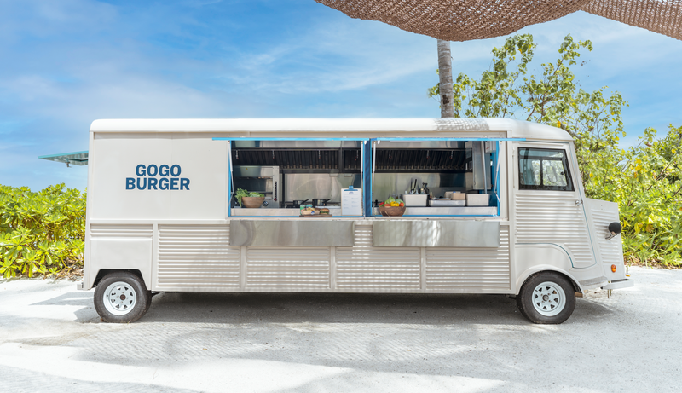
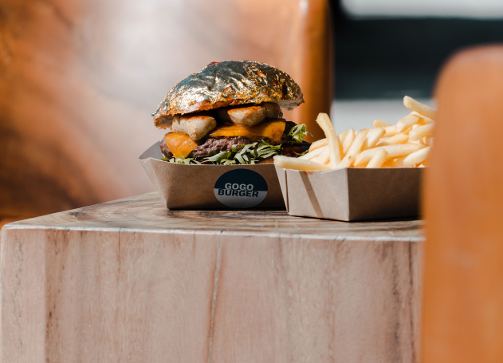
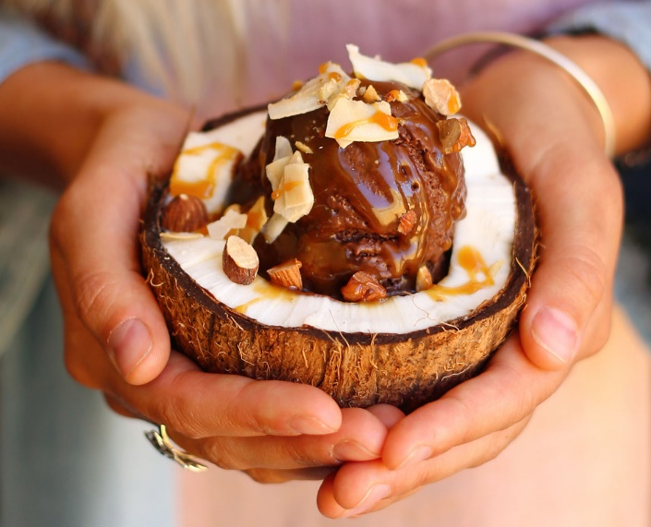
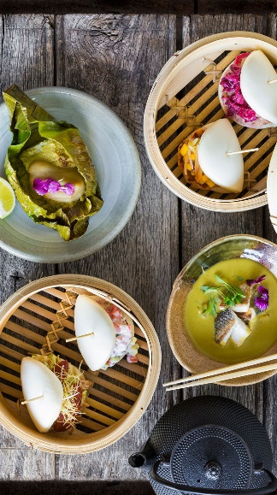
THE FOOD TRUCKS
GO GO
BURGERS
TUK TUK GELATO
TUM
TUM
Notes:
GO GO BURGERS
Innovation and freshness all packed into satisfying handfuls of indulgence. Our essential beach pitstop – because everyone needs a burger eventually.
TUK TUK GELATO
At our gelato truck, every day presents a playful adventure of flavours with an ever-changing menu. Appreciate life’s simple indulgences with this ubiquitous summertime treat.
TUM TUM
A perfect setting for guests seeking a romantic dinner in Maldives or food lover seeking dishes which capture the essence of Asian cuisine in Maldives.

Slide 15
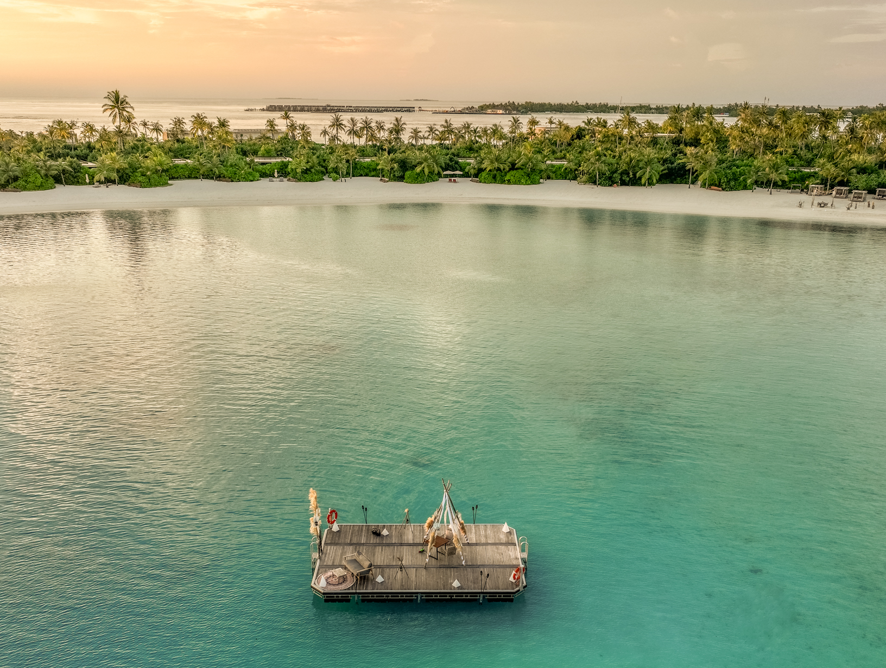
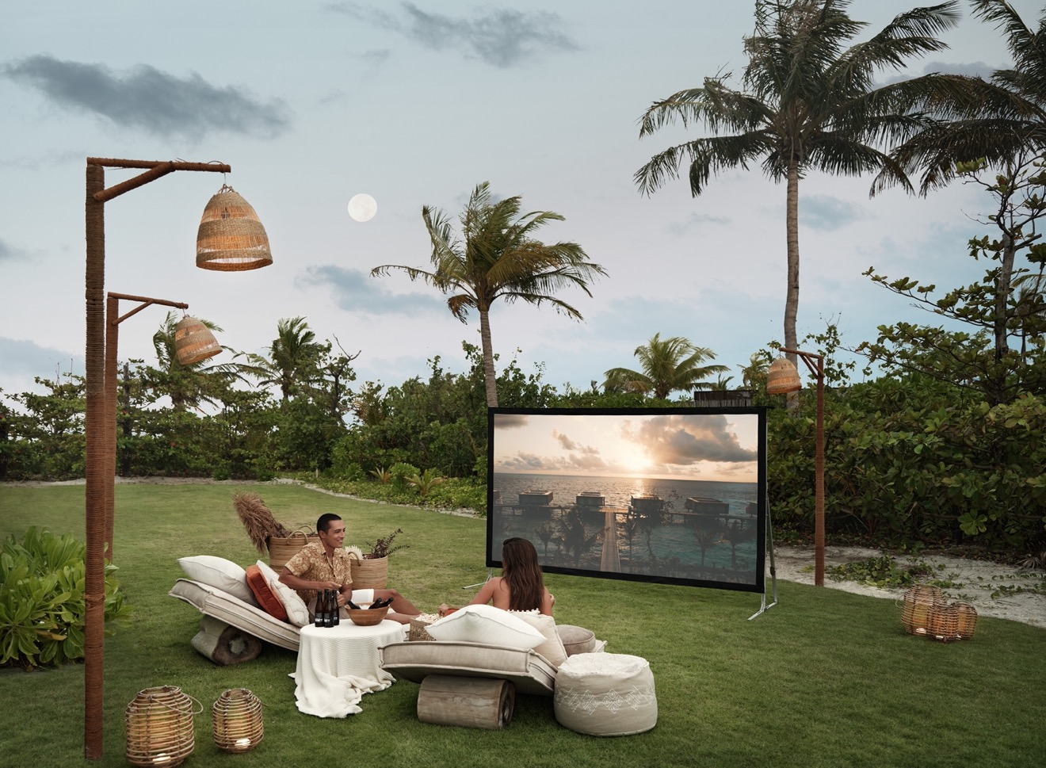
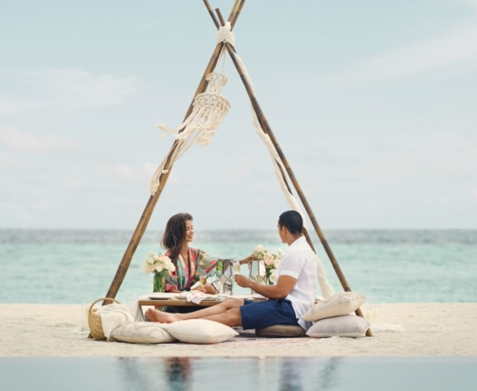
DESTINATION DINING

Slide 16
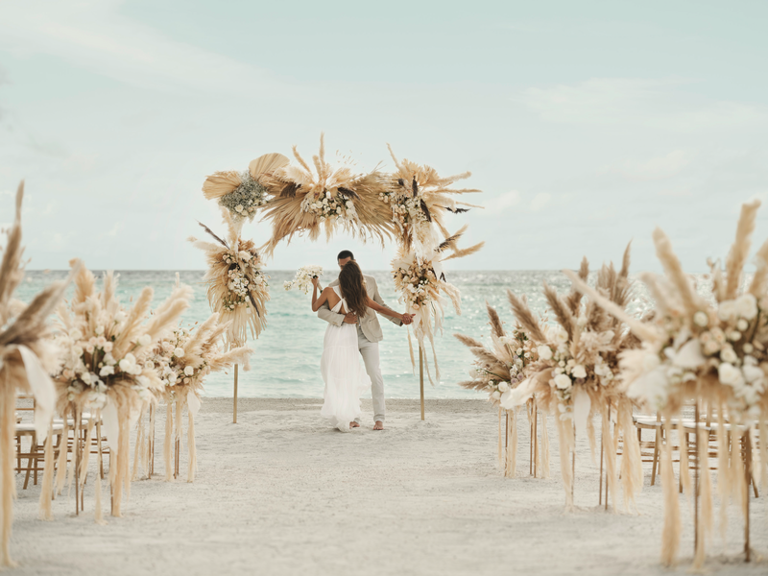
CELEBRATIONS AT PATINA

Slide 17
MEETINGS

Slide 18
Flow is the name we give to our wellbeing philosophy and the experiences we create to support it.
FACILITIES
5 double treatment rooms
1 watsu treatment suite
1 flotation tank suite
2 warm plunge pools with jets
Salon
Notes:
8 treatment rooms including Watsu, float pod, hammam bed, 4 doubles and 1 single suite.
Complimentary yoga, visiting practitioners,
Reboot fitness center.

Slide 20
WATERSPORTS AND DIVE SCHOOL
Notes:
To Marian Biologists on site.
Olive Ridley Project, Parley for the Oceans, island clean-ups, ghost nets removal,
Future plans: electric submarine for reef exploration.

Slide 21
OCEAN CONSERVANCY
Notes:
Patina’s ocean conservancy efforts focus on two key areas: coral reef restoration and turtle conservation.

Slide 22
Skyspace “Amarta” by James Turrell
“Ocean Archaeology Social” by Pamela Longobardi.
“Synthesis Monoliths” by Hongjie Yang.
“Momento” by FAHR Studio.

Slide 23
SUMMER AT PATINA MALDIVES
BAR TRENCH POP-UP
8 to 10 June 2024
EID AL ADHA CELEBRATION
16 June 2024
POTTERY CLASSES BY THE CLAY STUDIO MALDIVES
1 to 30 June 2024
LIFE ENERGY WITH SASSAN BEHNAM-BAKHTIAR
July 2024
REAL MADRID FOUNDATION FOOTBALL CLINIC
4 July to 12 August 2024
YOUTH SAILING ACADEMY
14 July to 15 August 2024

Slide 24
ISLAND FESTIVITIES
CHRISTMAS TREE LIGHTING CEREMONY
21 December
SANTA’S HOUSE (Pop-up)
Until 2nd January
FARI BEACH CLUB PARTY
22 December
CHRISTMAS EVE COCKTAILS AND DINNER 24 December
HERE COMES SANTA CLAUS 25 December
NET ZERO CANDLE LIGHT DINNER AT ROOTS
26 December
BEDOUIN NIGHT AT HELIOS 27 December
SAKE DEGUSTATION DINNER AT KOEN 28 December
FARI MARINE VILLAGE FESTIVAL 29 December
NEW YEAR’S EVE CELEBRATION 31 December

Slide 25
RESERVATIONS l reservations.maldives@patinahotels.com
WEBSITE l https://patinahotels.com/maldives-fari-islands
CONTACTS

