Slide 1
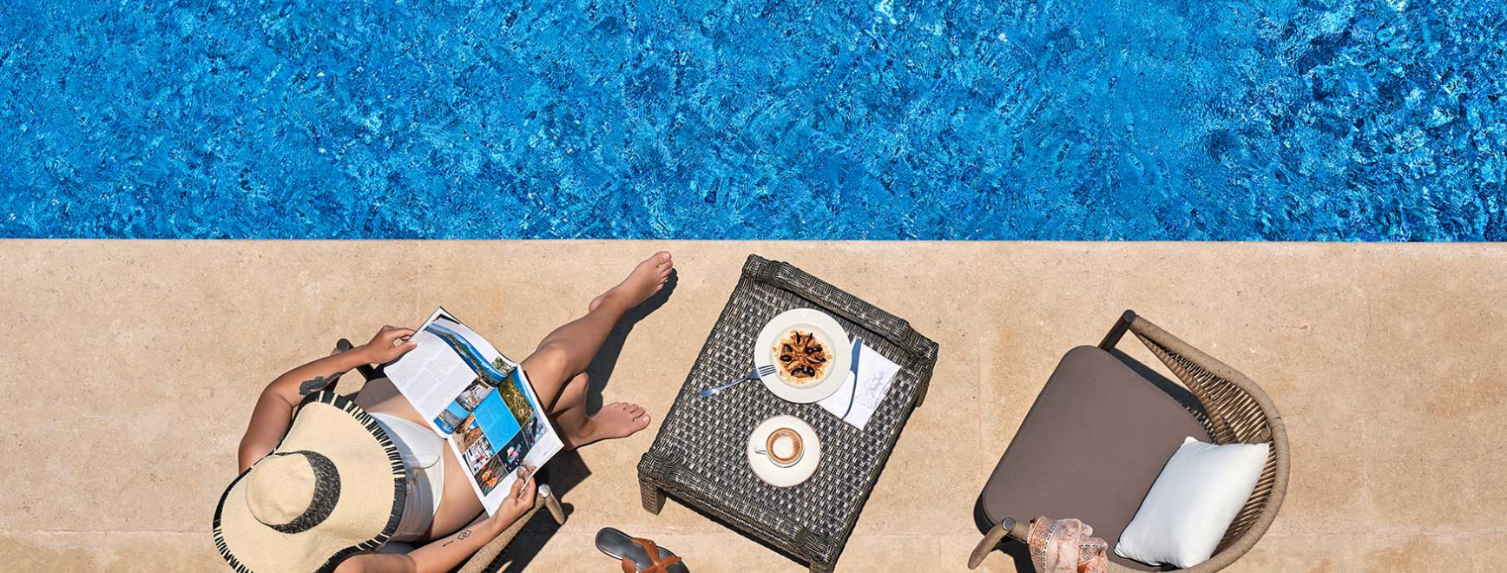

GHAZALA RESORT
AND SPA
GHAZAL RESORT AND SPA

Slide 2
WELCOME TO GHAZALA RESORT & SPA!
At Ghazala, your comfort, safety, and satisfaction are our top priorities.
Our mission is to deliver seamless, authentic coastal hospitality through sustainable practices and an empowered team culture.
Vision:
To be the heart of unforgettable summer escapes on the coast where every guest experience is exceptional, every team member is valued, and every season reflects our unity and growth.
Key Values:
Sustainability
Safety & Quality
Positive Culture

Slide 3
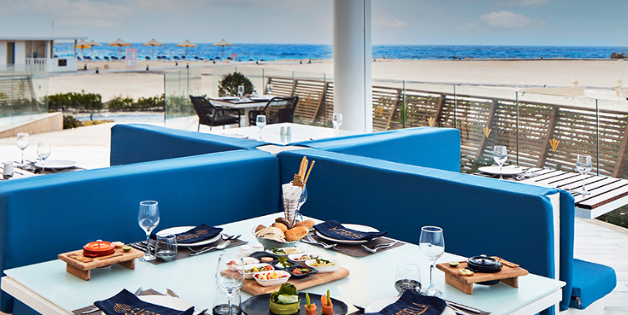




CONTACT INFORMATION
19 km from Alamein Airport
www.ghazalaresortandspa.com
reservations@ghazalaresortandspa.com
+20 46 4190060

Slide 4
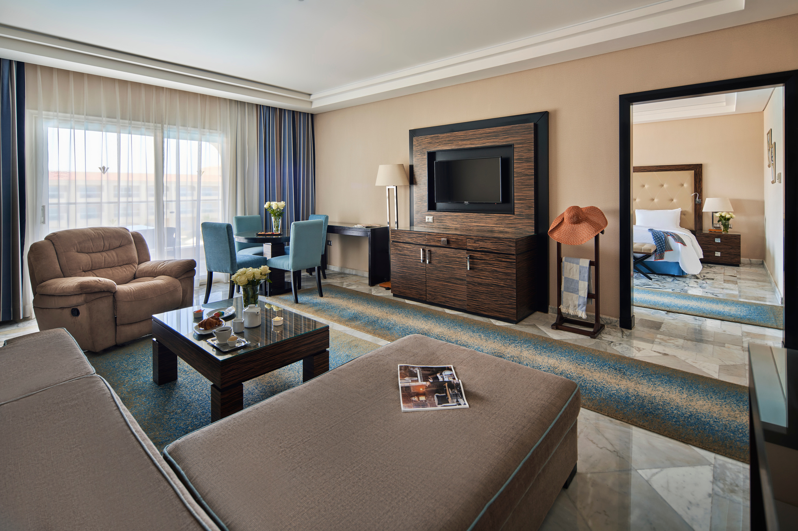
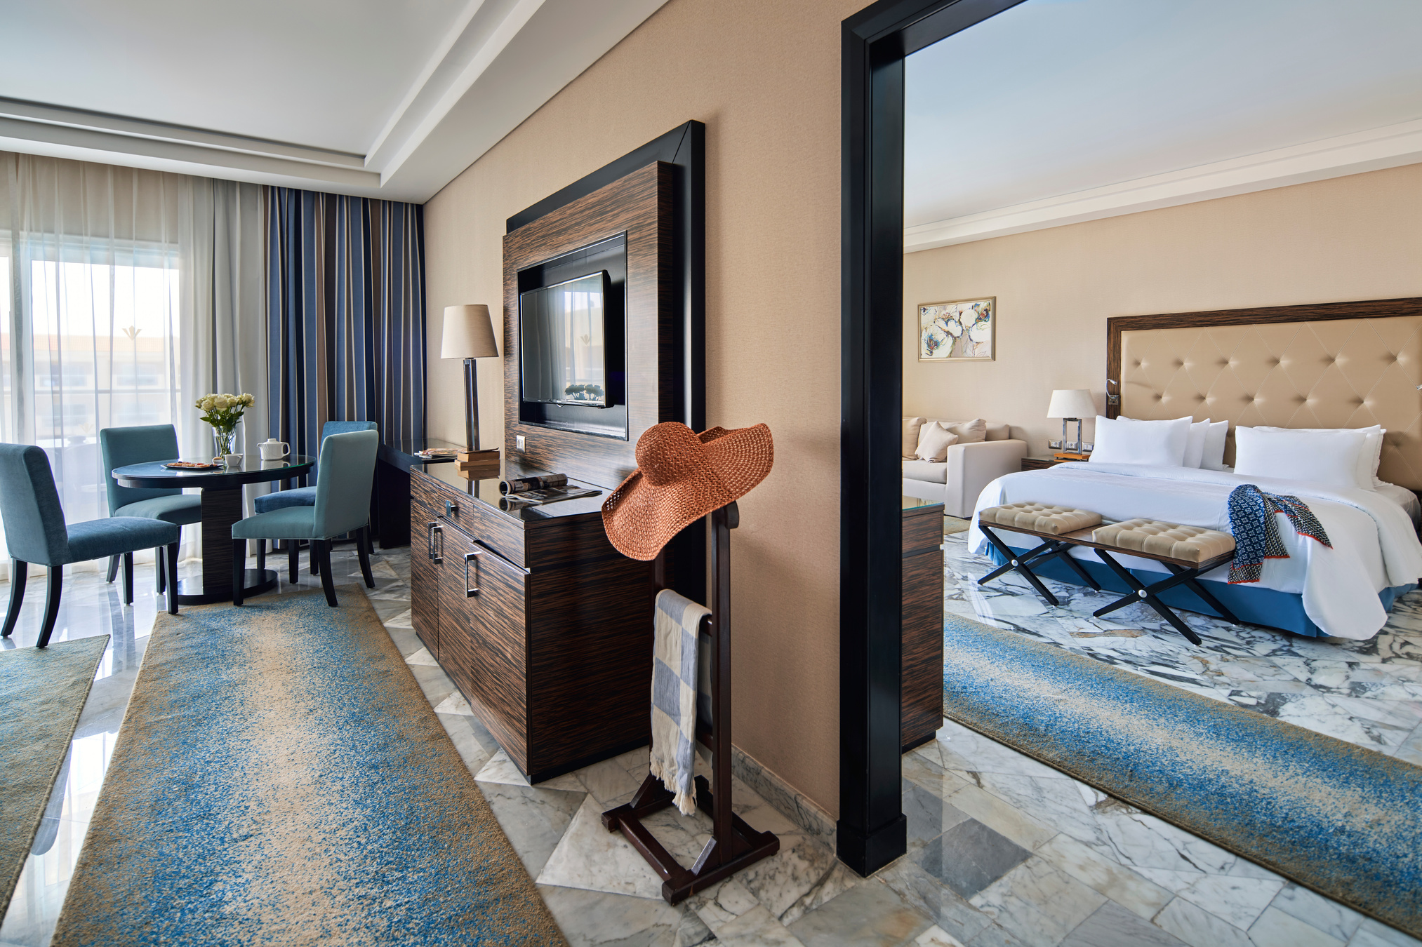
JUNIOR SUITE – SEA & POOL VIEW
A spacious 135 m² suite featuring a king-size bed, separate living area, and private balcony with stunning sea and pool views. Includes two bathrooms (shower or bathtub),
Minibar (on request), tea and coffee facilities, LCD TV with international channels, AC, safe, and hairdryer.
Maximum occupancy: 2 adults + 2 children or 3 adults + 1 child.
Amenities: Bathrobes, slippers, shower gel, shampoo, conditioner, lotion, bath loofah, shower cap, ear cotton pads, shoe care.
On request: Shaving kit, dental kit, sewing kit, make-up pads, hair comb, iron and ironing board.

Slide 5
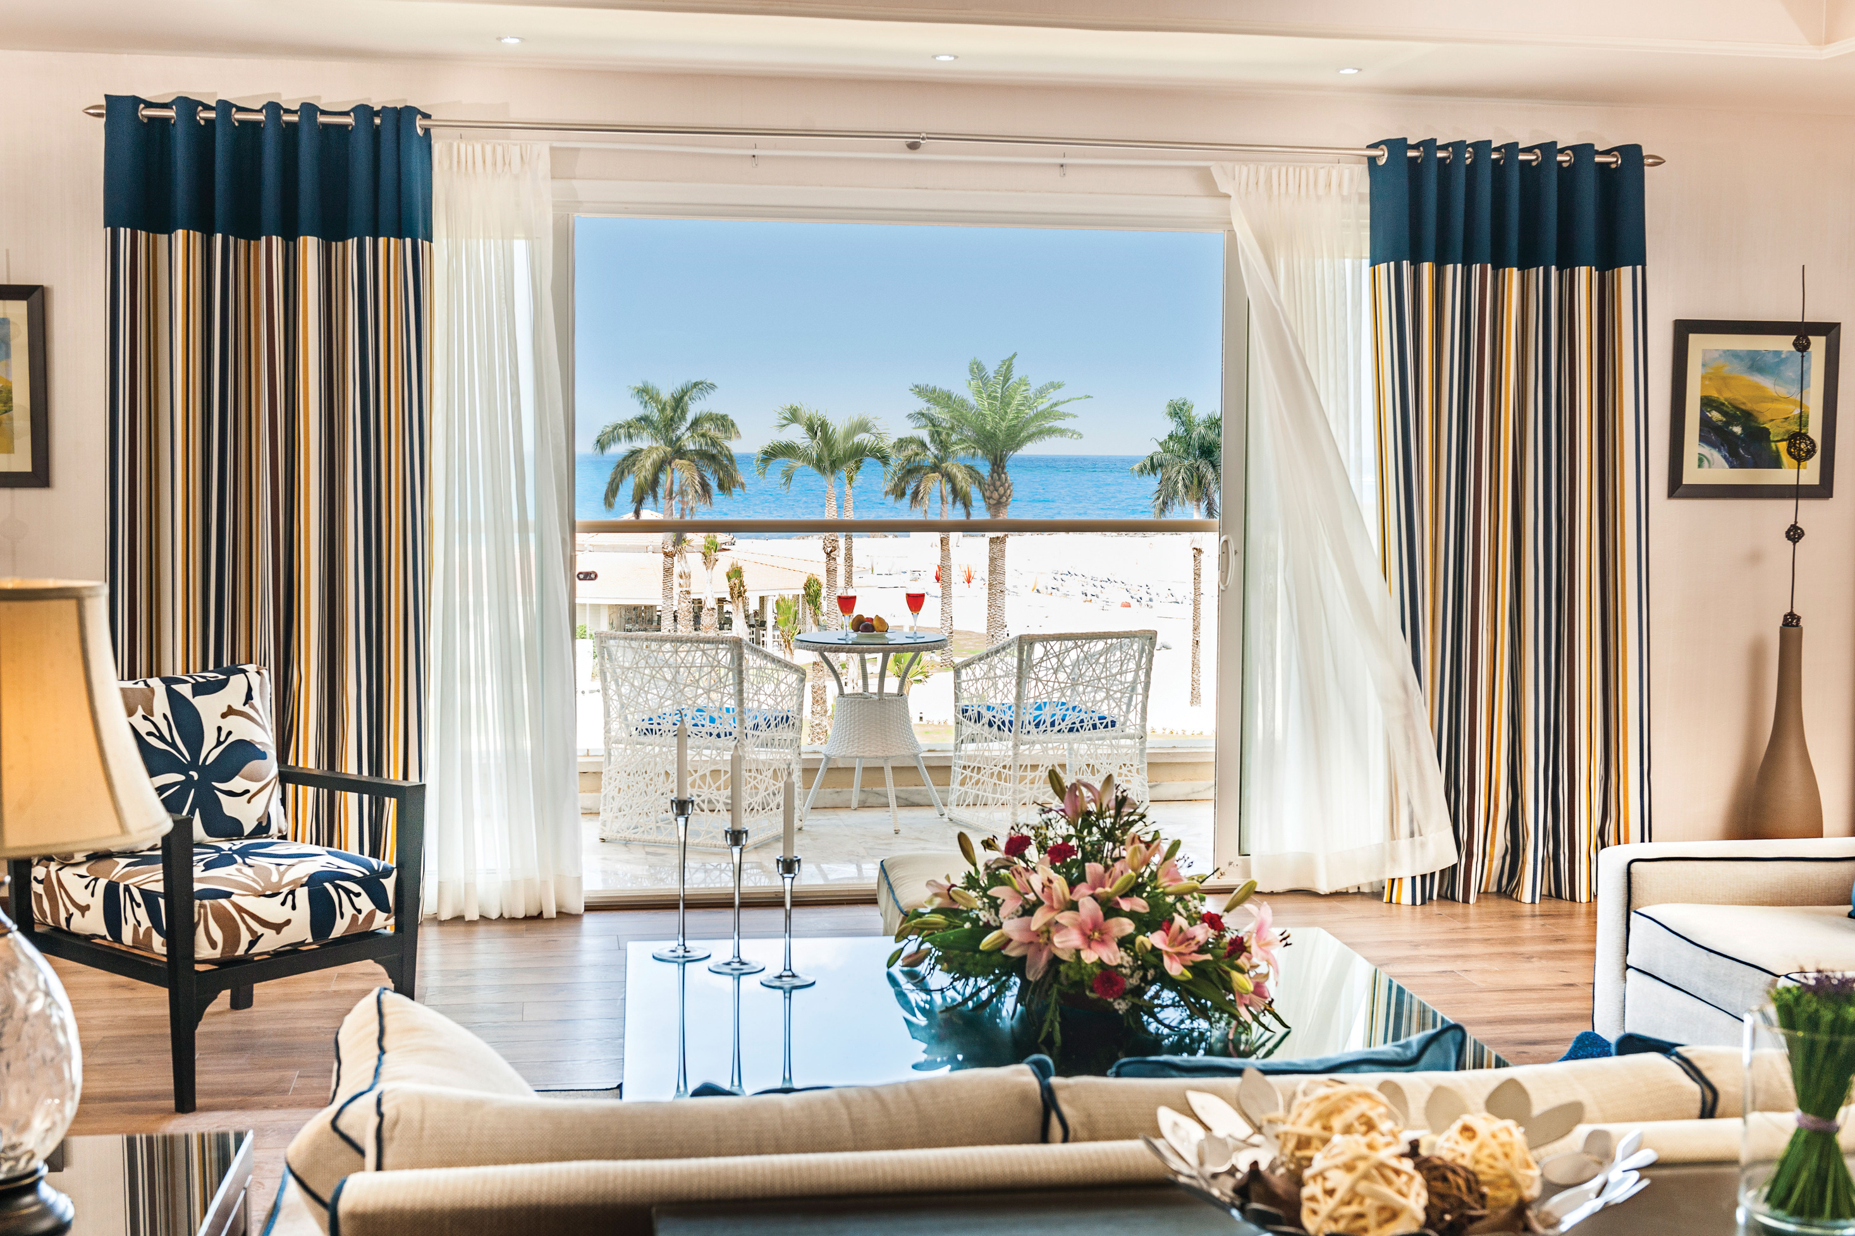
EXECUTIVE SUITE – SEA SIDE VIEW
An expansive 183 m² suite offering elegant comfort with a separate living room, one bedroom with a king-size bed, and another with twin beds. Enjoy a private balcony with charming side sea views, along with two bathrooms (shower or bathtub), LCD TV with international channels,
Minibar (on request), tea and coffee facilities, direct dial phone, AC, safe, and marble/tiled flooring.
Maximum occupancy: 4 adults + 2 children or 5 adults + 1 child.
Amenities: Bathrobes, slippers, shower gel, shampoo, conditioner, lotion, bath loofah, shower cap, ear cotton pads, shoe care.
On request: Shaving kit, dental kit, sewing kit, make-up pads, hair comb, iron and ironing board.

Slide 6
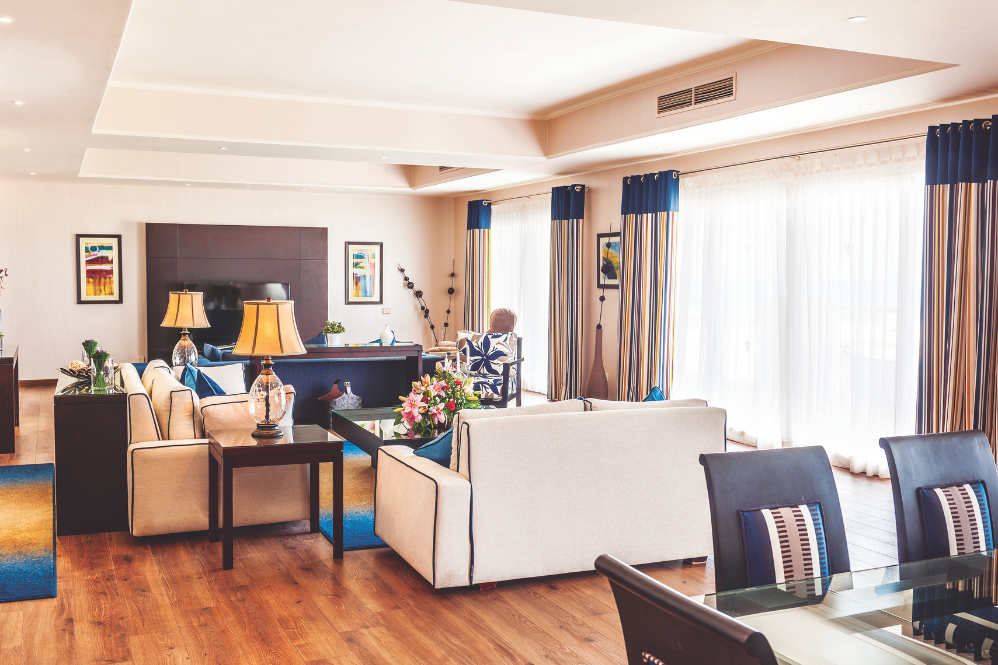
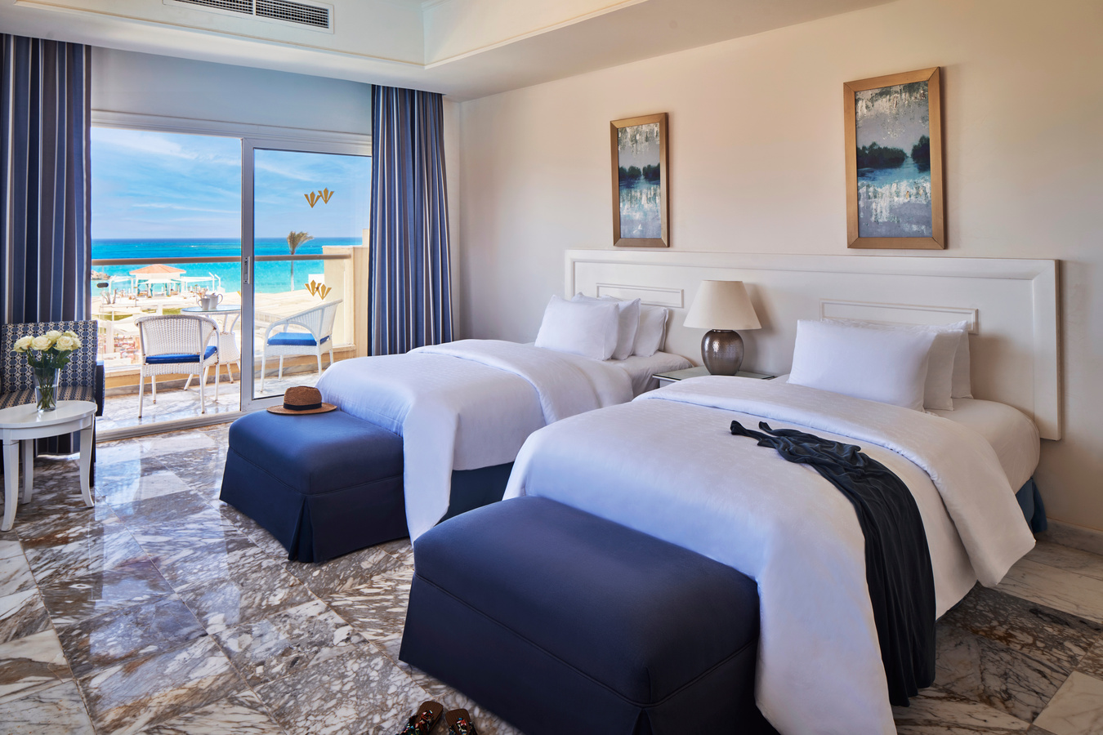
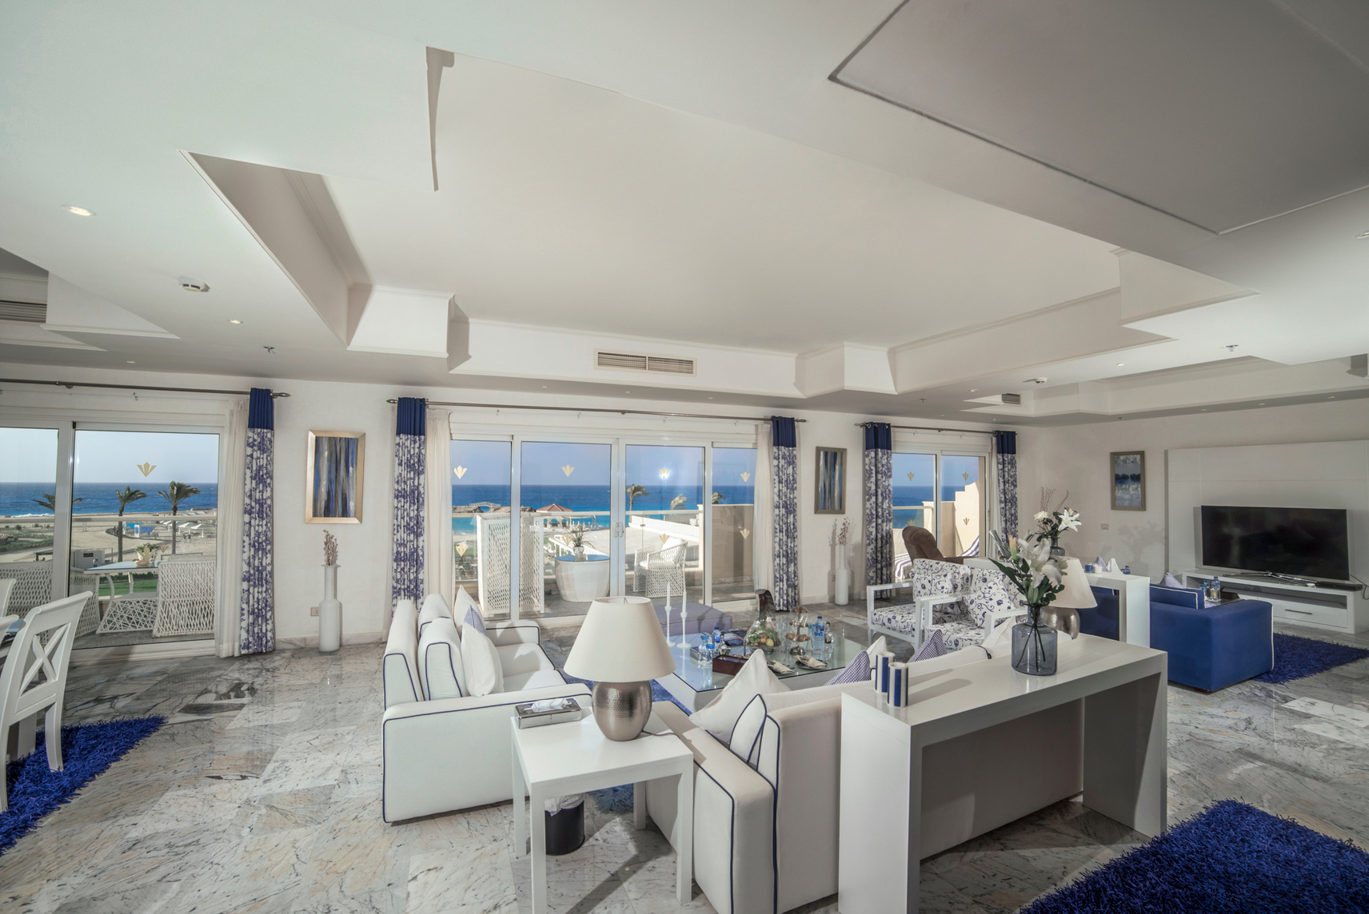
PRESIDENTIAL SUITE – SEA VIEW
A lavish 214 m² retreat featuring a spacious living and dining area, one bedroom with a king-size bed and another with twin beds. Enjoy a private balcony or terrace with stunning sea views, a Jacuzzi, two LCD TVs with international channels,
Minibar (refilled daily, complimentary), AC, and marble floors. Enhanced by private butler service for an elevated experience.
Maximum occupancy: 4 adults + 2 children or 5 adults + 1 child.
Amenities: Premium bathrobes and slippers, luxury bath amenities, male & female hygiene kits (shaving kit, dental kit, nail trimmers, body spray, sanitary bag, makeup buds, hair comb, cotton buds), bath loofah, fresh flowers, and a complete shoe care box.

Slide 7
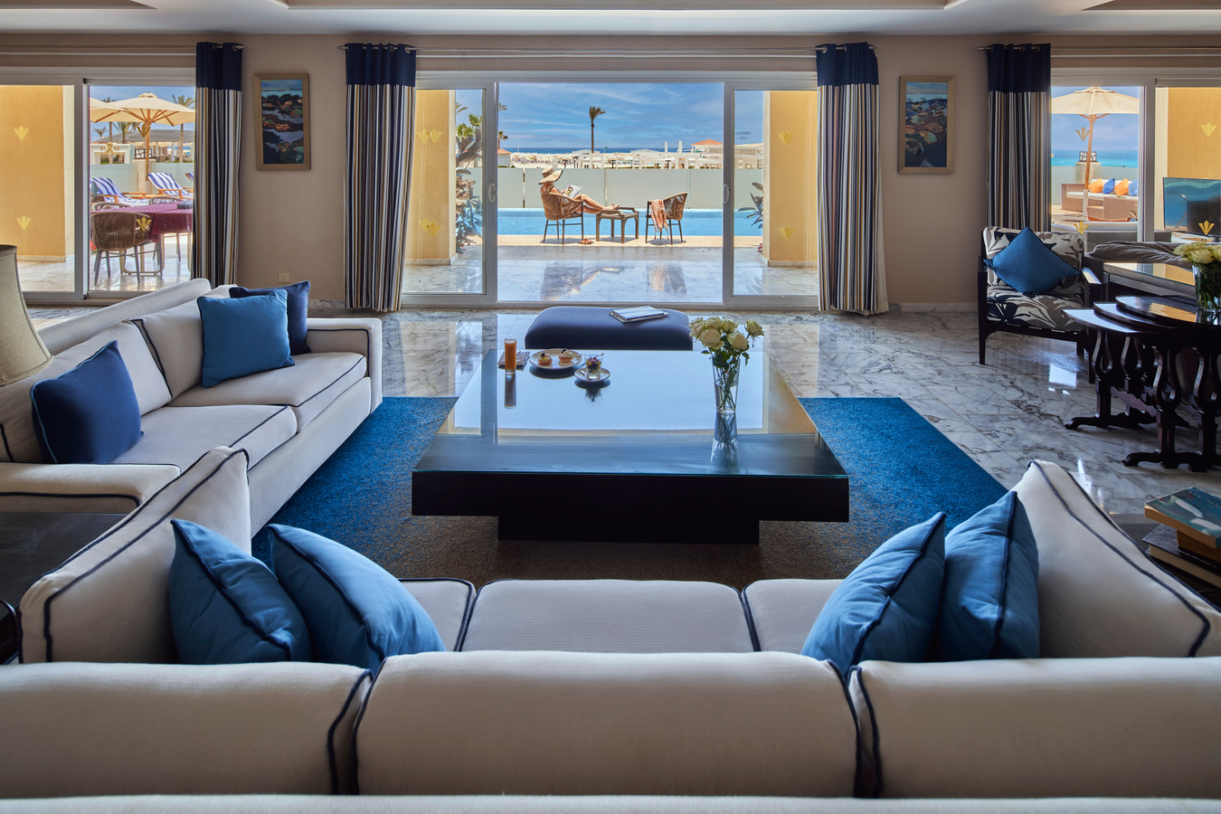
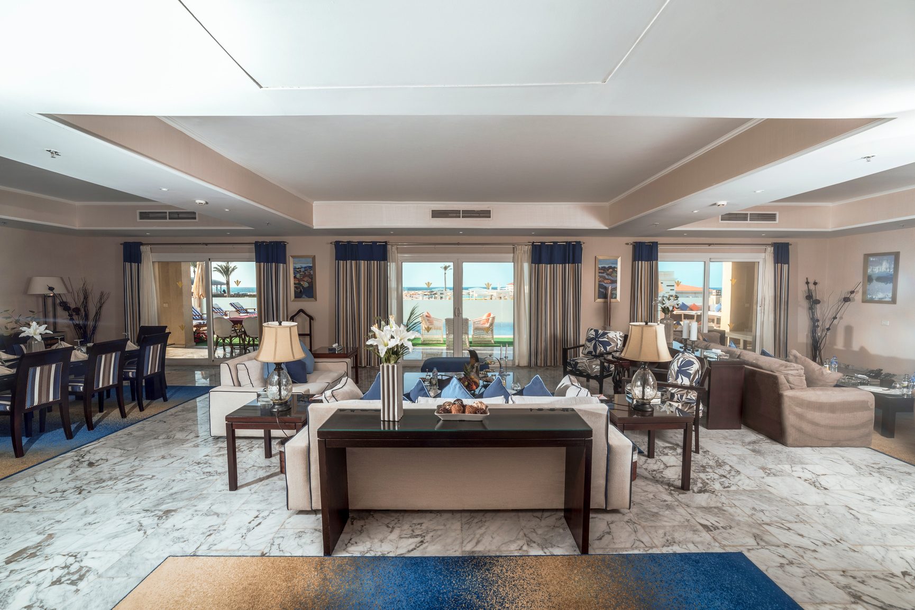
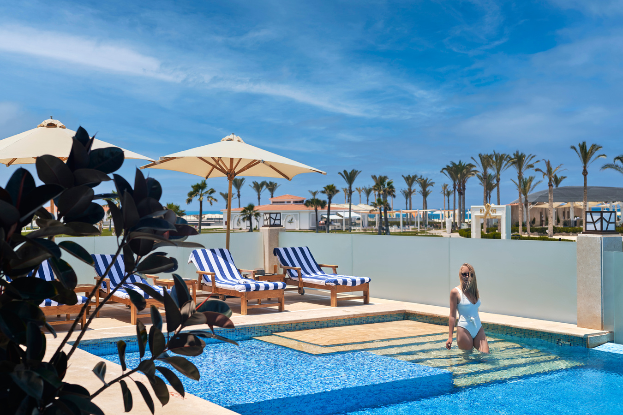
ROYAL SUITE – SEA VIEW
An opulent 410 m² sanctuary featuring a grand living area, one king bedroom and one twin bedroom, private pool, and a balcony or terrace with panoramic sea views. Includes an espresso machine, complimentary daily Minibar, 2 LCD TVs with international channels, Jacuzzi, AC, and marble floors. Enhanced with exclusive private butler service for a personalized stay.
Maximum occupancy: 4 adults + 2 children or 5 adults + 1 child.
Amenities: Deluxe bathrobes and slippers, premium bathroom amenities, male & female hygiene kits (shaving kit, dental kit, wipes, body spray, nail care tools, cotton buds, hair comb), shower fiber, sanitary items, fresh flowers, and a complete shoe care set.
EMAIL

Slide 8
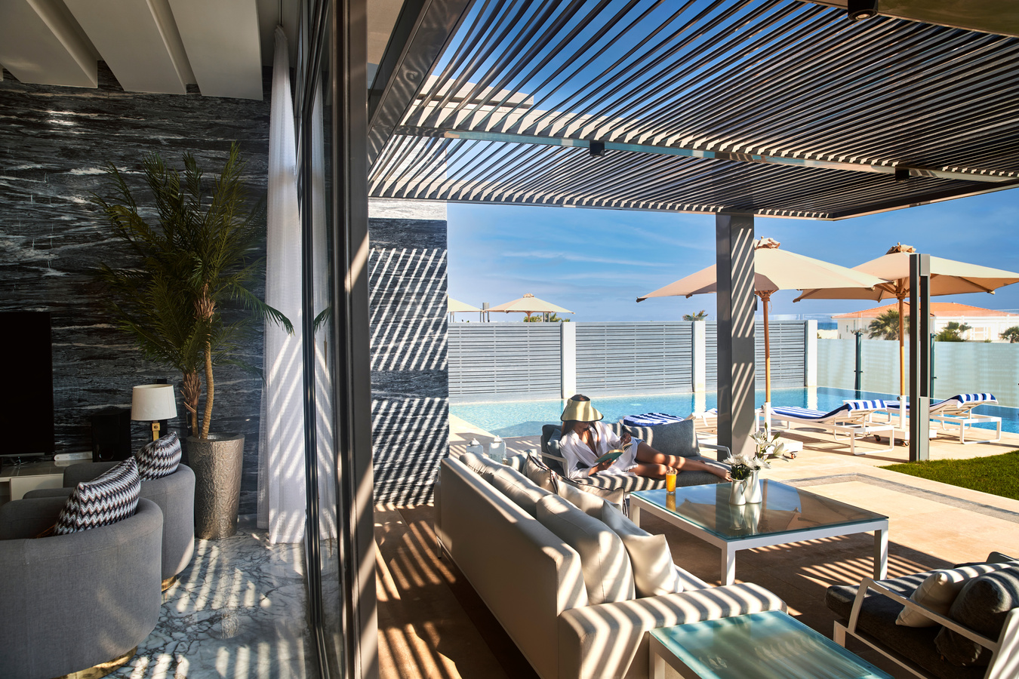
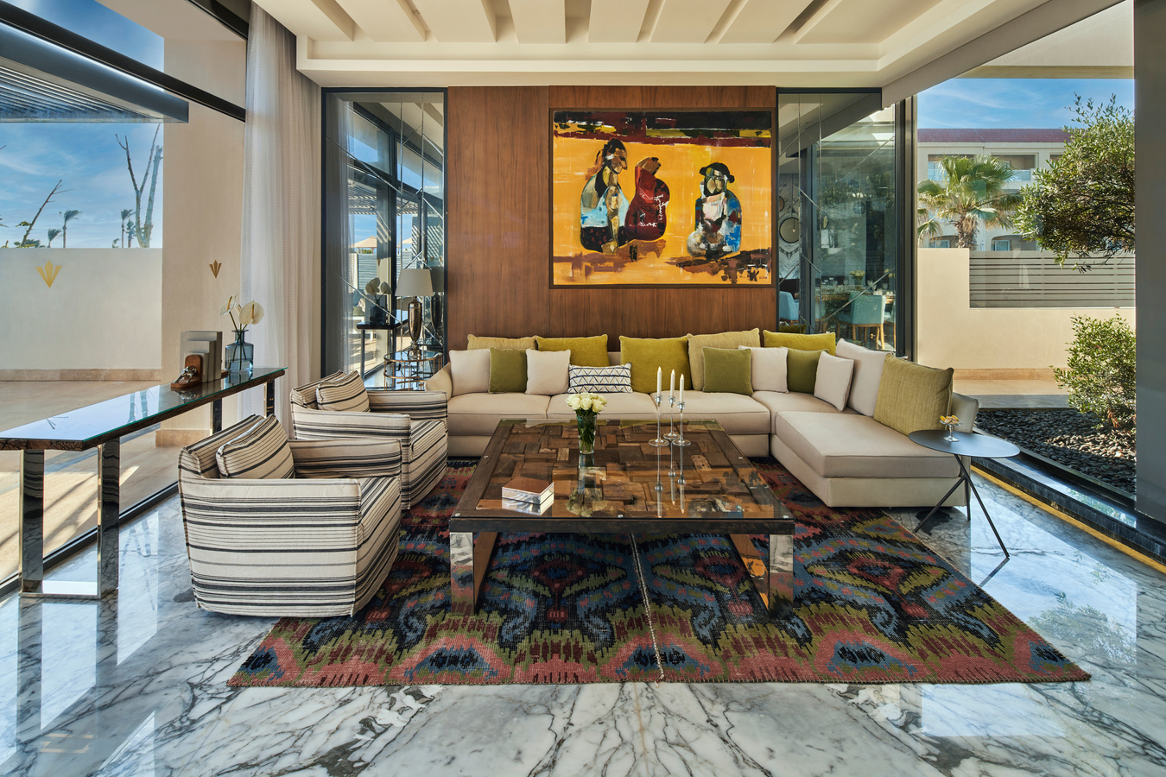
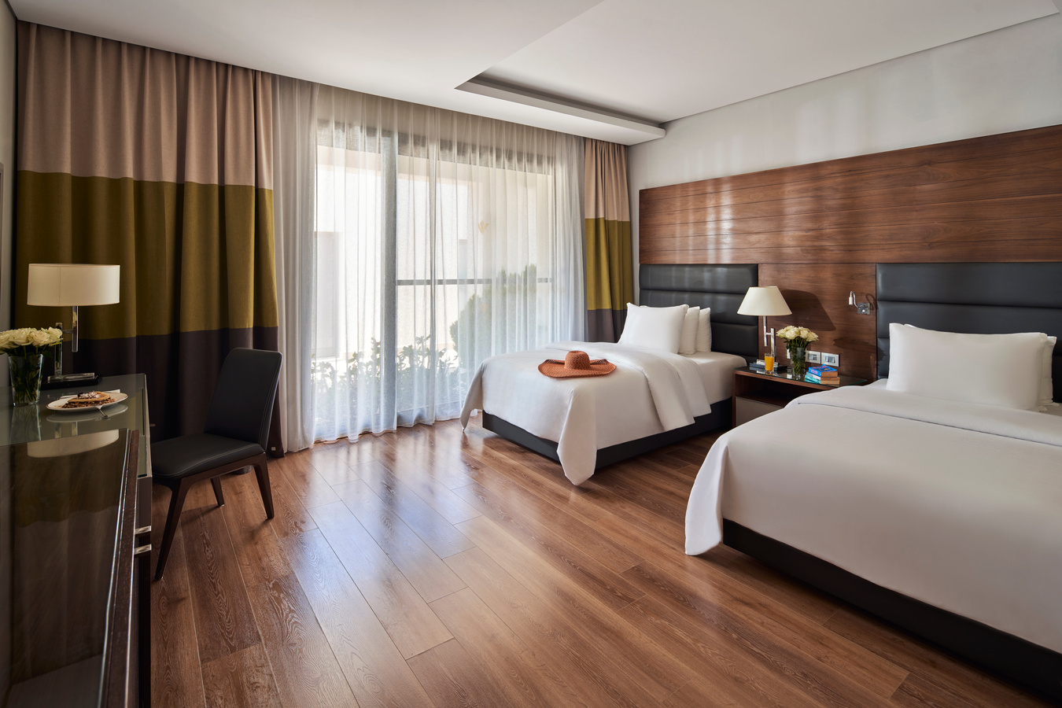
VILLA SEA VIEW – EXCLUSIVE LUXURY RETREAT
A lavish 980 m² villa featuring four bedrooms with king-size and twin beds, a spacious living room, dining area, and fully equipped kitchenette. Enjoy a private garden with pool, large terrace, and stunning sea views. Equipped with four bathrooms, one powder room, minibar (refilled daily, complimentary), espresso machine, surround sound home theatre, multiple LCD TVs with international channels, AC, and free Wi-Fi. Enhanced by dedicated private butler and chef services for an exceptional stay.
Maximum occupancy: 8 adults + 2 children.
Amenities: Premium bathrobes and slippers, luxury bath amenities, male & female hygiene kits (shaving kit, dental kit, nail trimmers, body spray, sanitary bags, makeup buds, hair comb, cotton buds), bath loofah, fresh flowers, shoe care box, pillow menu, and sanitizer dispenser.

Slide 9

DINING EXPERIENCES
BUFFET RESTAURANTS:
Mediterranean Restaurant
Breakfast: 07:30–10:30
Lunch: 13:00–15:30 (seasonal)
Dinner: 19:00–22:00
People’s Restaurant
Lunch: 13:00–15:30
Snacks: 16:30–18:00
Dinner: 18:30–21:30 (seasonal)
À la Carte Restaurants:
Lalezar (Turkish) – 19:00–22:30
Laill (Lebanese) – 19:00–22:30
SeaSalt Beach Club – Sushi & cocktails till 01:30 AM
Mangal Restaurant – Beach BBQ experience (Reservation required)
Dining Services:
In Room Dining: Available 24/7
Mini-bar: Stocked upon request or daily (Villa/Suite)
Takeaway meals available

Slide 10

BARS & LOUNGES
Lobby Bar – Open 24/7
Elegant and relaxing, perfect for coffee, cocktails, or a quiet drink at any hour.
Terrace Bar – 11:00 until late
Open-air views with seasonal cocktails, wine, and light bites in a breezy setting.
Beach Bar – 09:00–Sunset
Steps from the sea, offering chilled drinks, fresh juices, and snacks with a coastal breeze.
Pool Bar – 09:00–Sunset
Tropical cocktails and refreshing beverages served right by the water.
SeaSalt Lounge & Bar (Reopening soon)
Sophisticated beach club vibe with signature cocktails, premium spirits, shisha, cigars, and a resident DJ — ideal for sunset to late-night lounging.

Slide 11
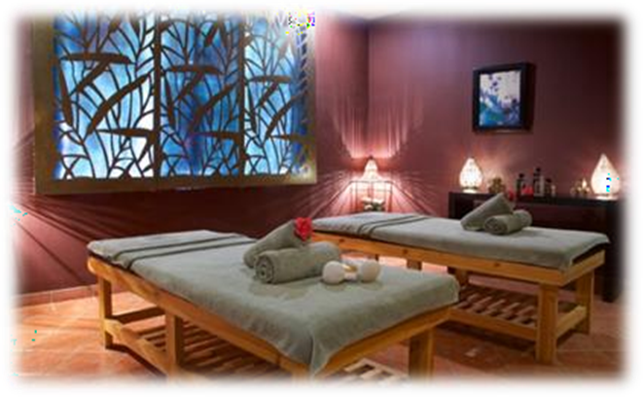
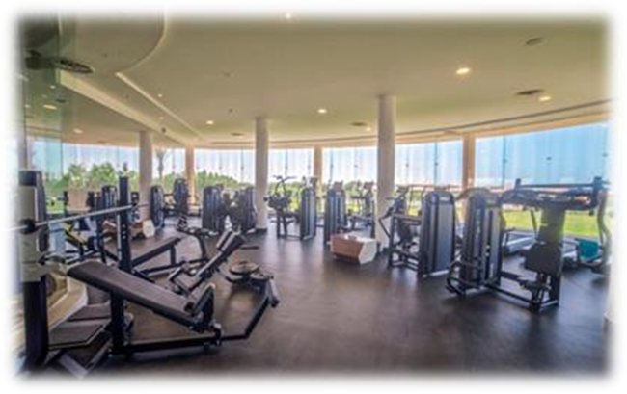
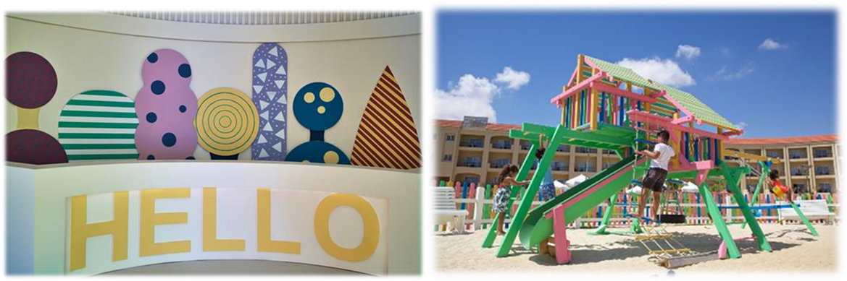
SERVICES, WELLNESS & FACILITIES
Spa & Wellness (09:00–20:00):
Sauna, Steam Room, Jacuzzi, Turkish Bath
Massage Rooms, Outdoor Massage, Skin Care
Manicure, Pedicure, Hairdresser
Fitness Center (07:00–21:00):
Fully equipped gym
Min. age: 14 years
Kids Area – Rixy Club:
Ages 1–12
Indoor: Craft, Cinema, Gym
Outdoor: Treasure Hunts, Chef Games, Mini Disco

Slide 12
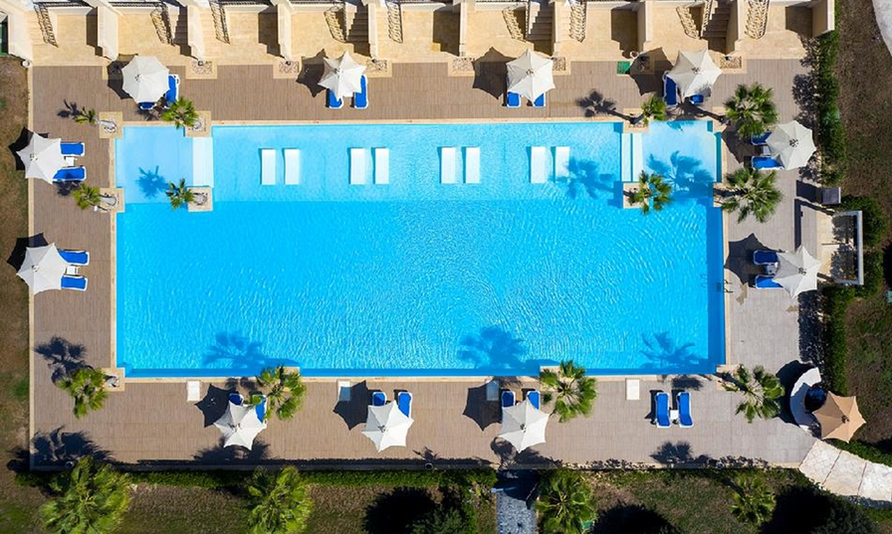
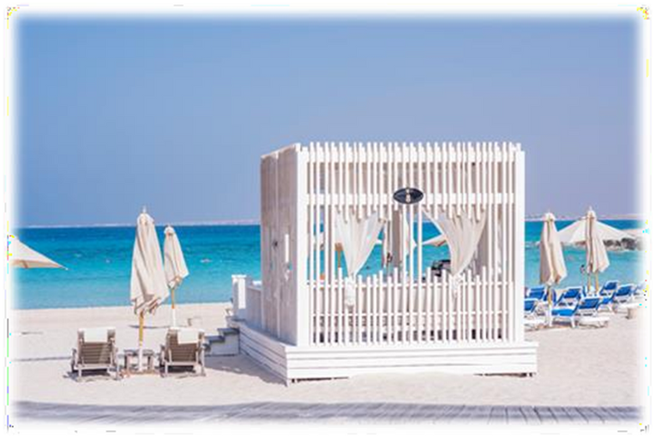
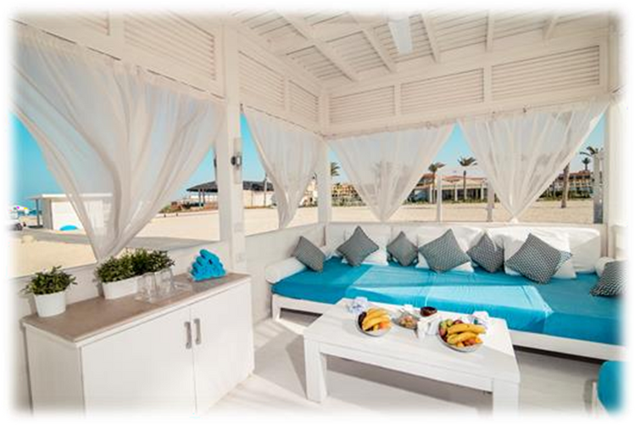
SERVICES, WELLNESS & FACILITIES
POOLS
3 Adult Pools: Spacious, sun-lounger equipped, with poolside drink service and lifeguards on duty.
2 Kids Pools: Safe, shallow pools with water games and links to the Kids Club.
Operating Hours: From sunrise to sunset (no swimming after sunset).
Towel Centers: Available for daily fresh towel exchange.
Pool Bar: Open daily 09:00–sunset, serving drinks and light snacks.
Note: Sunbed reservations are not allowed; unattended towels will be removed.
Beach Cabanas (09:00 to 19:30):
Types Available:
Platinum Cabanas – With Jacuzzi
Gold Cabanas – Without Jacuzzi
Capacity:
Up to 4 adults and 2 children (under 11 years)
Exclusive Features:
(Private waiter service, Jacuzzi in Platinum units, optional romantic dinner setup, sound system & Wi-Fi, fresh fruit basket, minibar, bathroom amenities, towel set, and personal safe.)

Slide 13
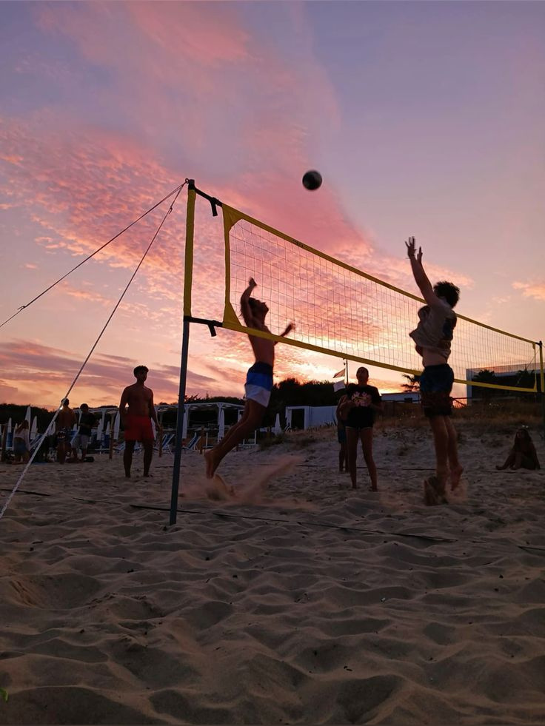
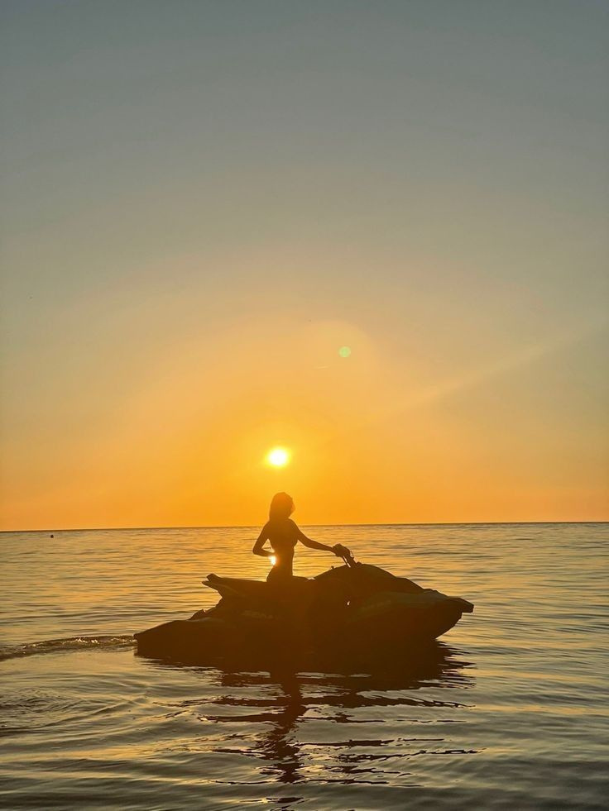
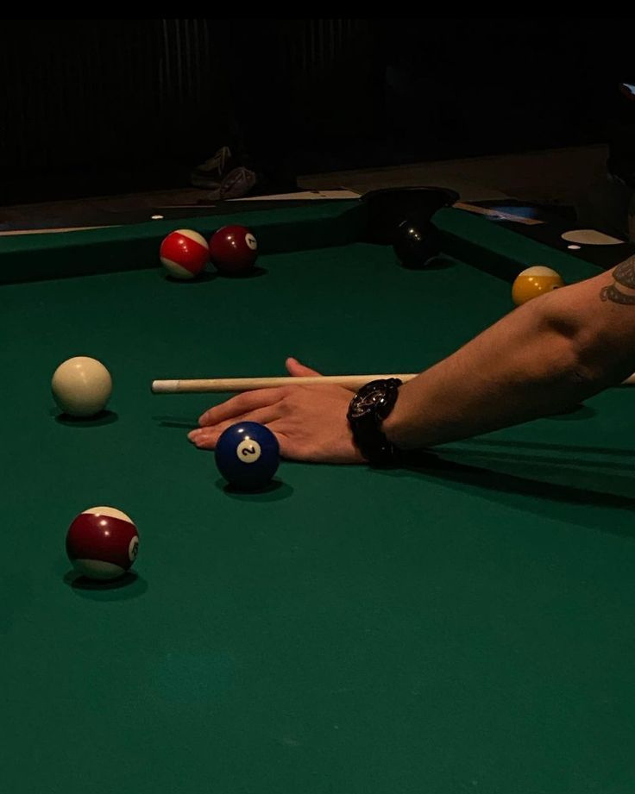
RECREATION, ACTIVITIES & EXPERIENCES
Daily Activities:
Yoga, Pilates, Stretching, Water Polo
Darts, Boccie, Aerobics, Beach Volleyball
Table Tennis, Pool Games
Tennis & Padel Courts:
Free until 19:00
600 EGP/hour after
Equipment provided
Water Sports (09:00–19:30):
Jet Ski, Paddleboard, and more (chargeable)
Book with Concierge
Other Leisure Options:
Billiards Table – Ask Lobby Bar
Romantic Dinner by Sea – Book 24h in advance
Live music, cultural shows, theme nights

Slide 14
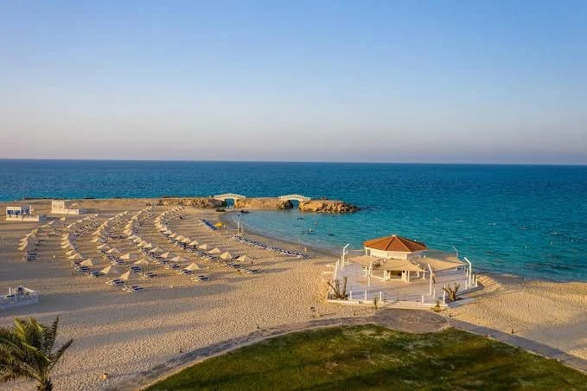
THANK YOU FOR YOUR ATTENTION
GHAZALA RESORT AND SPA

