Slide 1

Naturally Maldivian…

Slide 2
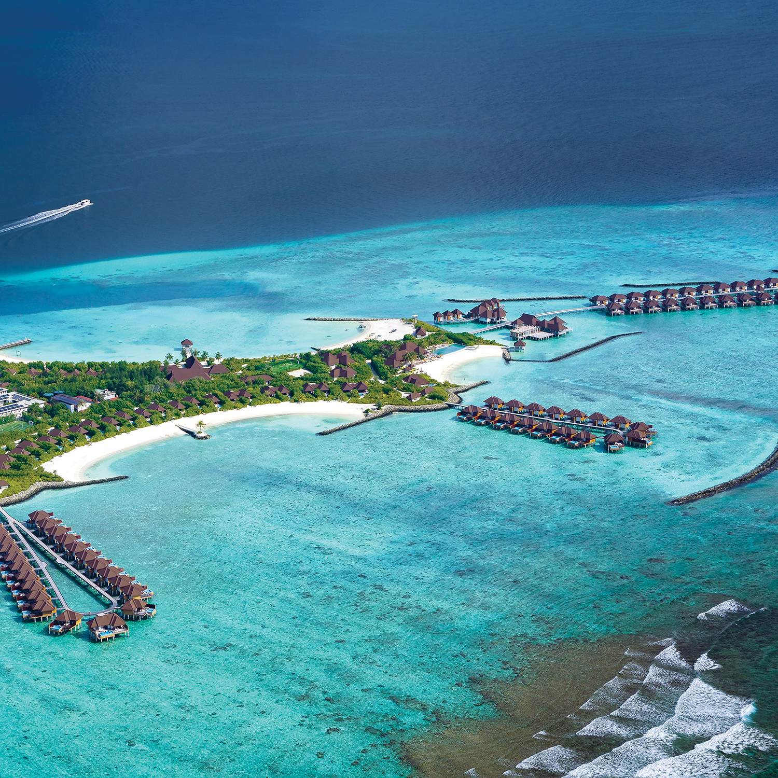
VARU by Atmosphere
Located in the North-West edge of Malé Atoll in the Maldives, the multi award-winning 5-star resort offers a truly Maldivian experience by incorporating aspects of local traditions and cultures, structural design - fused together with bursts of chic tropical vibes.
Positioned as a contemporary and ‘Naturally Maldivian’ resort experience with 111 Villas dotted around the white sandy beaches and expanding over the turquoise lagoons onto three jetties with the overwater accommodation options.
All guests at VARU will be on the unique Premium Holiday Plan The VARU Plan™; offering an array of food and beverage options, in-villa services and amenities, activities and excursions and much more!
Category: 5-star all-inclusive
Transfer: 40-minutes by speedboat
Distance from airport: 38 km / 20.5 N mi
Number of units: 111 units in 07 categories
VARU BY ATMOSPHERE

Slide 3
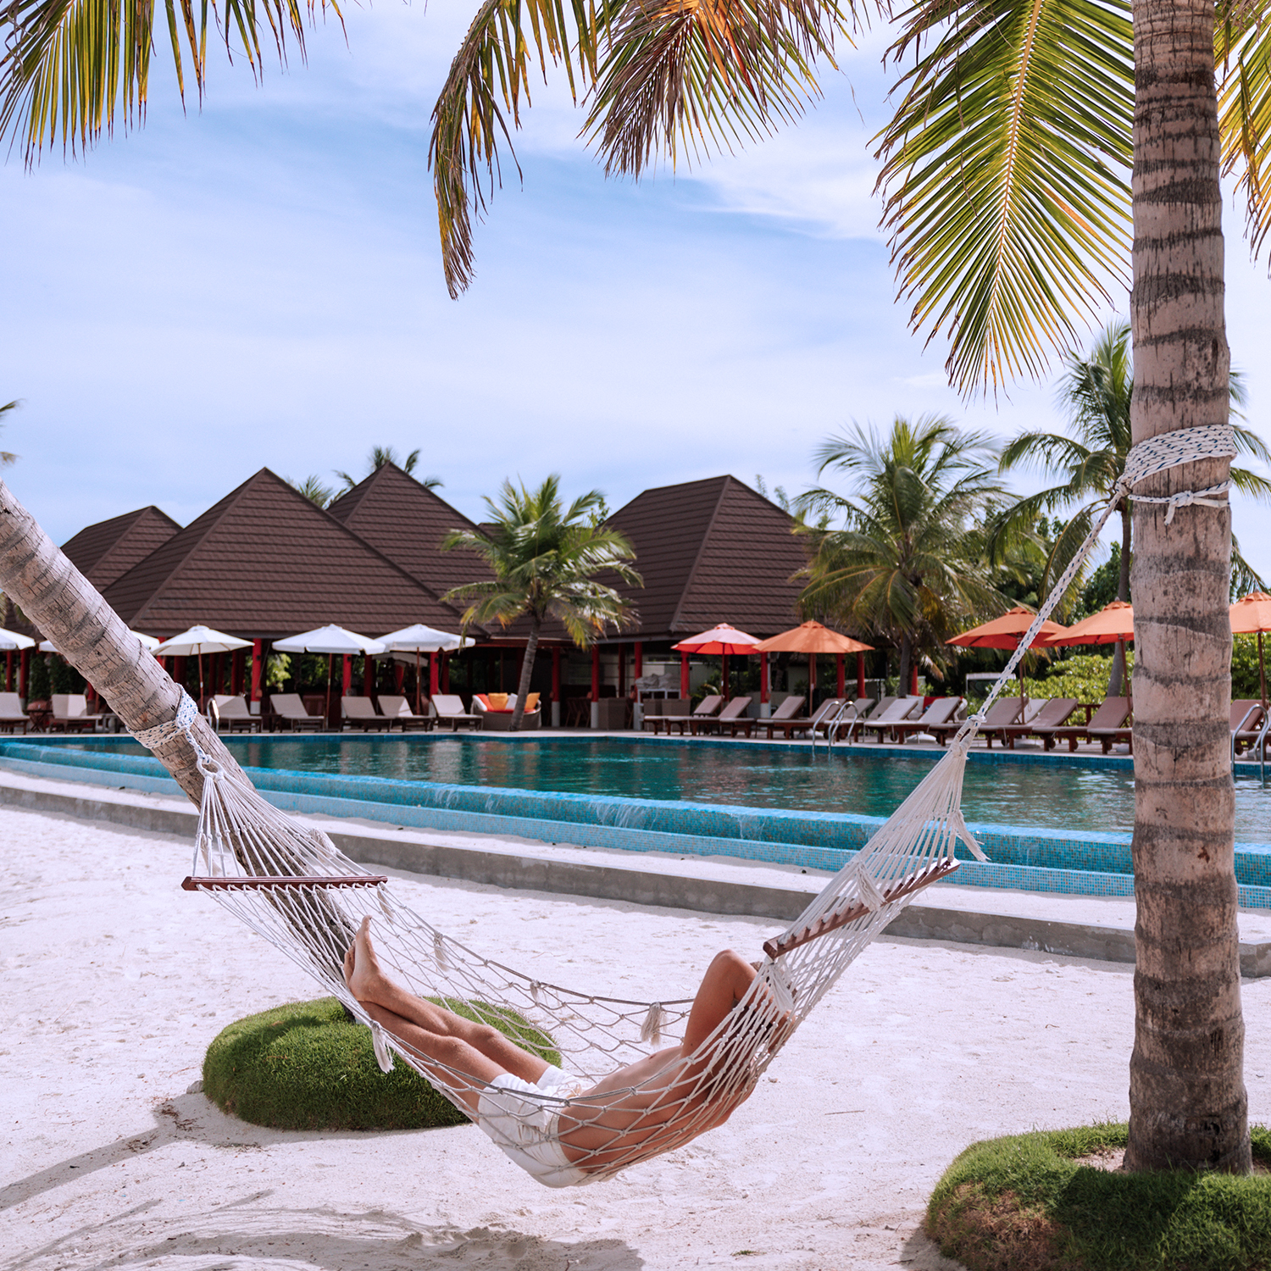
Resort Features & Facilities
VILLAS & SUITES
BEACH VILLA 16 units - 75m² | WATER VILLA 29 units - 95m²
BEACH VILLA WITH POOL 15 units - 90m² with 10m² Pool | WATER VILLA WITH POOL 39 units - 95m² with 10m² Pool
2 BEDROOM BEACH VILLA WITH POOL 08 units - 175m² with 10m² Pool | WATER SUITE 01 unit - 155m² with 15m² Pool
MAJLIS RESIDENCES 03 units - 330m² with 45m² Pool
SERVICES & FACILITIES
THE VARU PLAN™ PREMIUM HOLIDAY PLAN | RESTAURANTS ALL-DAY DINING + 05 SPECIALTY OUTLETS
ELENA AYUR - SPA & WELLNESS SPA CENTRE, GYMNASIUM & SALON | BARS MAIN BAR & POOL + SPECIALTY BAR
DIVE & WTERSPORTS CENTRE | KIDS CLUB & KIDS ACTIVITIES
VARU BY ATMOSPHERE

Slide 5
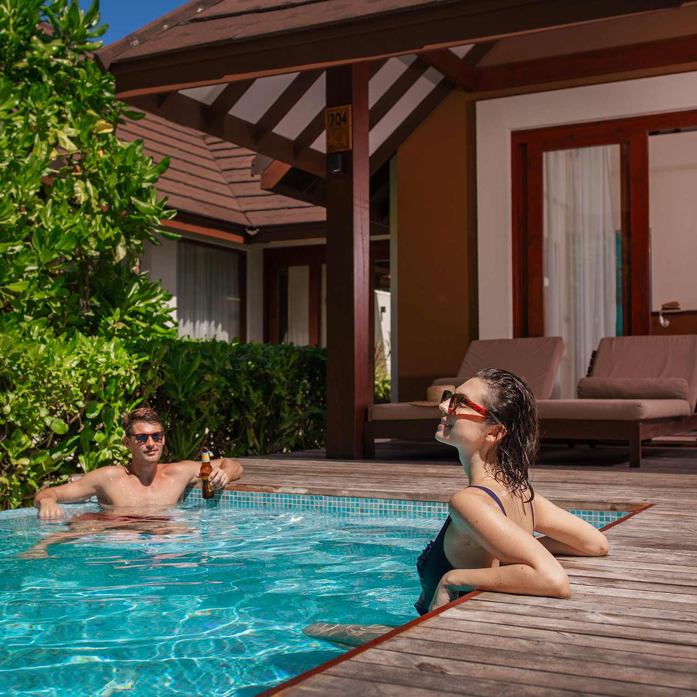
The VARU Plan™
The VARU Plan™ - the resort’s premium all-encompassing holiday plan combines your entire stay into one seamless adventure. Indulge in wide selection of premium beverages and dining experiences, explore the fascinating underwater world through snorkeling excursions or simply soak in the sun while you sip a refreshing cocktail! Let us pamper you with our ultimate VARU Plan™!
Arrival & Departure
Complimentary airport transfer, by speedboat on arrival
Enjoy an exhilarating 40 minutes speedboat transfer on arrival from Velana International Airport to the VARU Island
On reaching the resort, there’s a traditional Maldivian welcome with rhythmic Boduberu drumming
Enjoy a glass of Champagne as refreshing welcome drink
On the day of departure
A speedboat transfer back to the airport is arranged on the day of departure
VARU BY ATMOSPHERE

Slide 6
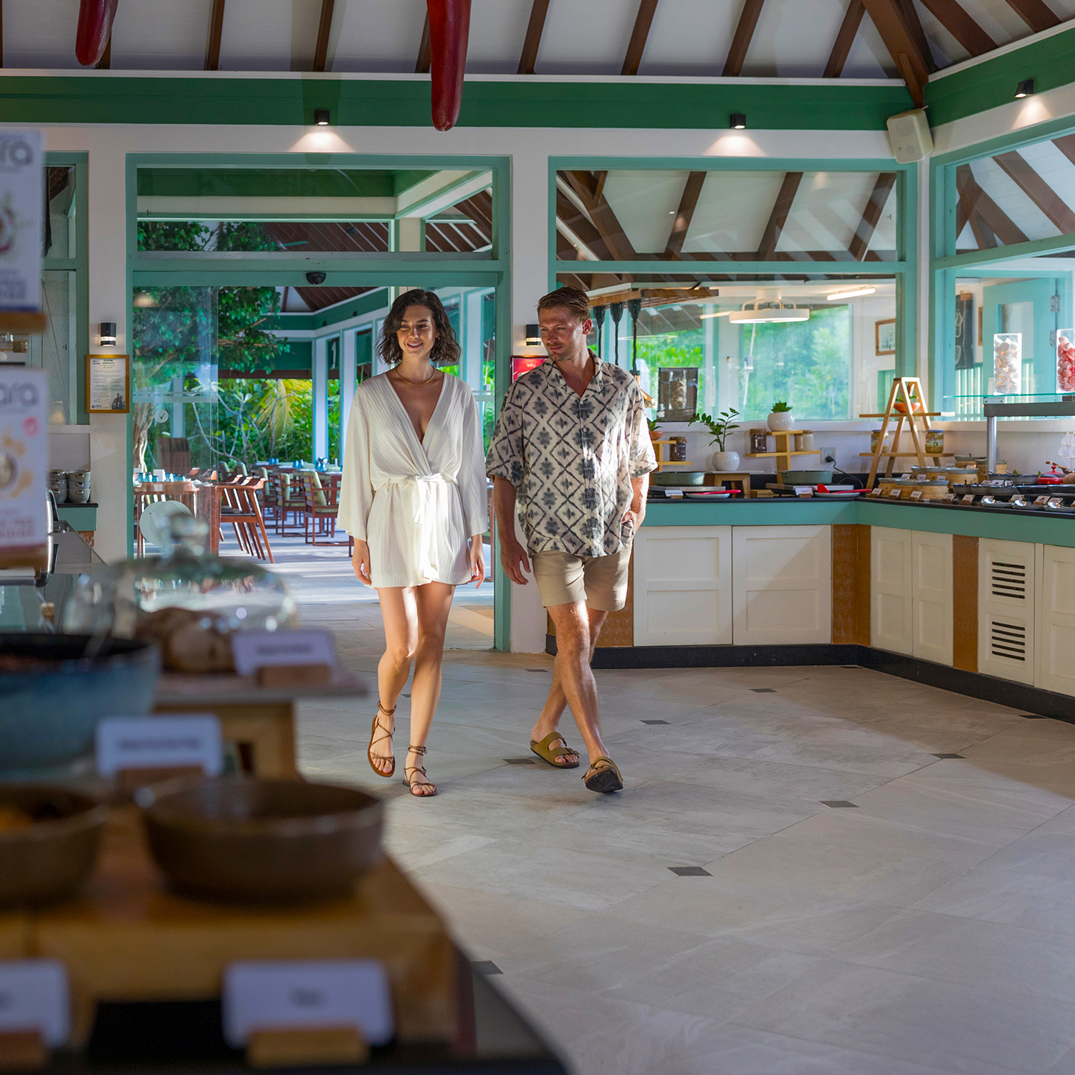
The VARU Plan™
All-Day Dining
LIME & CHILI – Breakfast, Lunch, and Dinner – 134 Covers
The elegant, all-day dining restaurant is designed to create a relaxed beachside vibe with open-air and covered seating options, white and cream décor, and subtle turquoise green highlights.
Operating Hours:
Breakfast: 07:00hrs to 10:00hrs every day
Brunch: 12:00hrs to 15:00hrs (Tuesday)
Lunch: 12:30hrs to 14:30hrs every day (except Tuesday)
Dinner: 19:00hrs to 22:00hrs every day
(Special Dinner: Asian night every Wednesday & Indian Ocean Gala Dinner every Friday)
Buffet service design with ‘cloche’ offering selection of Asian, European, Arabic and Maldivian platter, live cooking stations, pizza station, grills, ice-cream stations and delightful dessert displays
Special Indian Ocean Gala Dinner: Celebrate the Spirit of Maldives with an elaborate food selection, unlimited cocktails, and beverages.
Live entertainment with dancing, festivities, and a special Boduberu performance - Every FRIDAY at Lime & Chili
VARU BY ATMOSPHERE

Slide 7
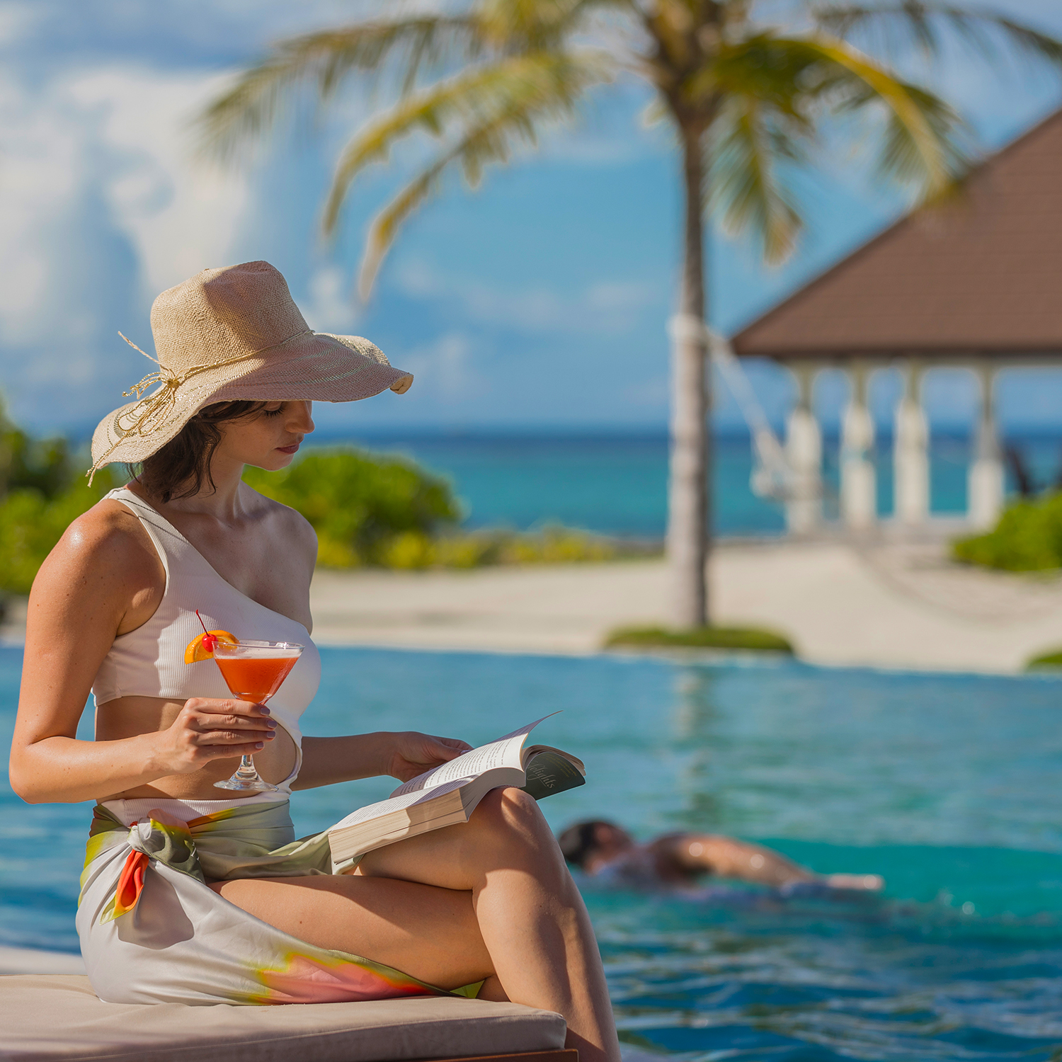
The VARU Plan™
Main Bar & VARU Plan™ Beverages
BAY ROUGE – Main Bar & Pool
The pool-side bar offers a front-row view of the dramatic Maldivian sunset, as you lounge at the bar with your favorite drink in hand and classic bar nibbles. - Pick from an extensive menu featuring premium spirits, beer, wine, cocktails, mocktails, signature drinks, and an assortment of tea and coffee
Operating Hours:
Pool: 07:00hrs to 19.00hrs everyday
Bar: 10.00hrs to 01.00hrs everyday
Light Snacks: 16:00hrs to 18:00hrs everyday
The VARU Plan™ Beverages
Premium brands of spirits, wines, and beers at Bay Rouge, Lime & Chili, Charcoal, Nü, and Kaagé
The VARU Plan™ Cocktails, Spirits & Beer Menu features:
  Premium brands of spirits, wines, and beers
  Unlimited cocktails and signature drinks
  Mocktails, seasonal fresh fruit juices, soft drinks, mineral water, and a variety of tea and coffee
The VARU Plan™ Wines & Bubbles Menu features:
  Global selection of over 40+ wines from renowned vineyards
VARU BY ATMOSPHERE

Slide 8
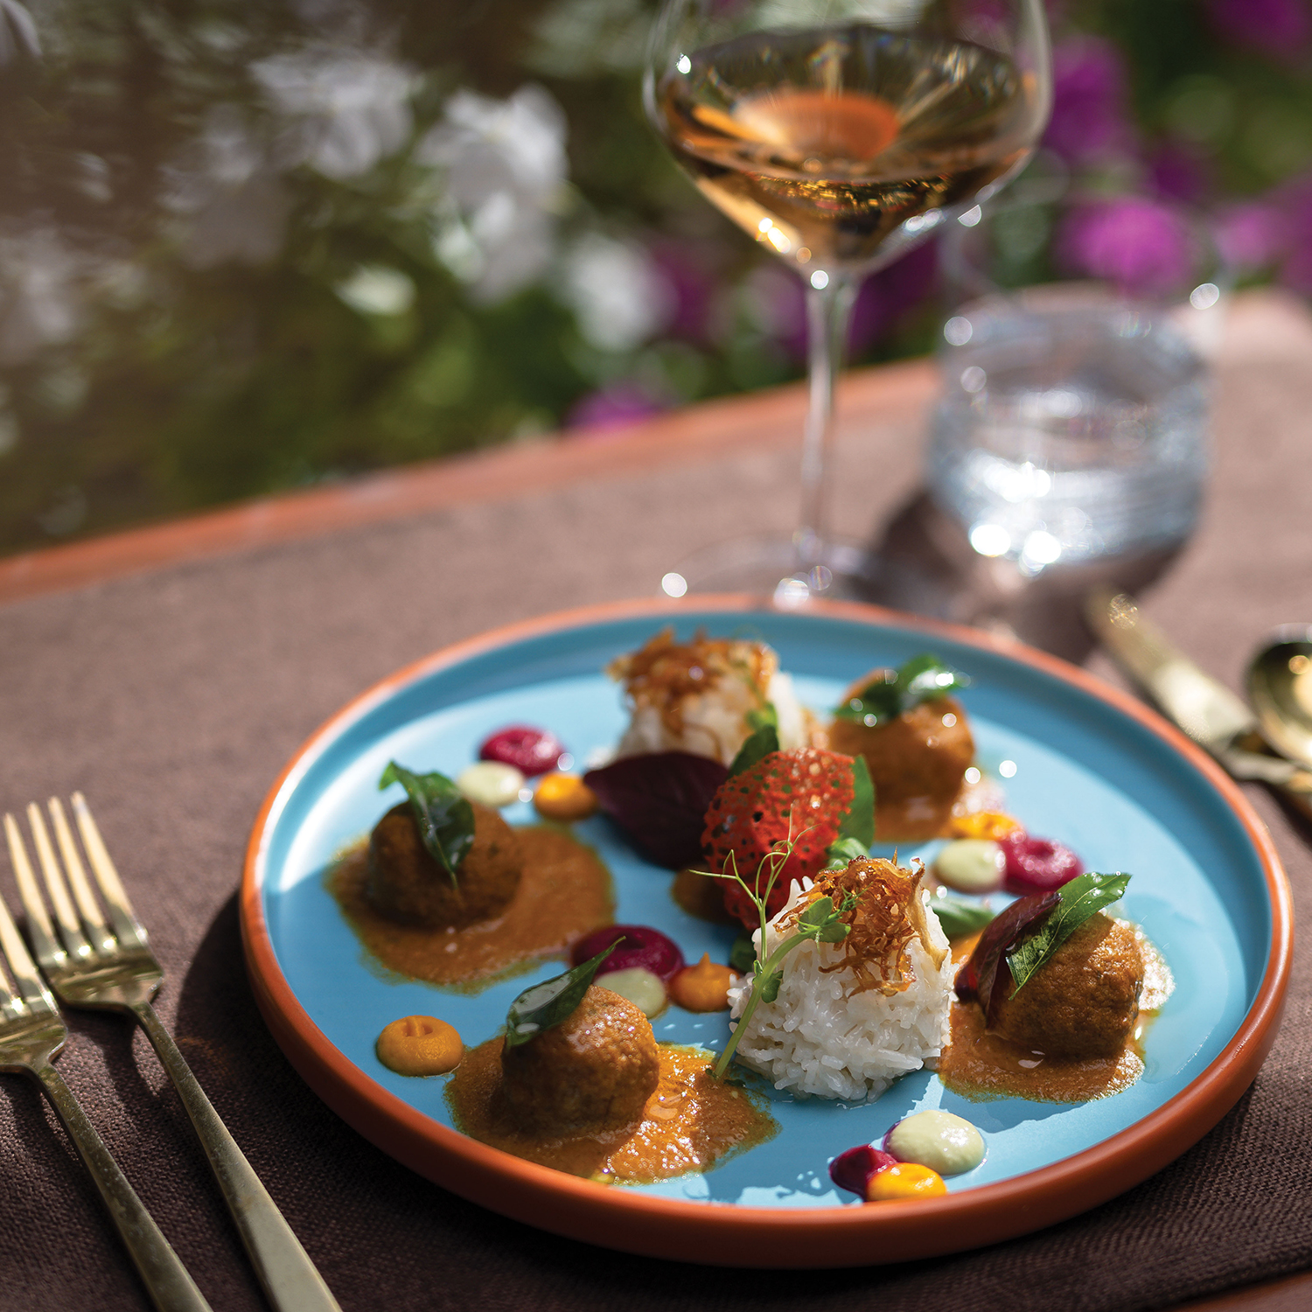
The VARU Plan™
Specialty Fine Dining
KAAGÉ * – Progressive Maldivian Cuisine – 28 Covers
Voted 2023 Travelers’ Choice Best of the Best Date Night Restaurants – Kaagé at VARU is designed like a traditional Maldivian house with accentuated wooden and floral tones, KAAGÉ creates an authentic setting complemented by warm hospitality. With a uniquely crafted menu by the award-winning Maldivian Chef Niyaz which fuses traditional homestyle Maldivian dishes with a progressive twist.
Wrap a colourful sarong and get treated to the best local flavours presented with a progressive twist
Operating hours (Pre-booking is required):
Lunch: 12:30hrs to 14:30hrs (Open 3 days a week)
Dinner: 19:00hrs to 22:00hrs (Open daily except Fridays)
* Eligible only for four-night stays and above
VARU BY ATMOSPHERE

Slide 9
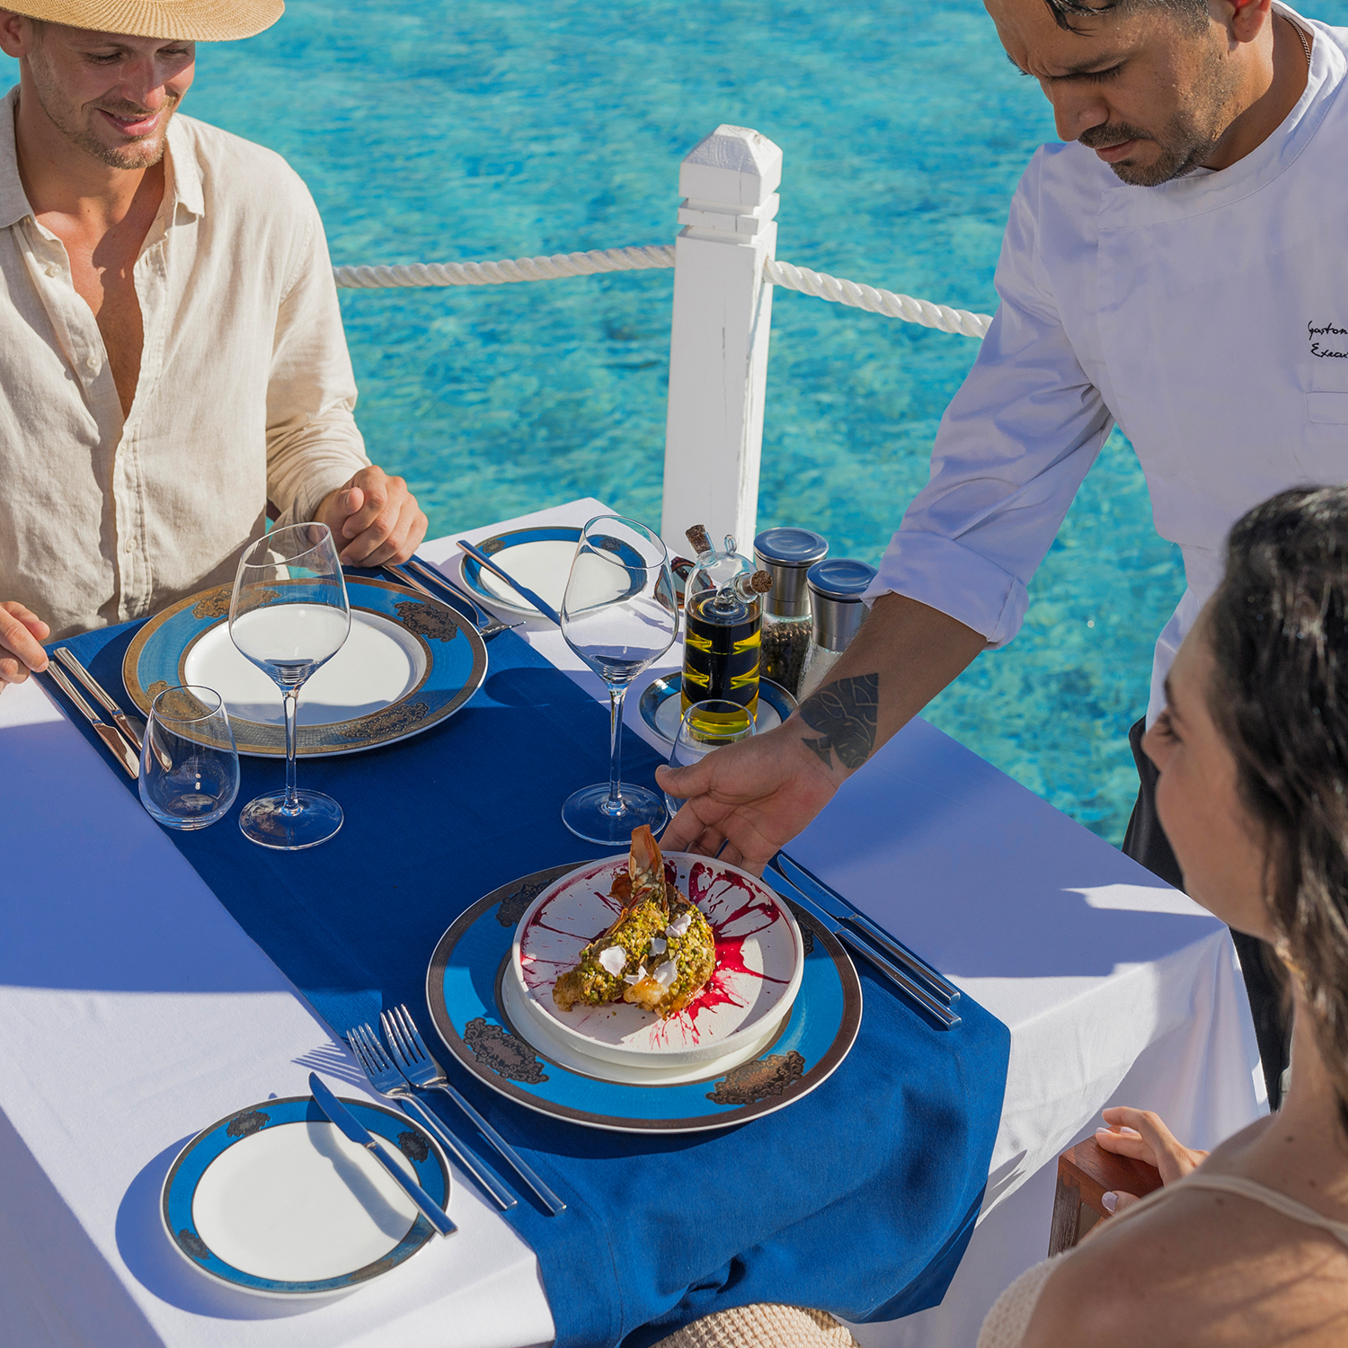
The VARU Plan™
Specialty Fine Dining
NÜ * – Mediterranean Seafood Restaurant – 40 Covers
NÜ in Dhivehi, the Maldivian dialect, translates to ‘blue’. Like its name, everything in this classy over-water restaurant has a touch of blue and an ocean themed décor.
Savour the best of French, Italian, and Mediterranean cuisine in a three-course meal at this elegant restaurant, with standout dishes like Sopa de Mariscos, Squid Ink Pappardelle, and Lagoon Crab Risotto
Operating hours (Pre-booking required) :
Lunch: 12:30hrs to 14:30hrs (Open 3 days a week)
Dinner: 19:00hrs to 22:00hrs Everyday (except Friday)
Bar
Afternoon: 2.00hrs to 14:30hrs (Open 3 days a week)
Evening: 18:00hrs to 22:00hrs Everyday (except Friday)
* Eligible only for four-night stays and above
VARU BY ATMOSPHERE

Slide 10
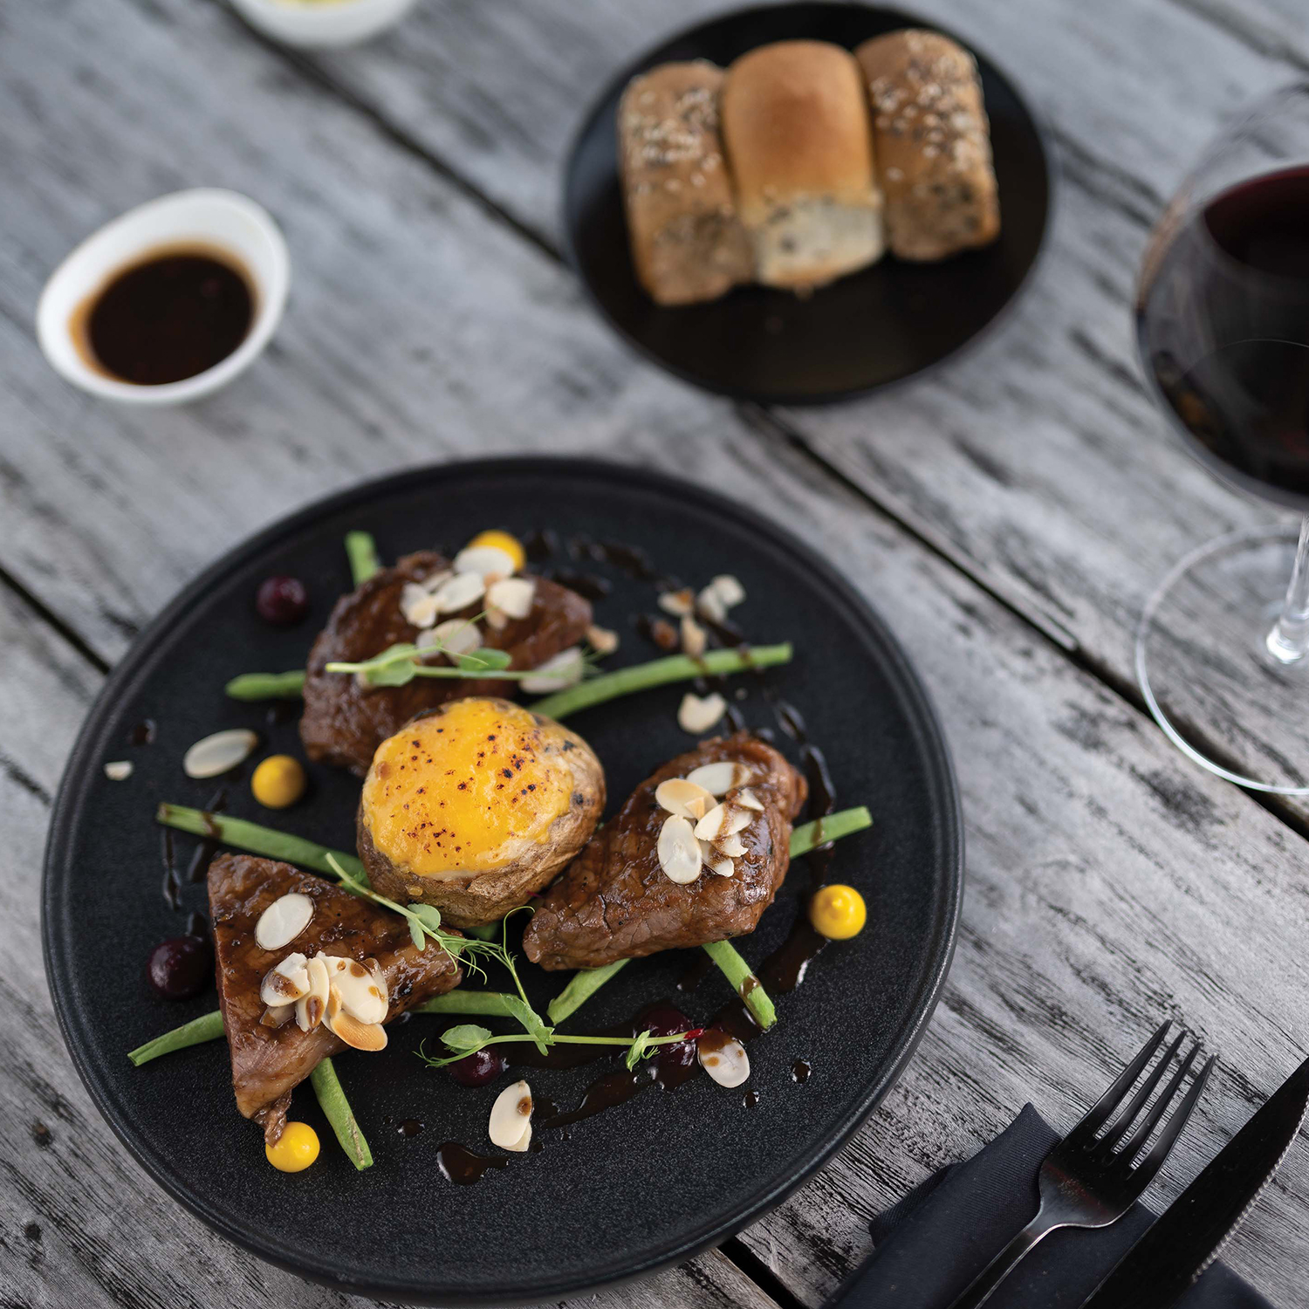
The VARU Plan™
Specialty Fine Dining
CHARCOAL ** – Beach Grill – 38 Covers
Choose from a wide selection of appetizers, salads, kabab platters or classic entrees like Filet Mignon, Sirloin Steak, Ribeye, or Bourbon Baby Back Ribs. Bid adieu to a memorable meal with a Stewed Apricot Crème brûlée. Enjoy ‘à la carte’ beach dinner with aromatic char-grilled meat.
Operating hours (Pre-booking is required):
Dinner: 19:00hrs to 22:00hrs Everyday (except Fridays)
* Eligible only for four-night stays and above
VARU BY ATMOSPHERE

Slide 11
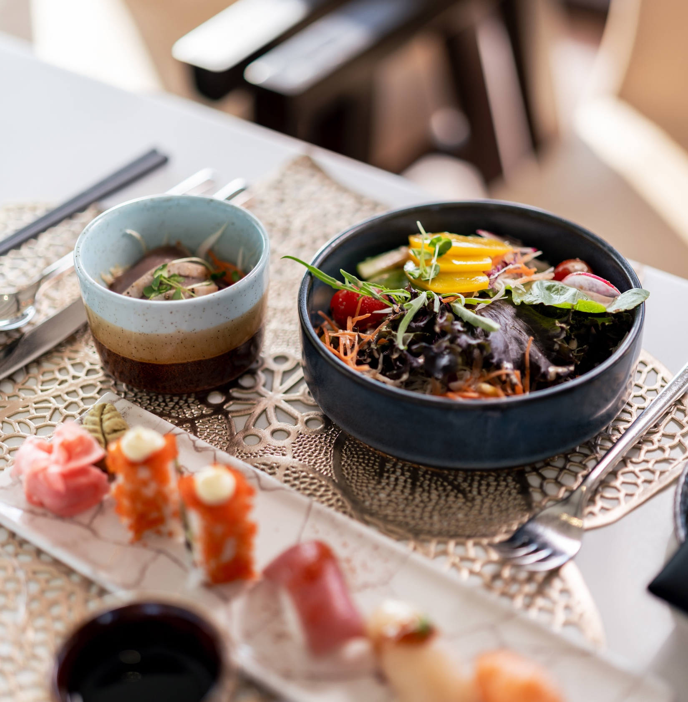
The VARU Plan™
Specialty Fine Dining
TEPPANYAKI OVER WATER *** – Authentic Japanese Cuisine– 06 Covers
Imagine Japan brought to your table, right in the heart of paradise. Enjoy seasoned chefs turn the art of Teppan grilling into a captivating performance, crafting premium seafood, wagyu, and sushi with precision and flair. Reserve a front-row feast to a sizzling spectacle
of playful flair and unforgettable flavors.
Operating hours (Pre-booking is required):
Lunch: 12:30hrs to 14:30hrs (open 6 days a week)
Dinner: 19:00hrs to 22:00hrs (open 6 days a week)
*** On chargeable basis
VARU BY ATMOSPHERE

Slide 12
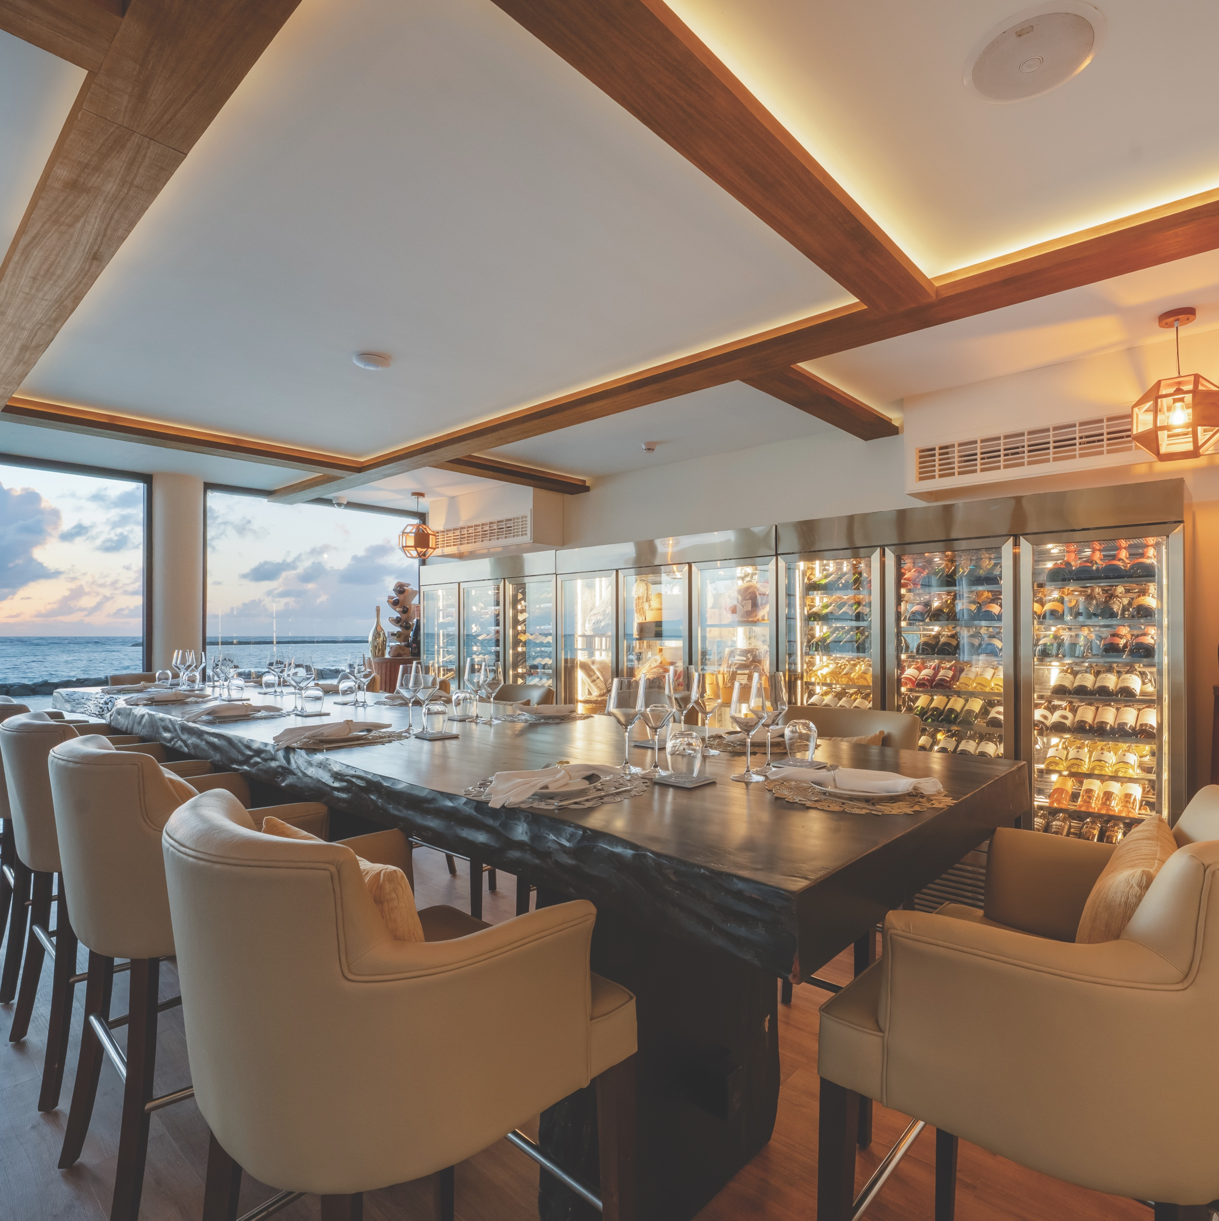
The VARU Plan™
Specialty Fine Dining
CELLAR AT NÜ*** – Overwater wine degustation lounge – 12 Covers
Cellar at NÜ invites you on an elevated overwater wine-and-dine journey. Discover an extensive selection, from legendary Champagne houses and iconic European vintages to bold New World labels. Savour each pour alongside cheese and charcuterie platters and
decadent chocolate bites, or indulge in the full dinner experience with an exclusive six-course paired dégustation menu. An exquisite addition to your stay, perfect for celebrating life’s finest flavours in evenings that sparkle a little brighter.
Operating hours (Pre-booking is required):
Dinner: 18:00hrs to 22:00hrs (open 6 days a week)
*** On chargeable basis
VARU BY ATMOSPHERE

Slide 13
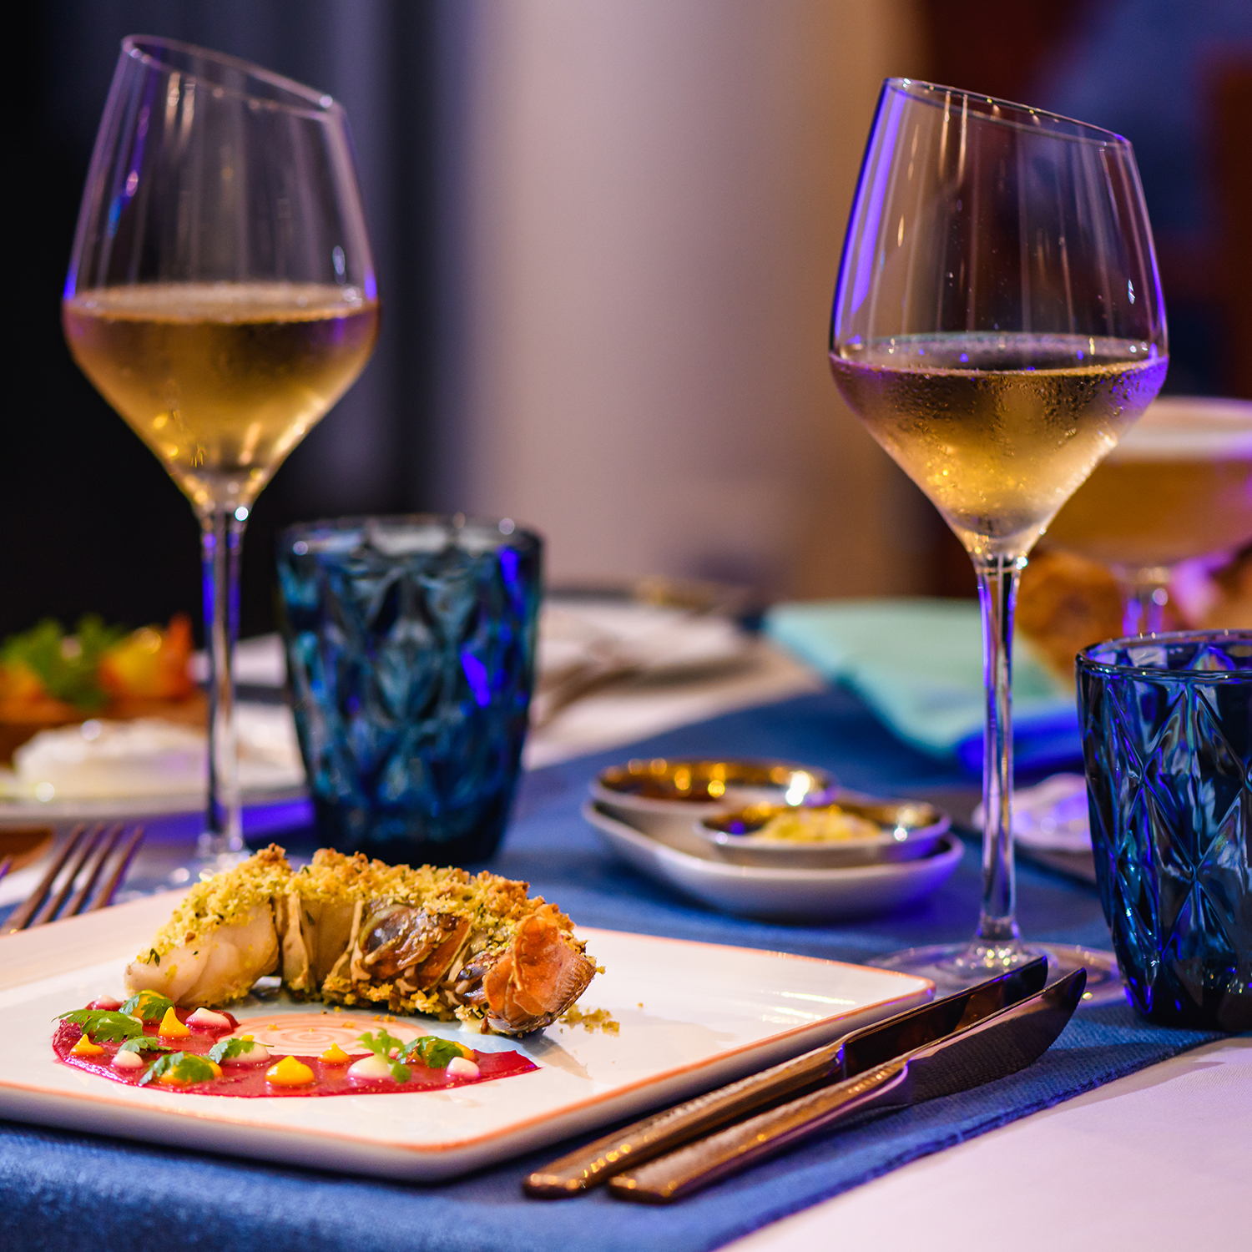
The VARU Plan™
Beverages
Premium brands of spirits, wines, and beers at Bay Rouge, Lime & Chili, Charcoal, Nü, Teppanyaki Over Water, and Kaagé
The VARU Plan™ Cocktails, Spirits & Beer Menu features:
  Premium brands of spirits, wines, and beers
  Unlimited cocktails and signature drinks
  Mocktails, seasonal fresh fruit juices, soft drinks, mineral water, and a variety of tea and coffee
The VARU Plan™ Wines & Bubbles Menu features:
  Global selection of over 40+ wines from renowned vineyards
VARU BY ATMOSPHERE

Slide 14
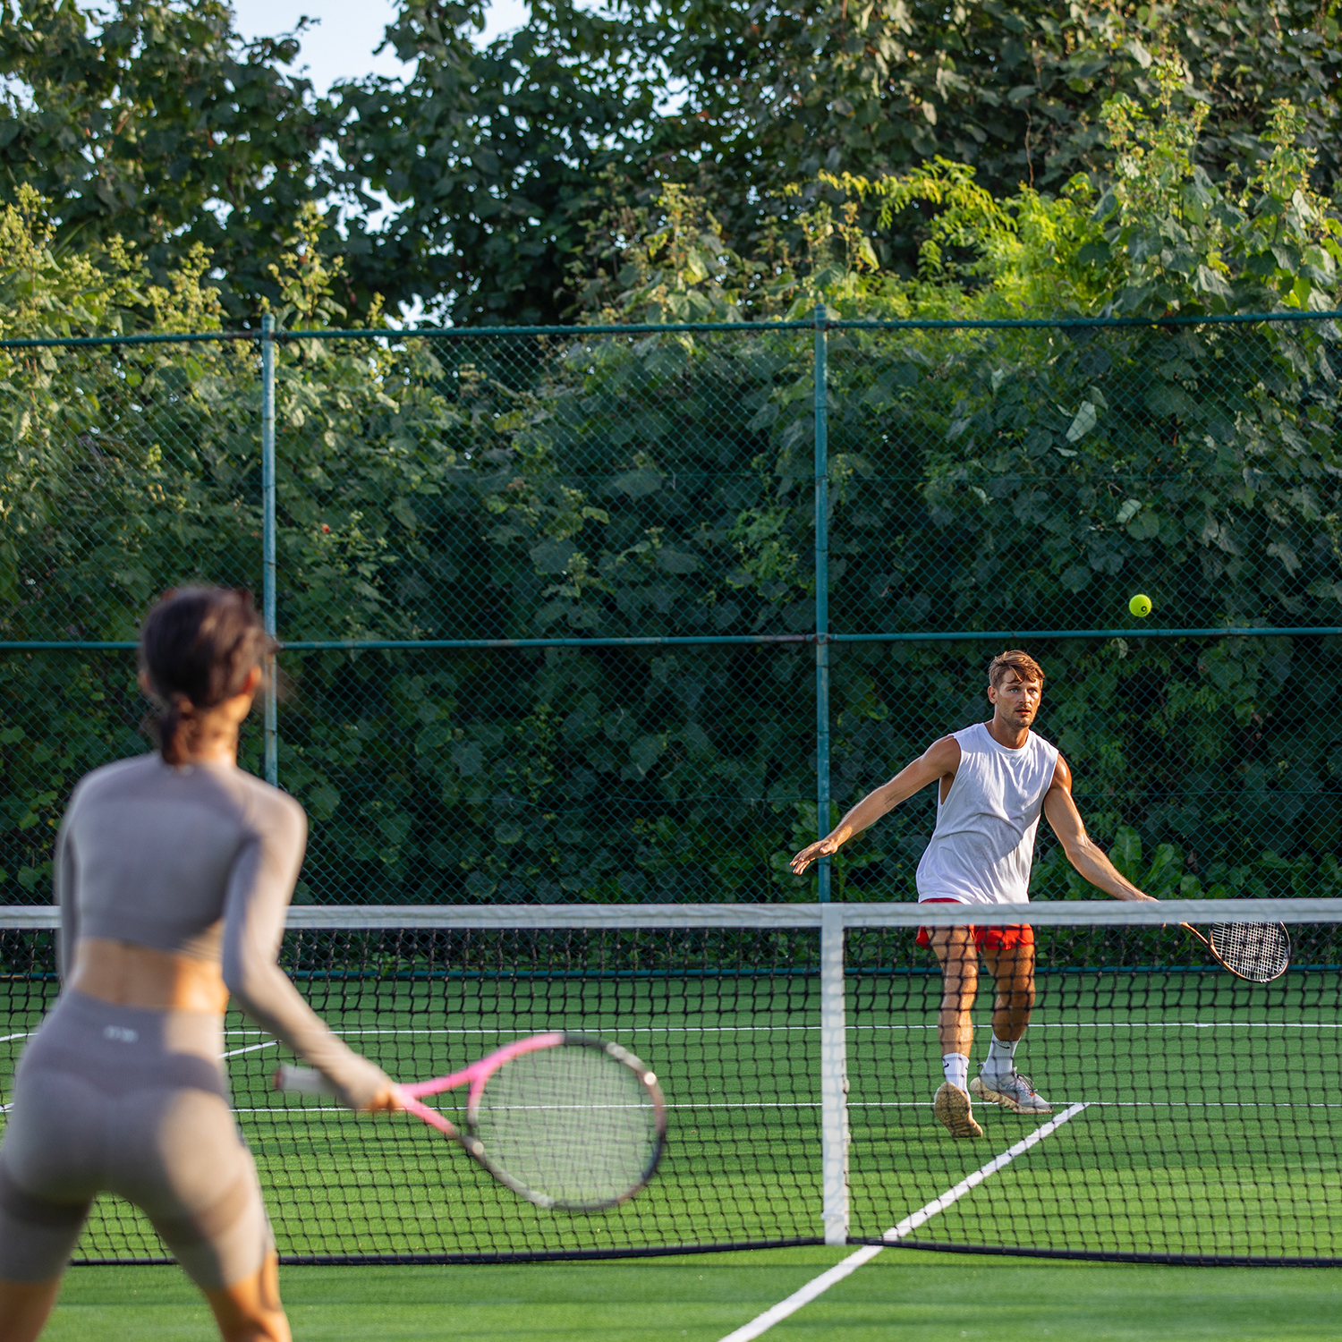
The VARU Plan™
Activities & Adventure
DISPORT – Sports & Recreation Centre
Complementary access to a fully equipped gymnasium, outdoor and indoor recreational activities, flood-lit tennis court, badminton, and beach-volley to keep you active
Weekly and seasonal group activities including yoga, Pilates, strength training, and more
ON THE MOVE – Kids Club
A host of fun activities and learning experiences organized daily, especially for kids
ENTERTAINMENT
Daily DJ Music or live entertainment
Engaging events organized on a weekly and seasonal basis
VARU BY ATMOSPHERE

Slide 15
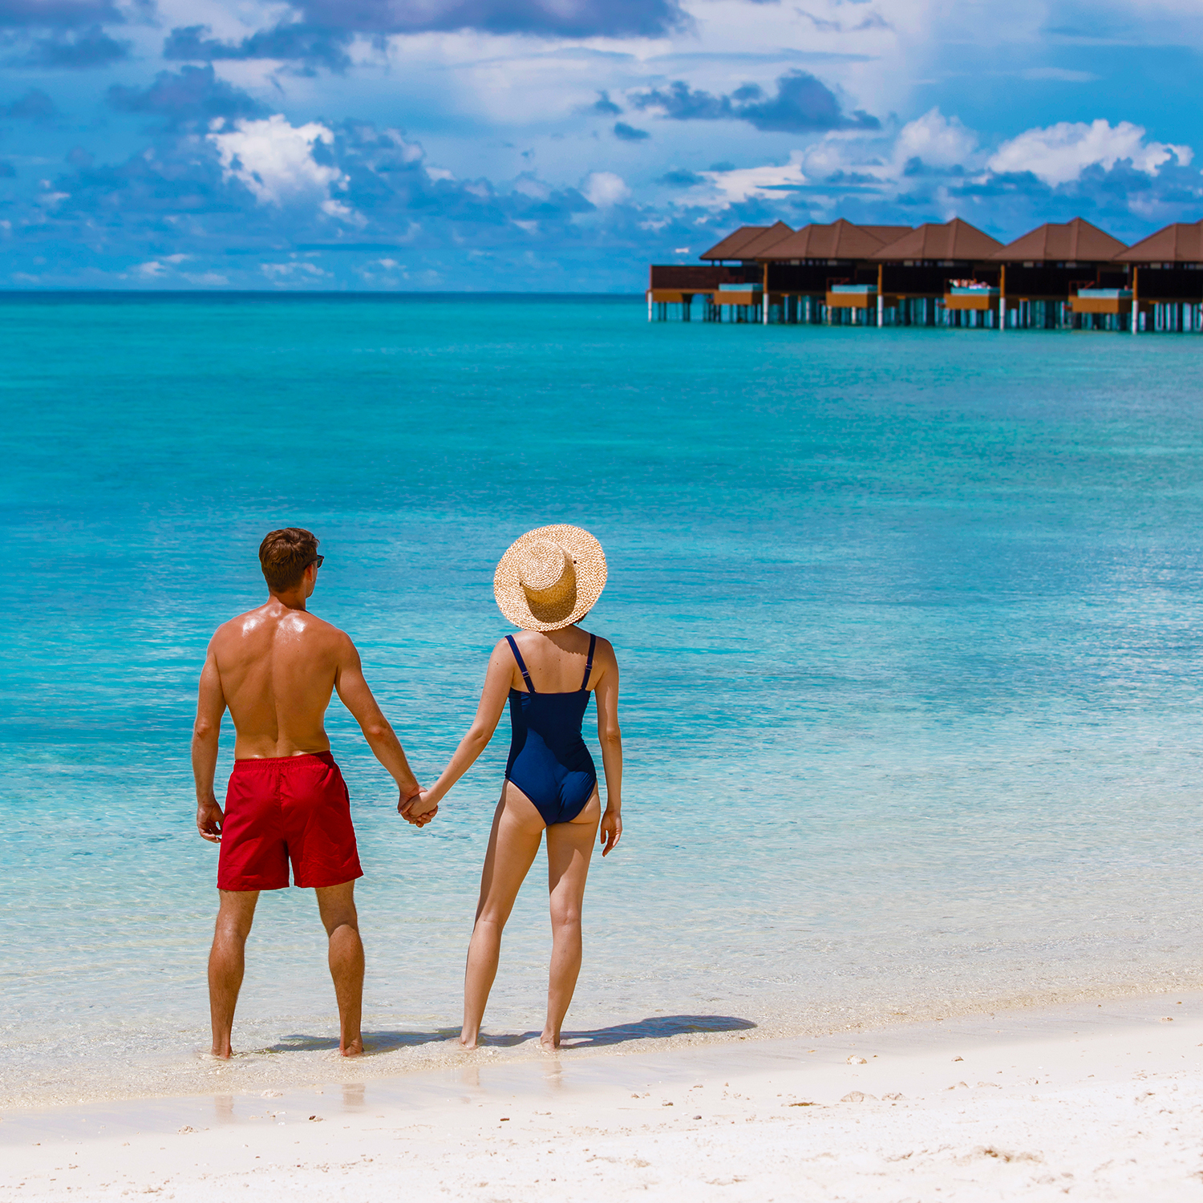
The VARU Plan™
Activities & Adventure
SNORKELING AND WATERSPORTS
Complimentary use of non-motorized water sports throughout the stay. Includes *Windsurf, Stand Up Paddle Boards, Canoes, Water Bikes, Waterlogs, and Water Castle Weekly and seasonal group activities
  * Guests must clear a windsurfing competence check to avail the Windsurf
Complimentary snorkeling equipment for all guests throughout their stay
TWO snorkeling excursion shuttles daily to selected sites nearby**
  **On pre-registration basis, weather permitting
20% Discount on first TWO regular dives** per guest
EXCURSIONS**
Sunset fishing ONCE per guest during stay
ONE Complimentary excursion per guest from a selection of excursions:
  Sunset Cruise
  Stargazing cruise
** Weather permitting
VARU BY ATMOSPHERE

Slide 16
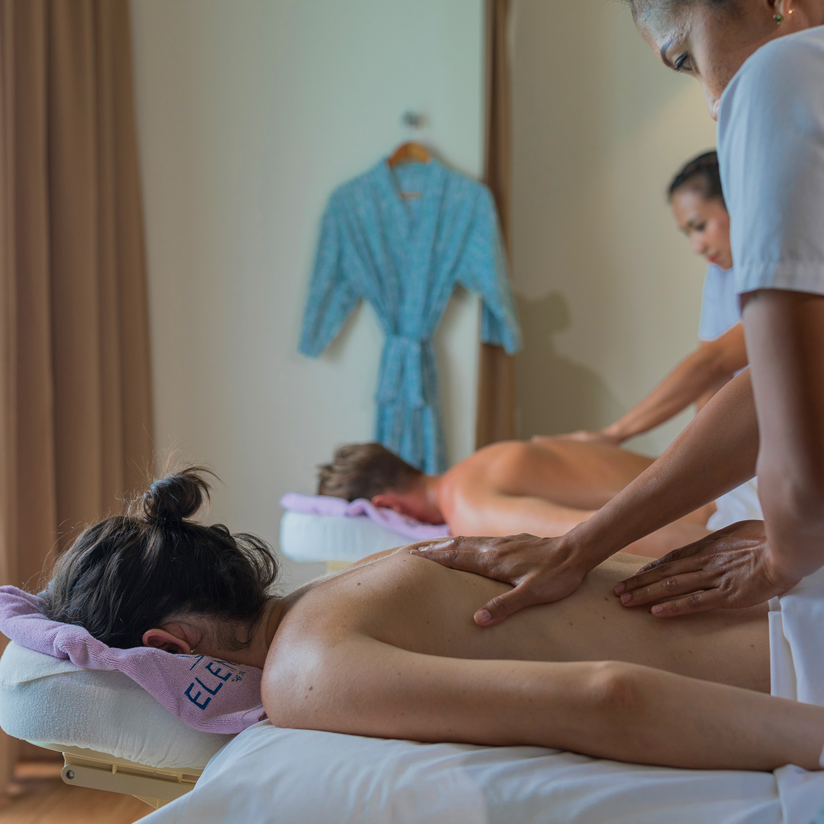
The VARU Plan™
Additional Services:
ELE|NA AYUR**
The overwater ELENA Spa at VARU offers a range of holistic treatment inspired by natural elements, that nourish the mind, body, and soul
**Eligible per person per stay for adults (18 years & above) depending on the duration of the stay:
  4-7 nights stay: ONE 45-minute spa treatment
  8-11 nights stay: TWO 45-minute spa treatment
  12-15 nights stay: THREE 45-minute spa treatment
  16-19 nights stay: FOUR 45-minutes spa treatment
**Additional Spa Services is for EVERY FOUR NIGHTS OF STAY
IN VILLA MINIBAR
Replenished DAILY with an assortment of wines, beer, soft beverages, and snacks
VARU BY ATMOSPHERE

Slide 17
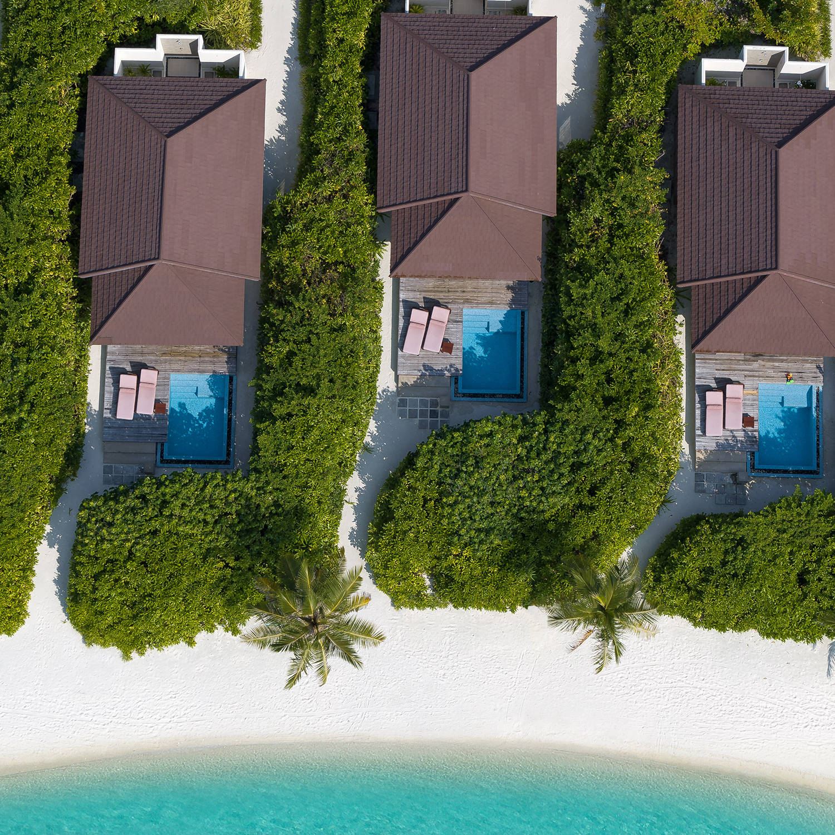
Beach Villas
Beach Villa – 16 units - 75m²
Beach Villa with Pool - 15 units - 90m² with 10m² Pool
All villas have direct access to the surrounding pristine white sandy beaches views of the ocean beyond.
Villas come with spacious interiors and outdoor decks surrounded by lush green vegetation. Interiors are appointed with natural materials of wood and stone, minimalistic design with splashes of colours and decorative items.
Each villa comes with traditional open-air bathrooms and luxurious interiors and furnishings. Guests have the option of enjoying a 10m² private pool on the deck!
Maximum Villa Occupancy
2 Adults + 1 Child or 3 Adults
VARU BY ATMOSPHERE

Slide 18
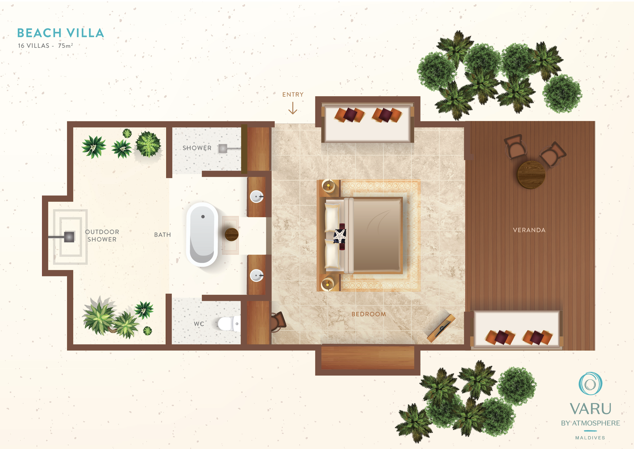
Beach Villa
VARU BY ATMOSPHERE

Slide 19
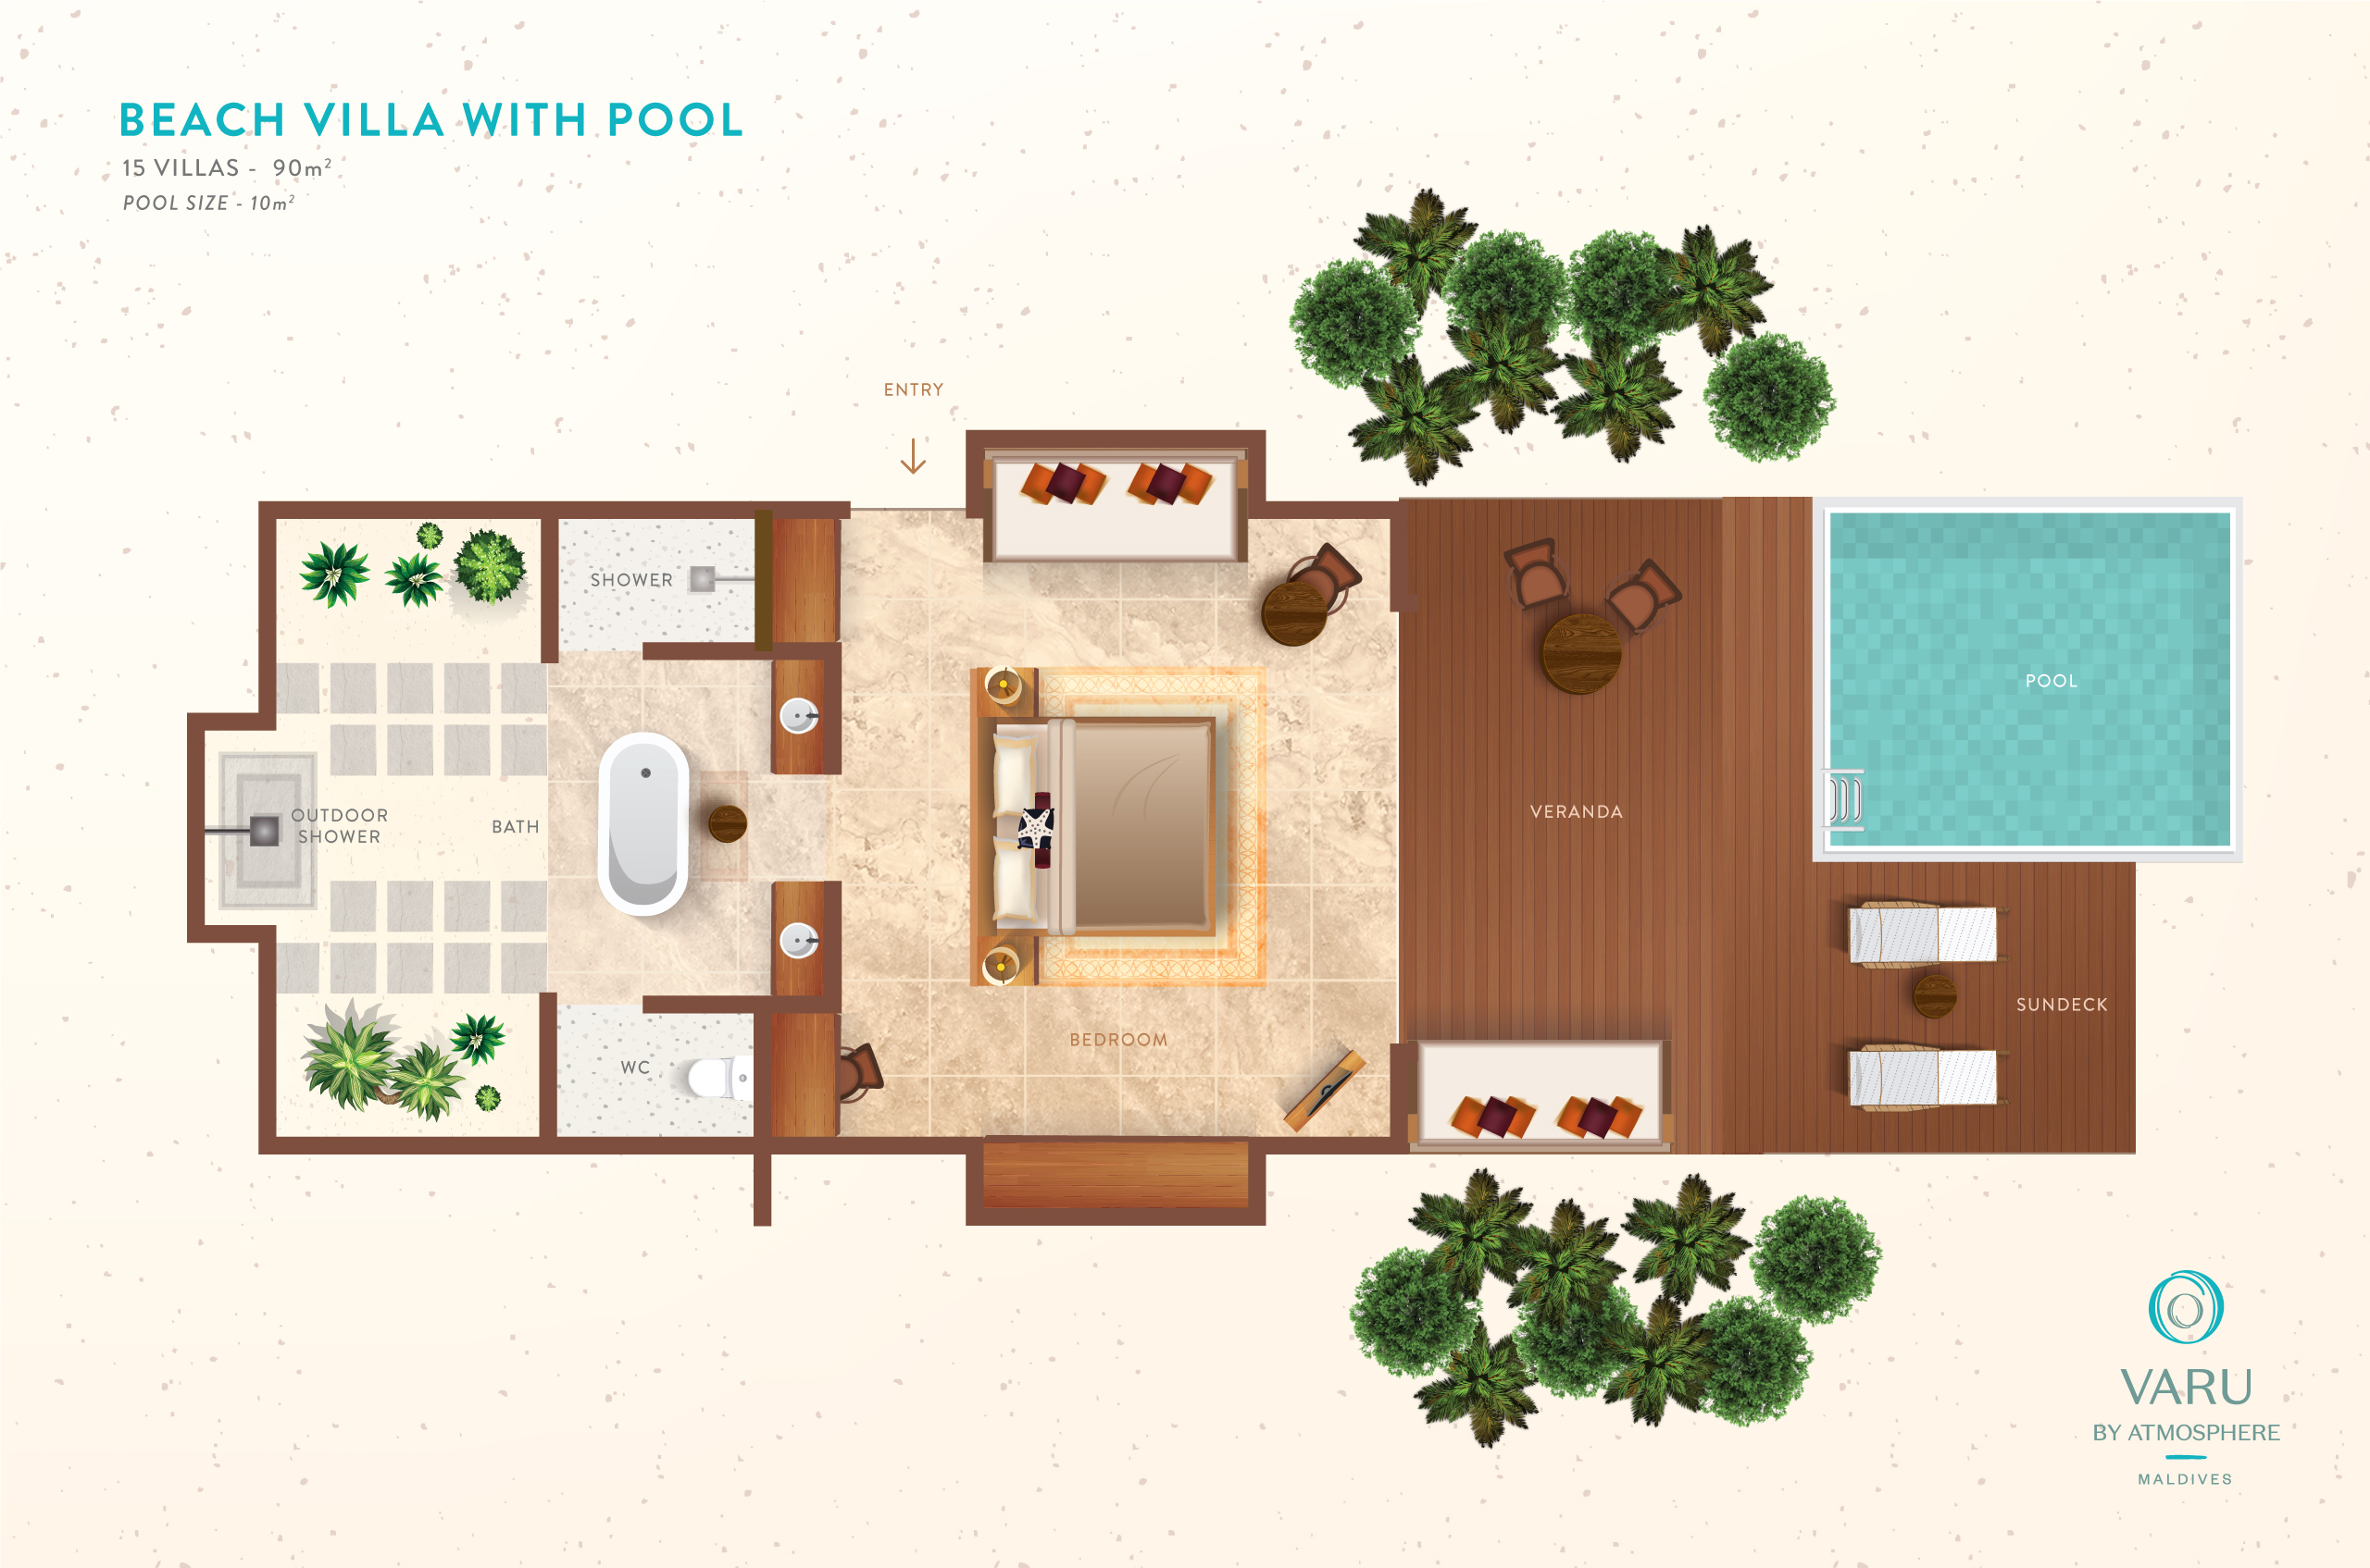
Beach Villa with Pool
VARU BY ATMOSPHERE

Slide 20
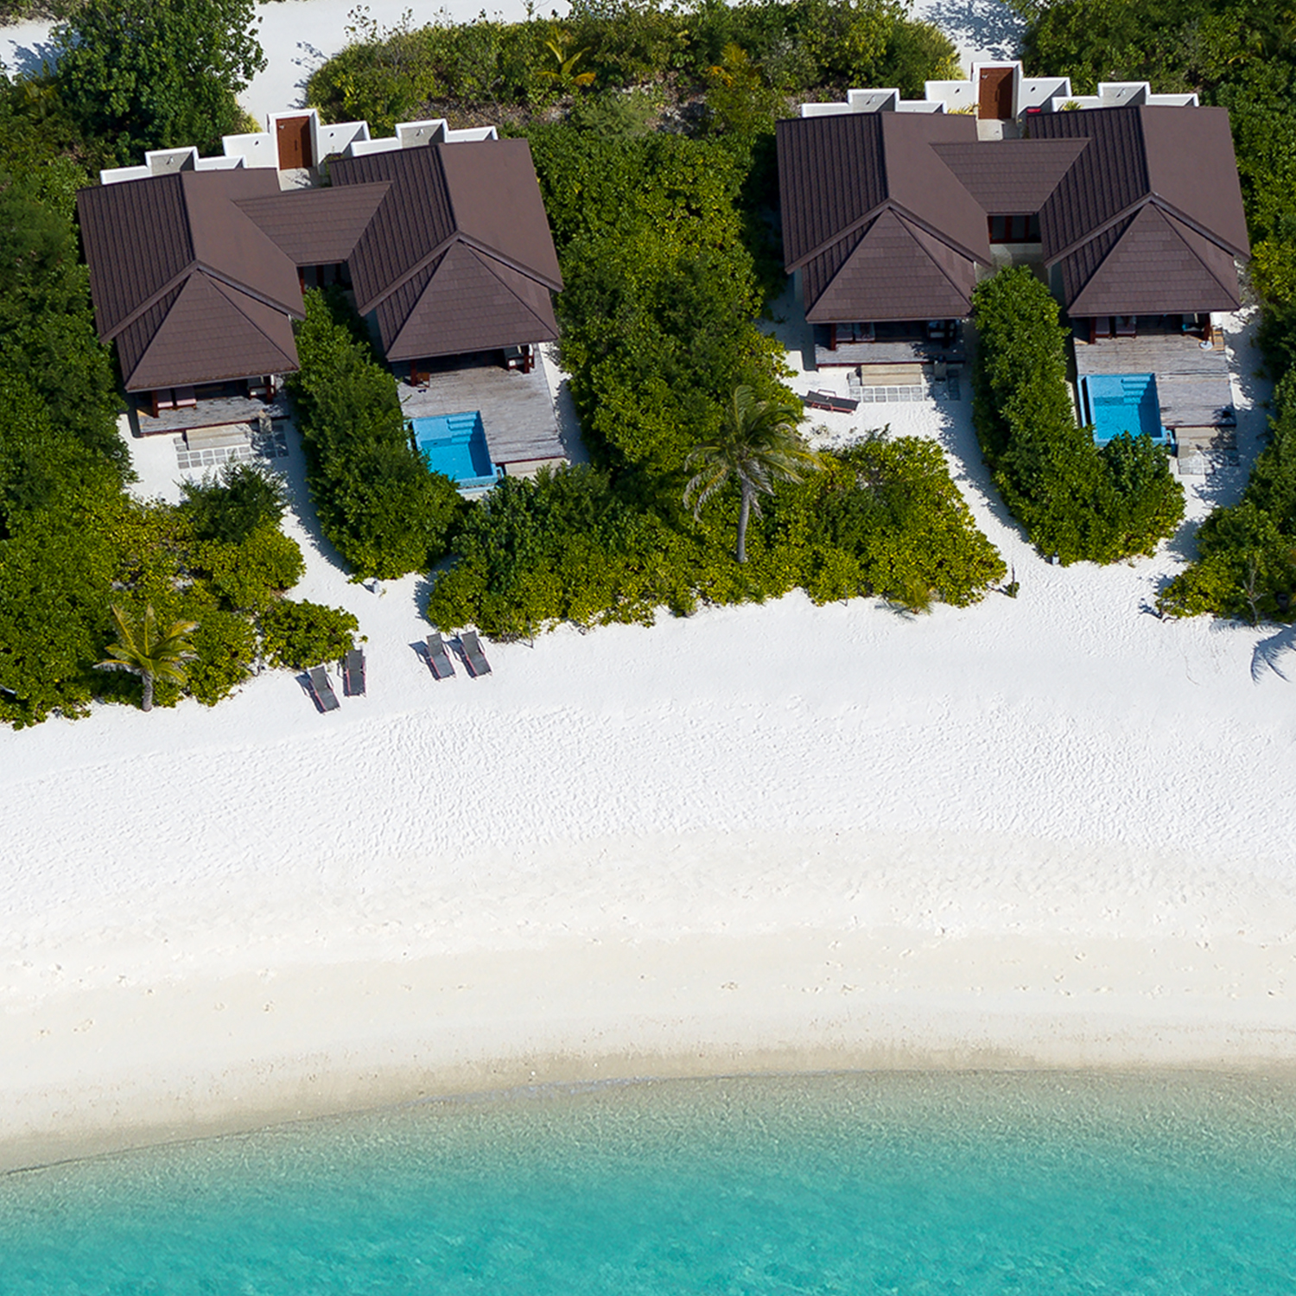
2-Bedroom Beach Villas with Pool
2-Bedroom Beach Villas with Pool - 08 units - 175m² with 10m² Pool
Open a beautiful wooden door, your portal to a picturesque island hideaway. These beach front villas come with two inter-connected bedrooms is perfect for group travelers and families travelling to the Maldives with up to four children.
Exceptionally spacious interiors with plush furnishing and Maldivian design touches create a stylish indoor space where you can unwind, read, or enjoy quiet family time at our Maldives private beach villas.
These villas comes with a 10m² private plunge pool and a wooden sundeck outside the master bedroom veranda, flanked by a lush tropical garden and the beach beyond.
Maximum Villa Occupancy
4 Adults + 2 Children OR 3 Adults + 3 Children OR 2 Adults + 4 Children
VARU BY ATMOSPHERE

Slide 21
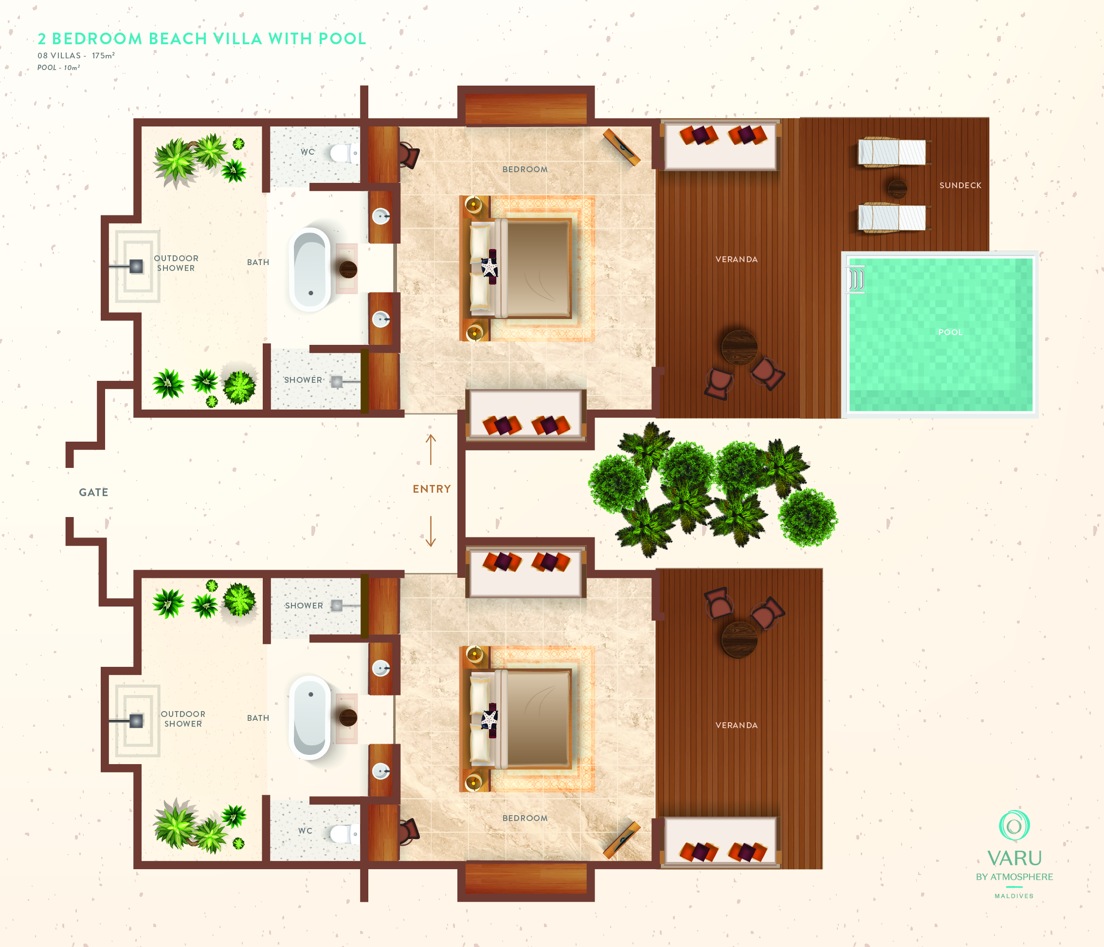
2-Bedroom Beach Villa with Pool
VARU BY ATMOSPHERE

Slide 22
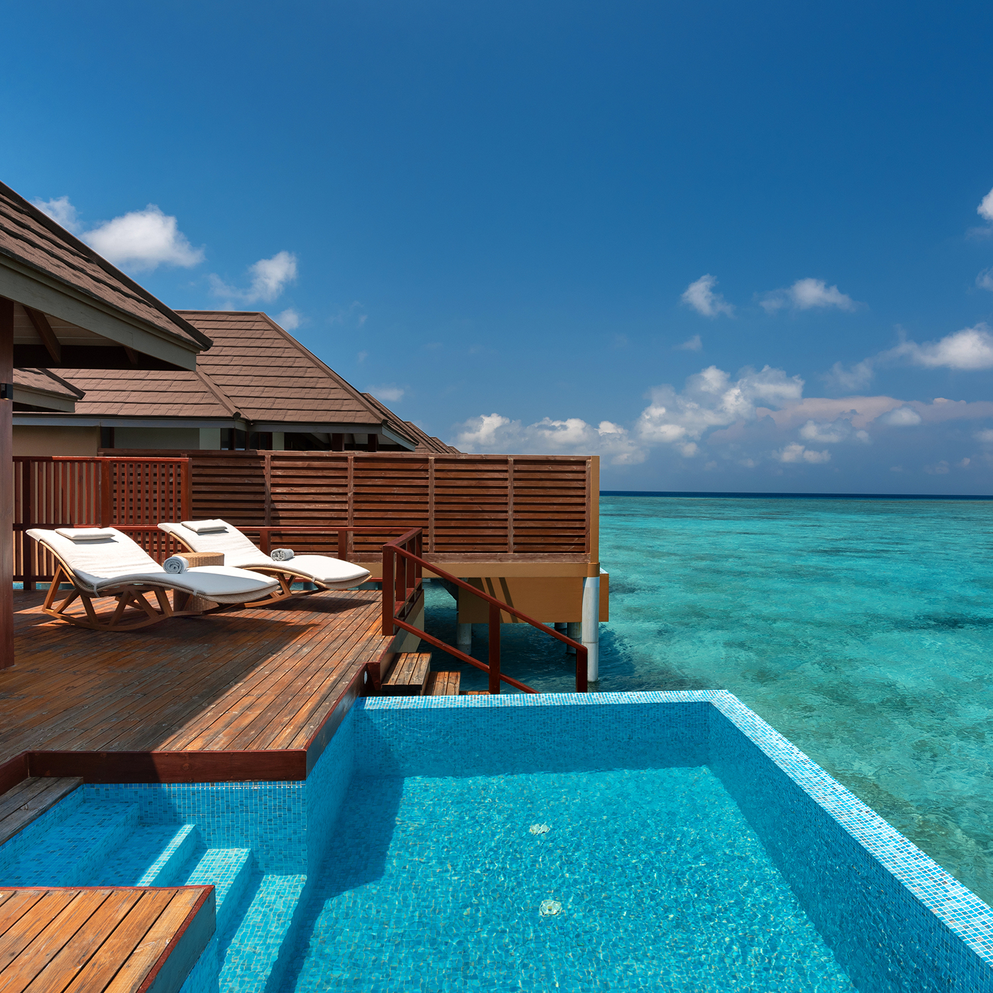
Water Villas
Water Villa – 29 units - 95m²
Water Villa with Pool - 39 units - 95m² with 10m² Pool
Escape to an enchanting retreat at our Maldives Overwater pool villa a moment from the crystal-clear turquoise lagoon. This meticulously designed space offers the best of modern living with state of the art comforts.
Everything here echoes the exotic Indian Ocean surroundings of the island – from Maldivian style interiors to appealing tropical highlights.
For Water Villas with Pool - the spacious veranda comes with a private 10m² infinity pool – perfect for a refreshing swim surrounded by the romantic lagoon views.
Maximum Villa Occupancy
2 Adults + 1 Child
VARU BY ATMOSPHERE

Slide 23
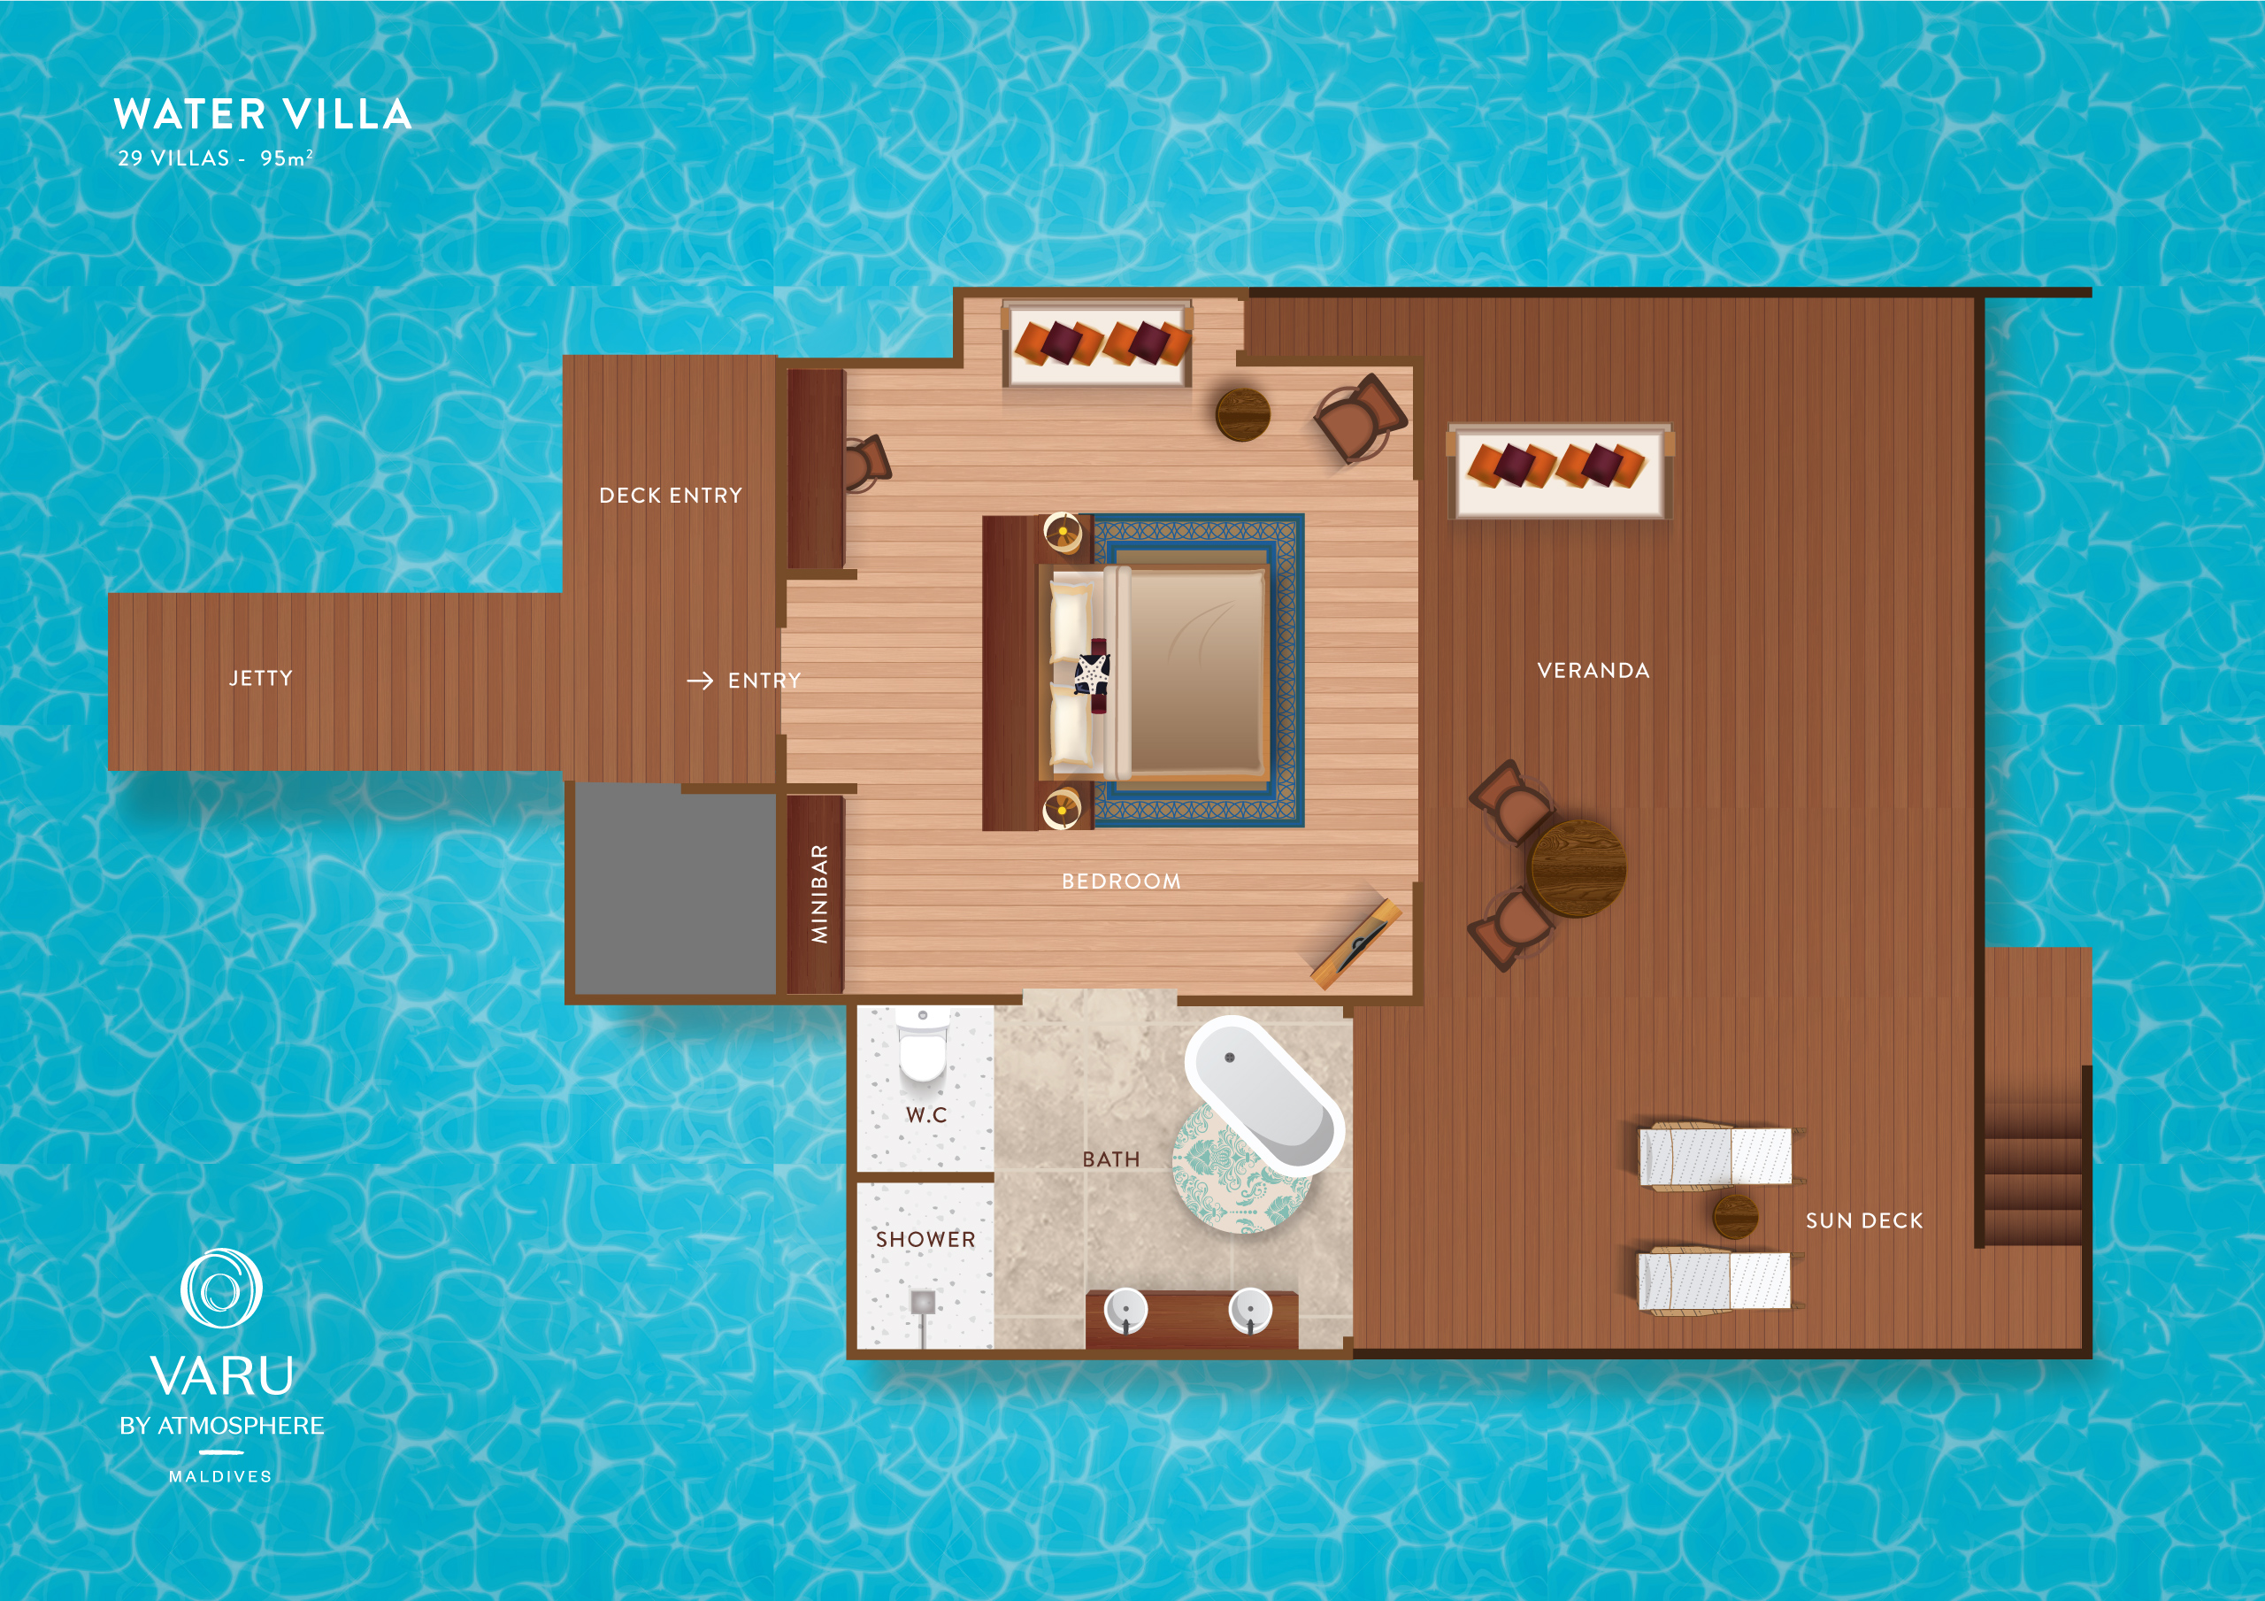
Water Villa
VARU BY ATMOSPHERE

Slide 24
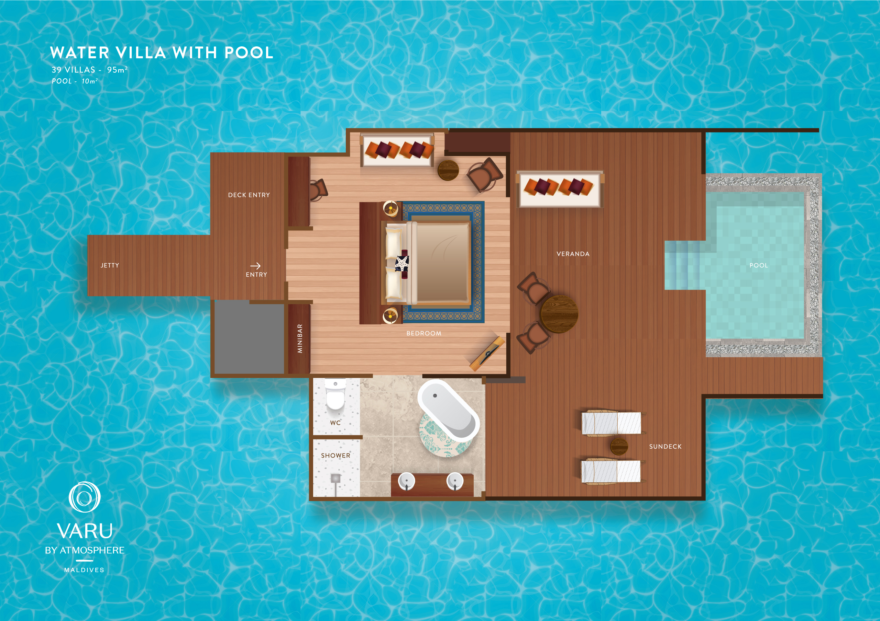
Water Villa with Pool
VARU BY ATMOSPHERE

Slide 25
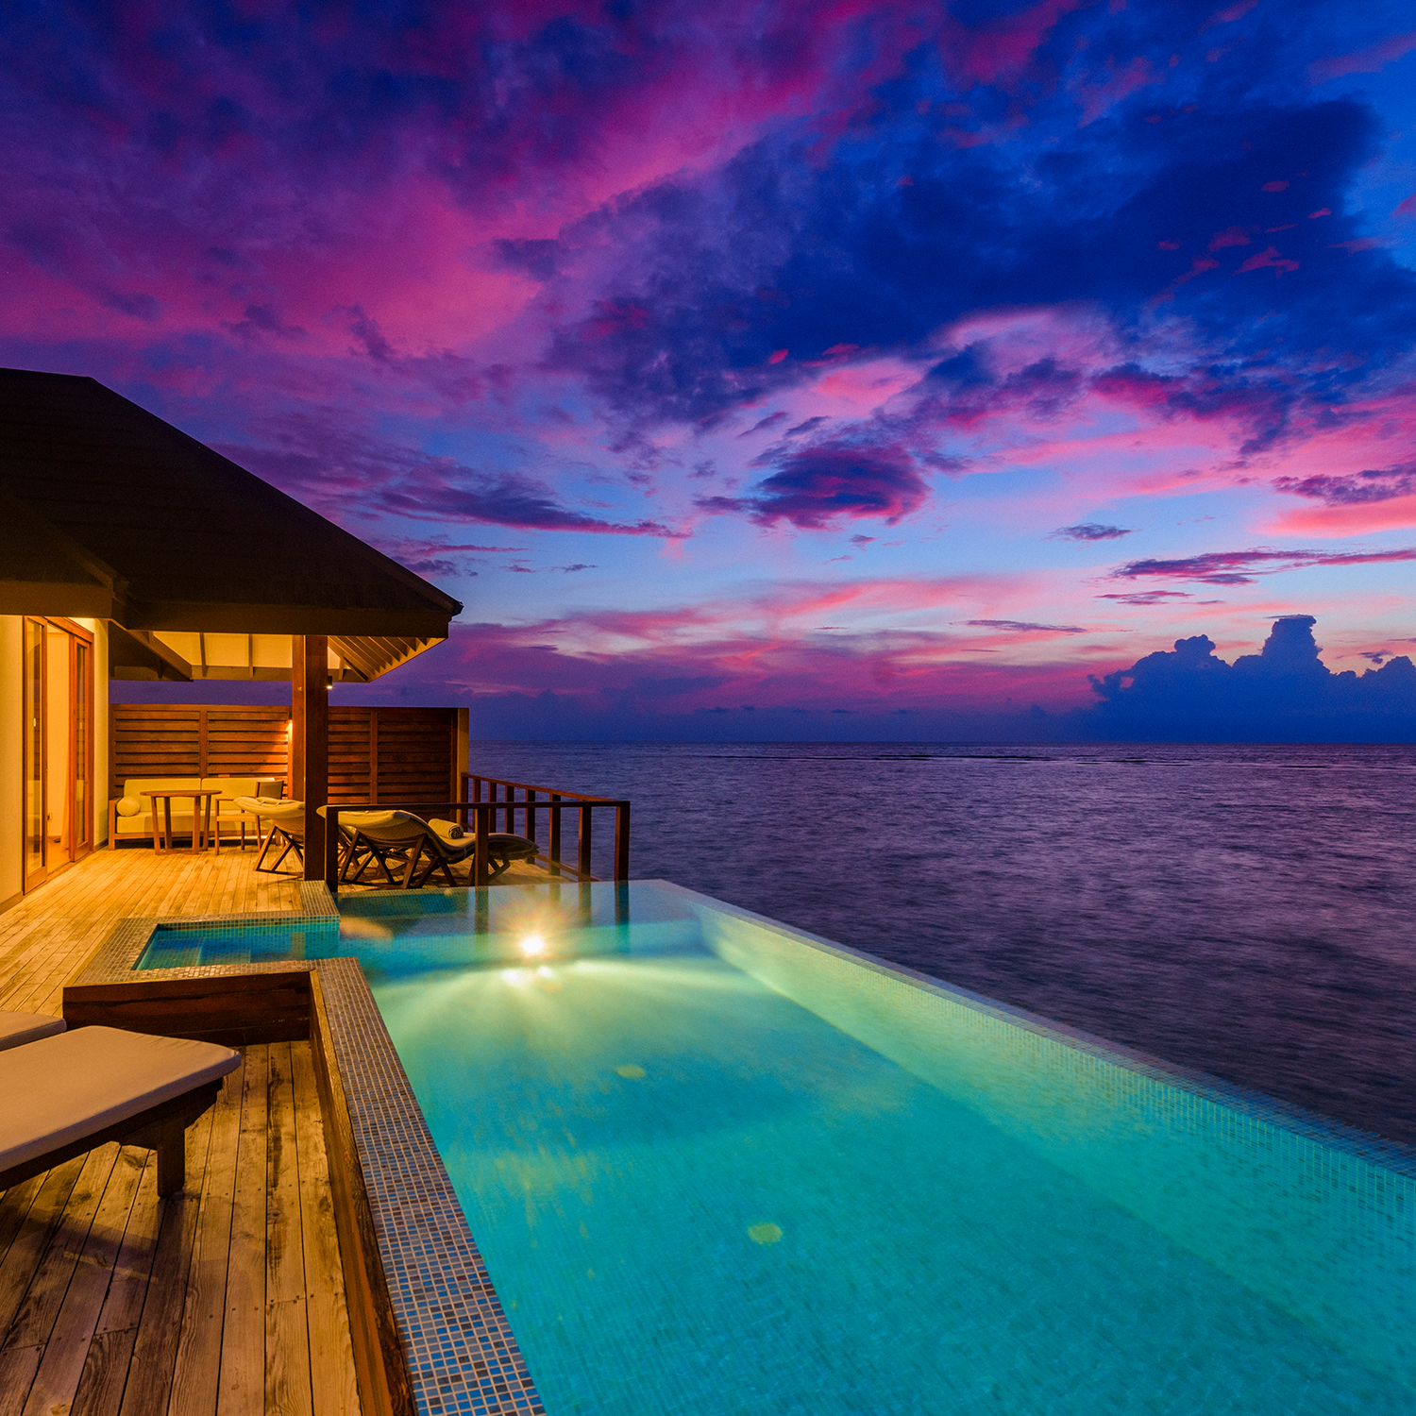
The Water Suite
The Water Suite – 01 unit – 155m² with Pool 15m²
Stay in an aquatic paradise. Located at the end of a wooden jetty this stand-alone Water Suite offers uninterrupted sunset views and absolute privacy for a truly romantic lagoon stay.
Interiors feature a lavishly furnished master bedroom, a living room with a pantry, and a luxurious bathroom. Enjoy special benefits like in-villa services.
Outside, the spacious terrace has comfy daybeds and a 15m² infinity pool. Curl up on the comfortable rattan sun loungers or sink into the inviting sofa on your private veranda, with the turquoise and azure waters stretching as far as the eyes can see. The warm lagoon with marine life is just a few steps away from your private deck.
Maximum Villa Occupancy
2 Adults + 1 Child
VARU BY ATMOSPHERE

Slide 26
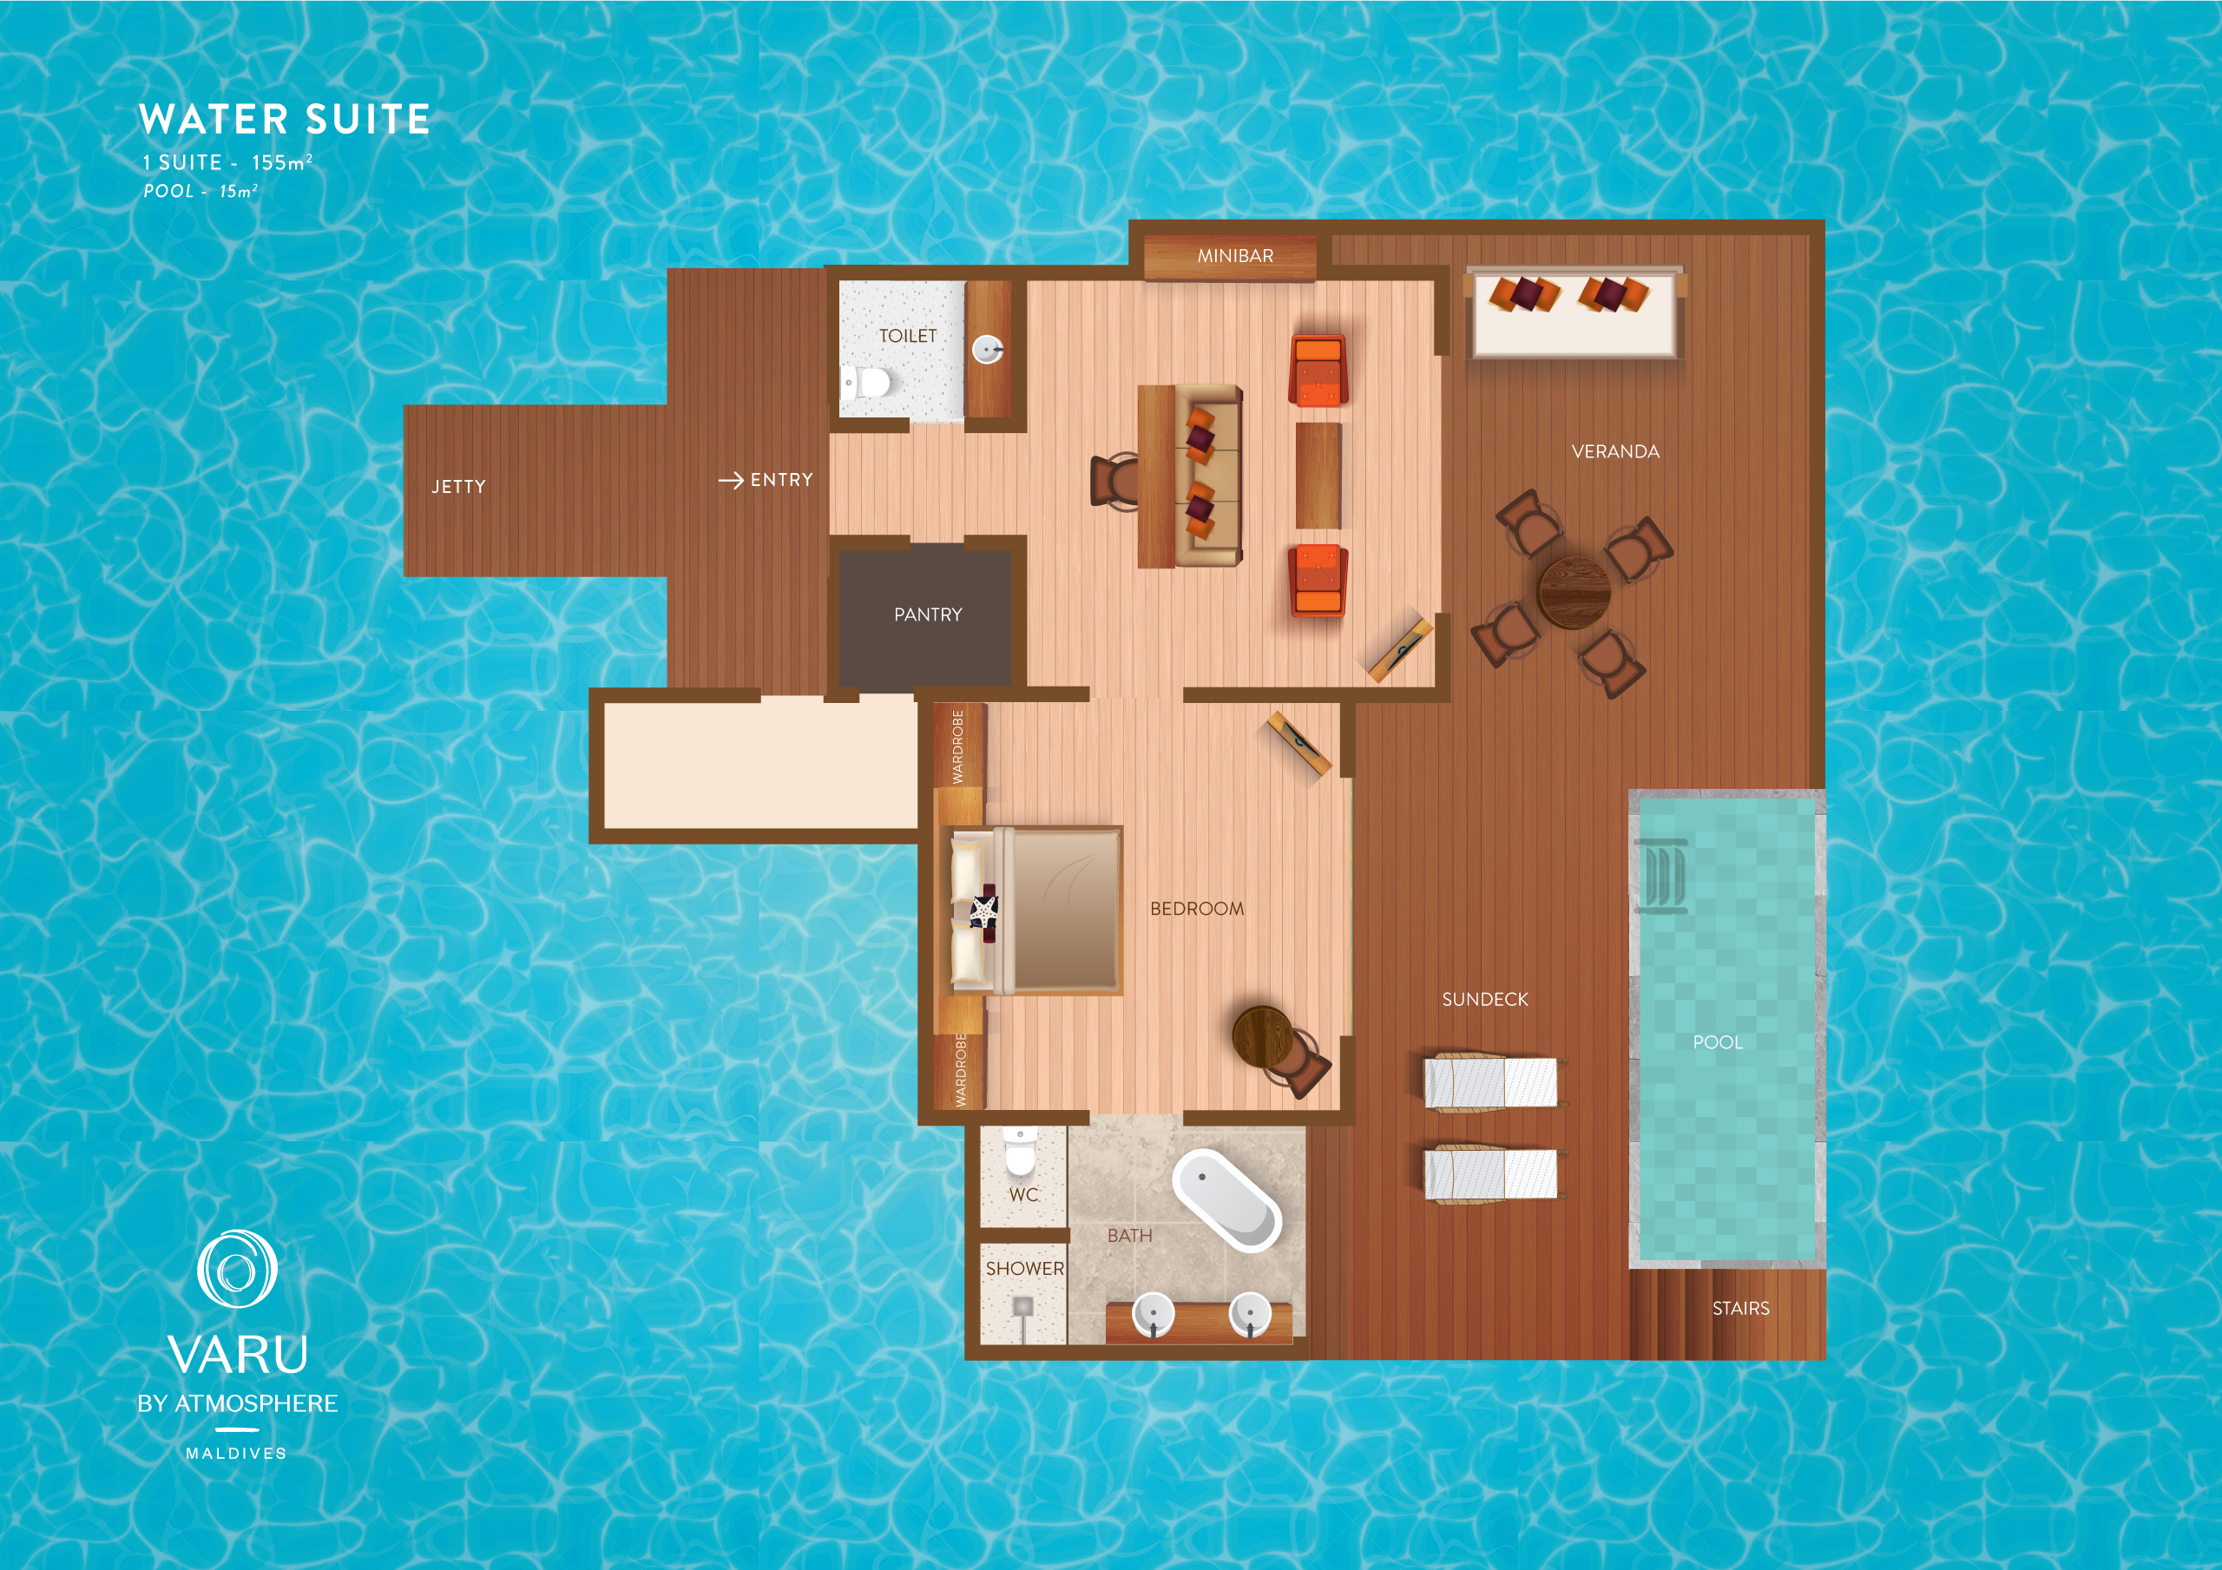
The Water Suite
VARU BY ATMOSPHERE

Slide 27
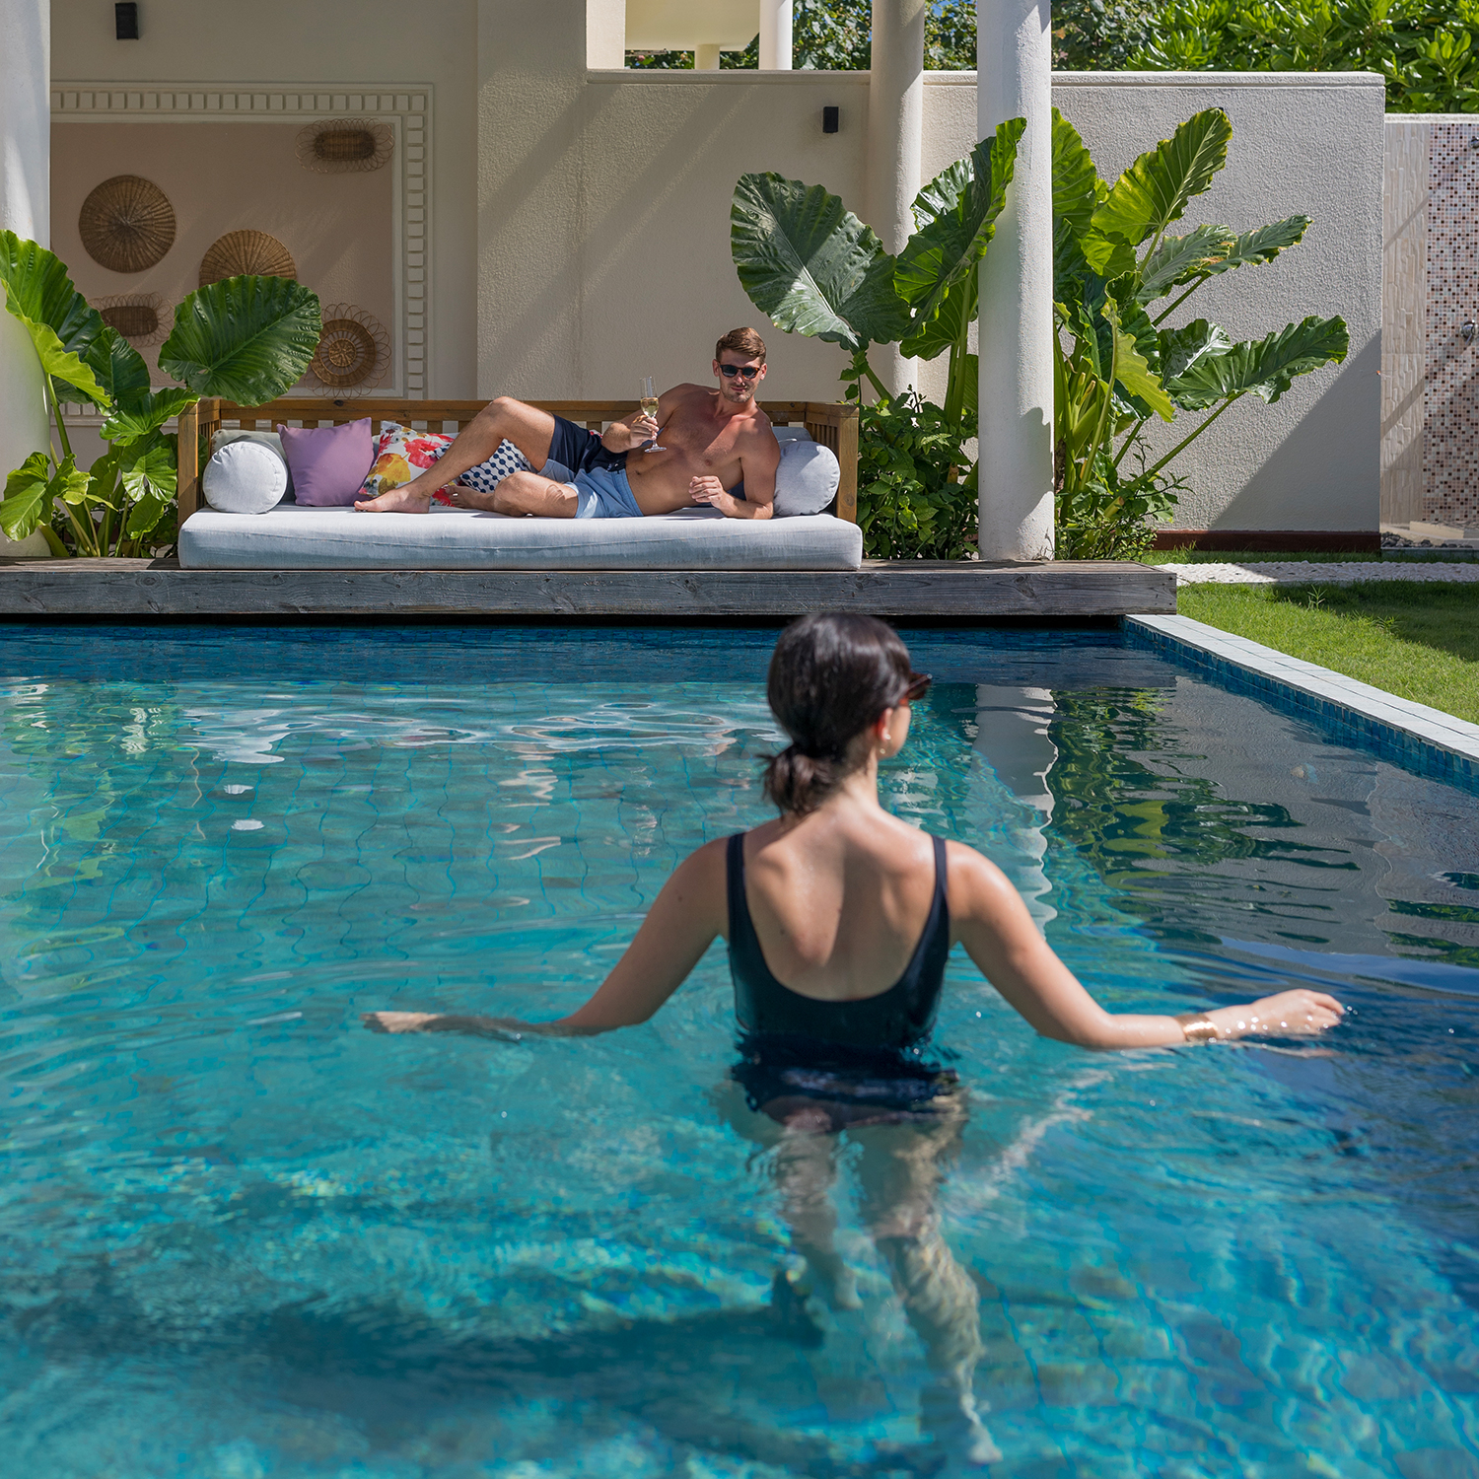
The Majlis Residence
The Majlis Residence – 03 units - 330m² with Pool 45m²
Surrounded by lush tropical gardens and with easy access to the beach, our three exclusive Majlis Residences are an oasis of tranquility.
Built around a beautiful courtyard with a stunning 45m² private plunge pool, this secluded suite offers two bedrooms, a master bedroom on the first floor and another on the ground floor. A vast ocean view living-cum-dining room with an adjoining mini-library and a bedroom for the au pair adds to the comfort.
With the soft sandy beach and shimmering lagoon just a few steps away, have a rendezvous with nature from the comfort of your beach hideaway.
Maximum Villa Occupancy
4 Adults + 2 Children OR 3 Adults + 3 Children OR 2 Adults + 4 Children
VARU BY ATMOSPHERE

Slide 28
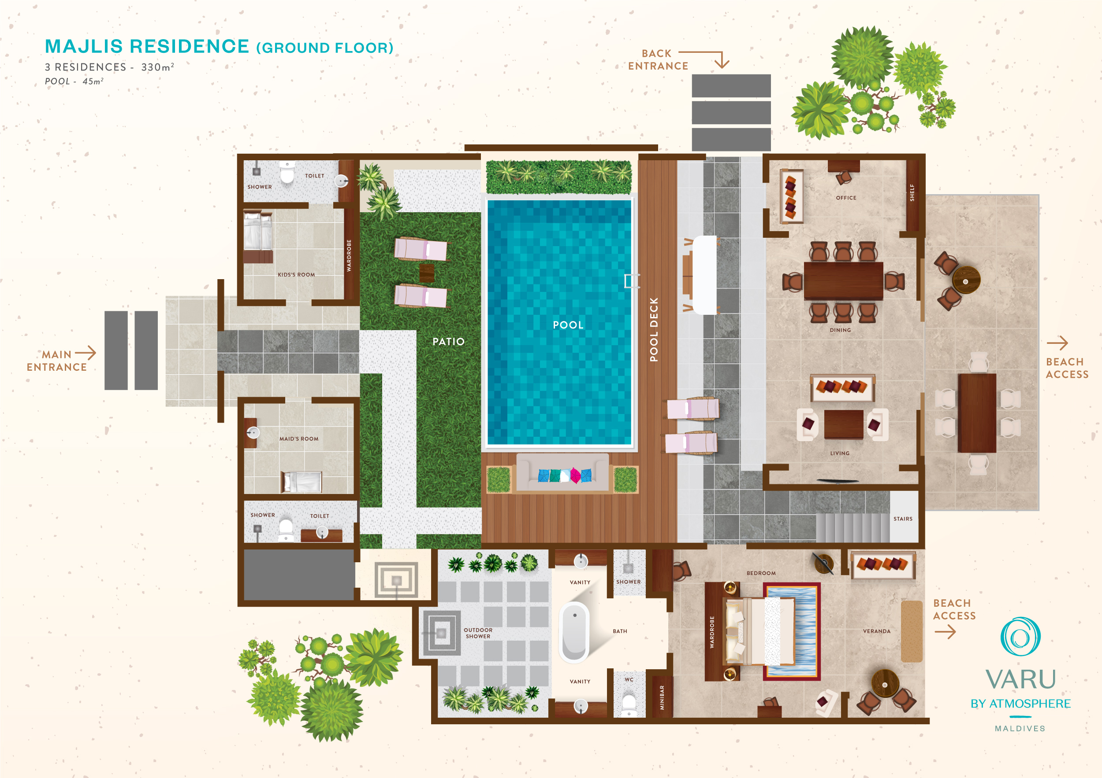
The Majlis Residence – Ground Floor
VARU BY ATMOSPHERE

Slide 29
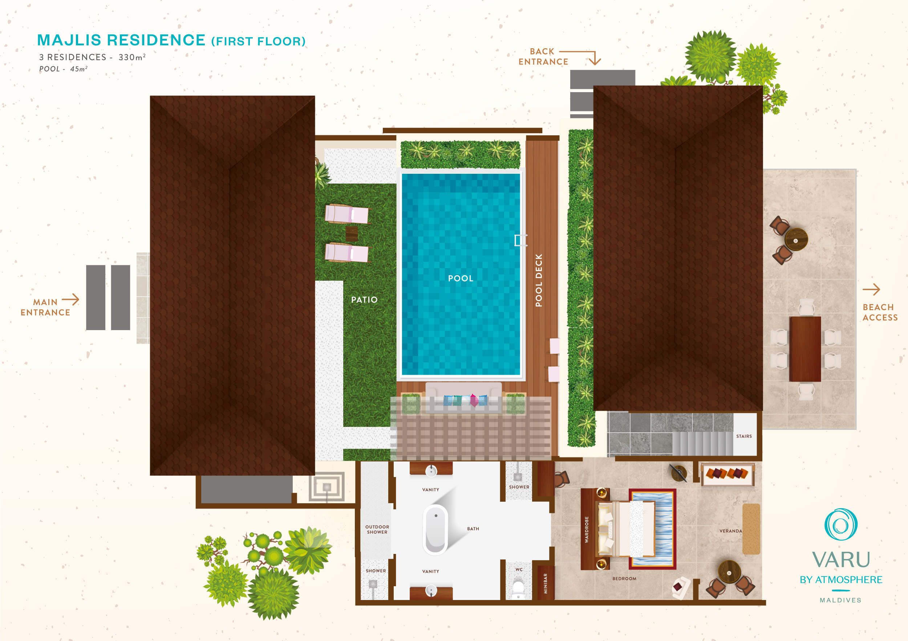
The Majlis Residence – First Floor
VARU BY ATMOSPHERE

Slide 30
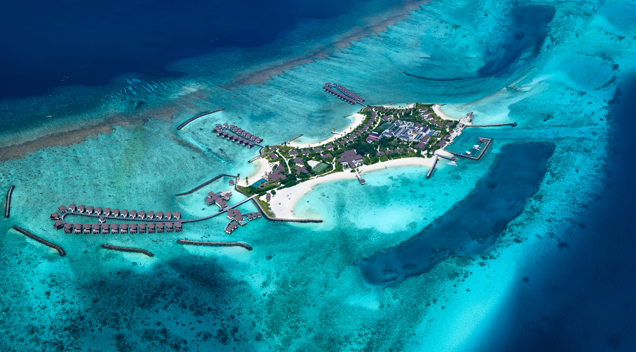
VARU BY ATMOSPHERE

Slide 31
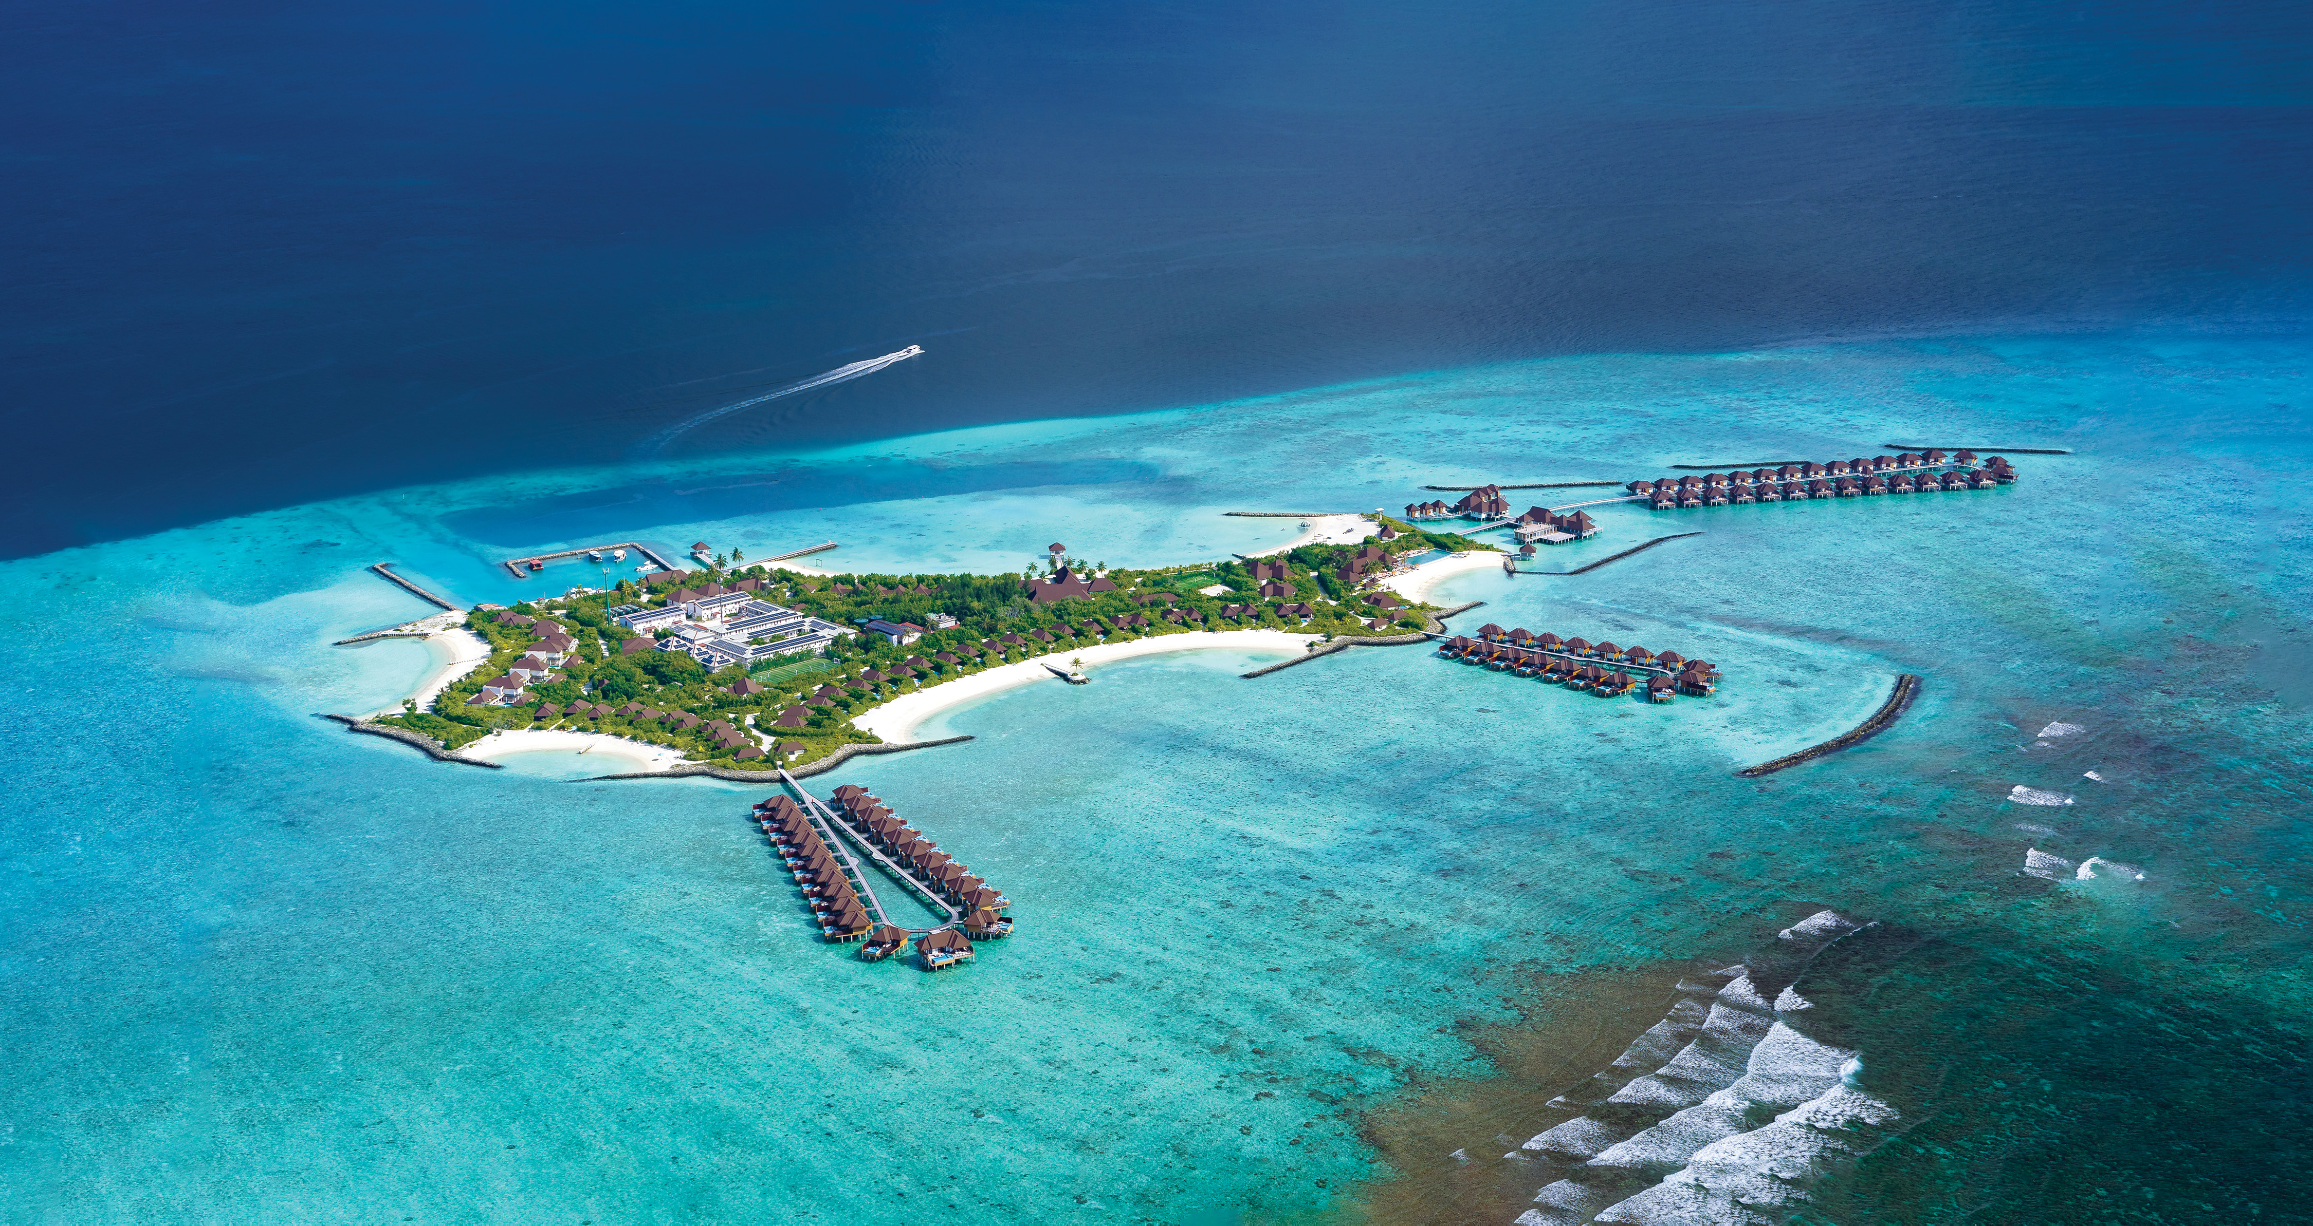
VARU BY ATMOSPHERE

Slide 32
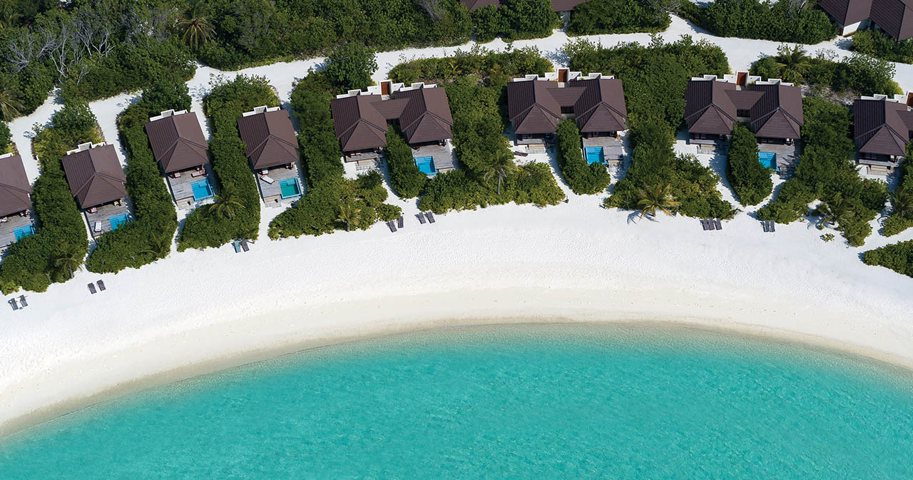
VARU BY ATMOSPHERE

Slide 33
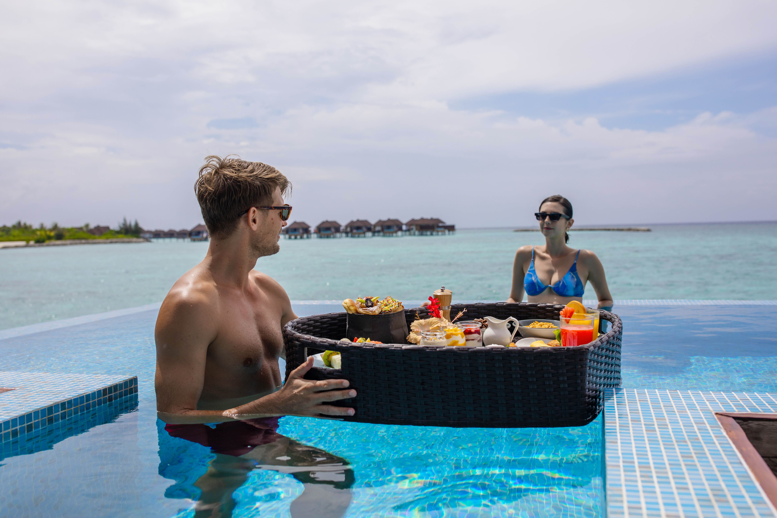
VARU BY ATMOSPHERE

Slide 34
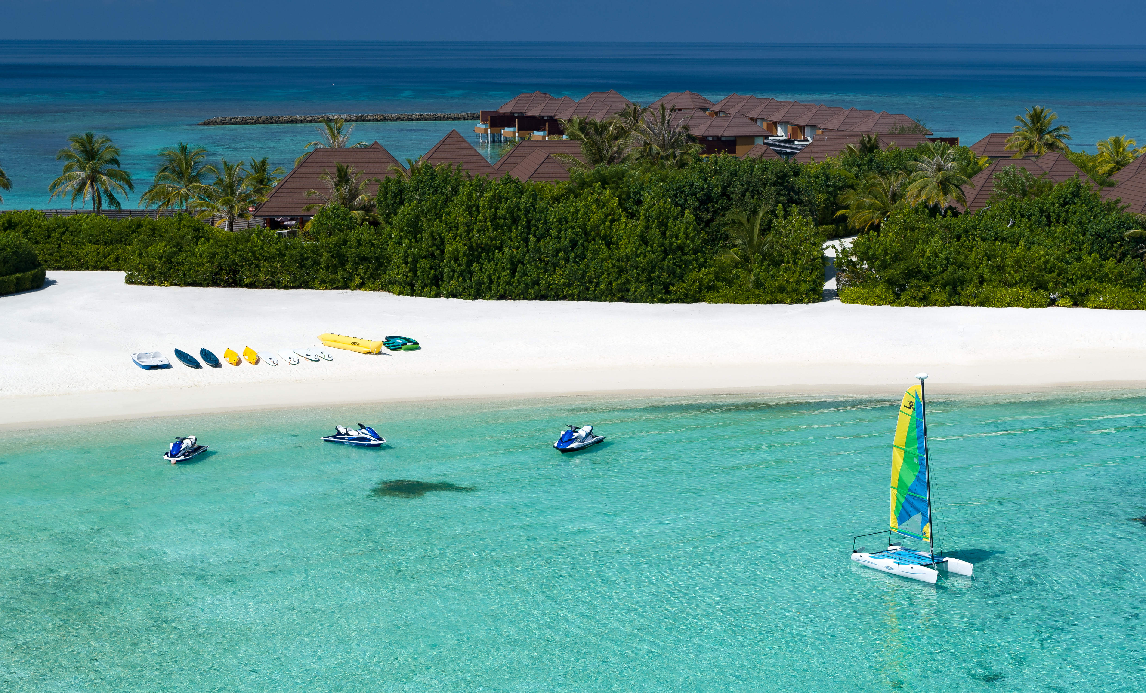
VARU BY ATMOSPHERE

Slide 35
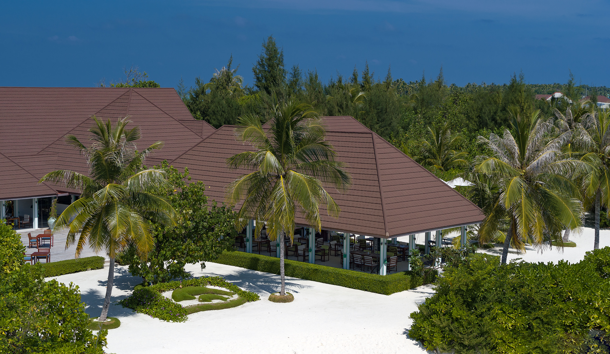
VARU BY ATMOSPHERE

Slide 36
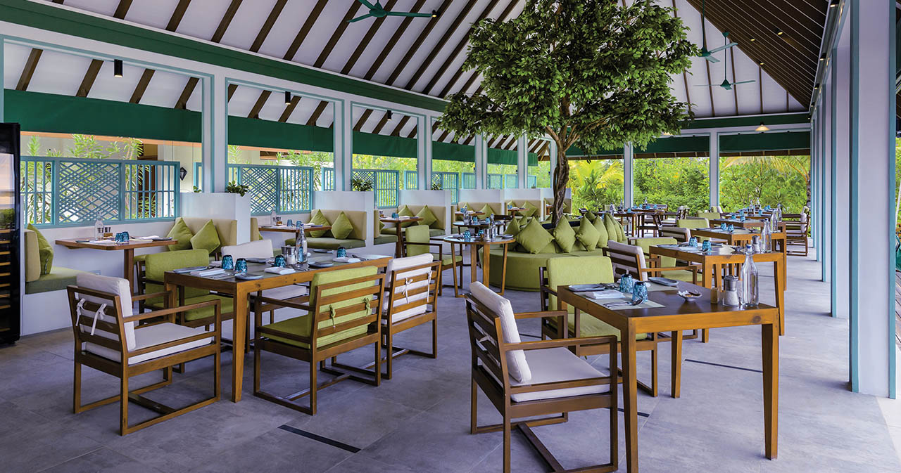
VARU BY ATMOSPHERE

Slide 37
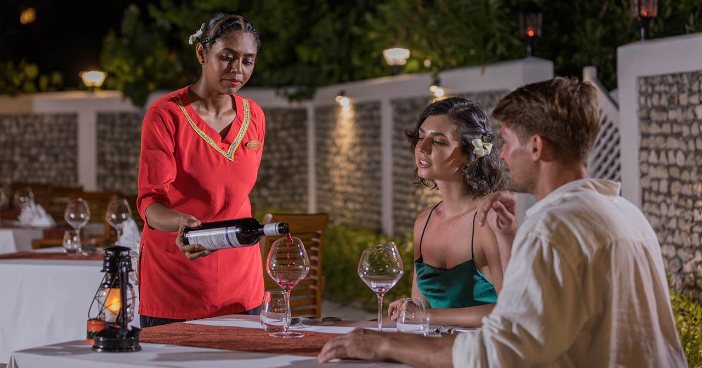
VARU BY ATMOSPHERE

Slide 38
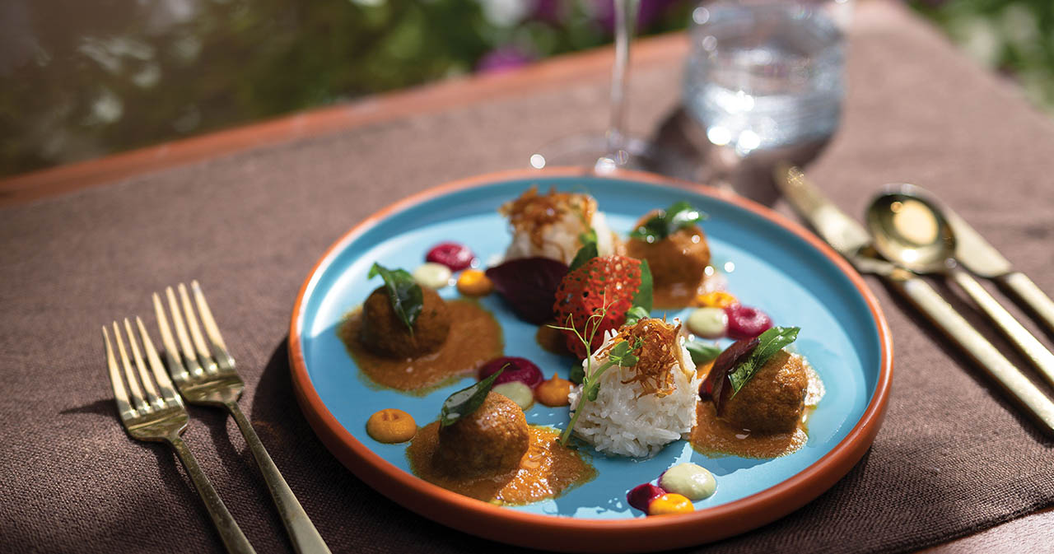
VARU BY ATMOSPHERE

Slide 39
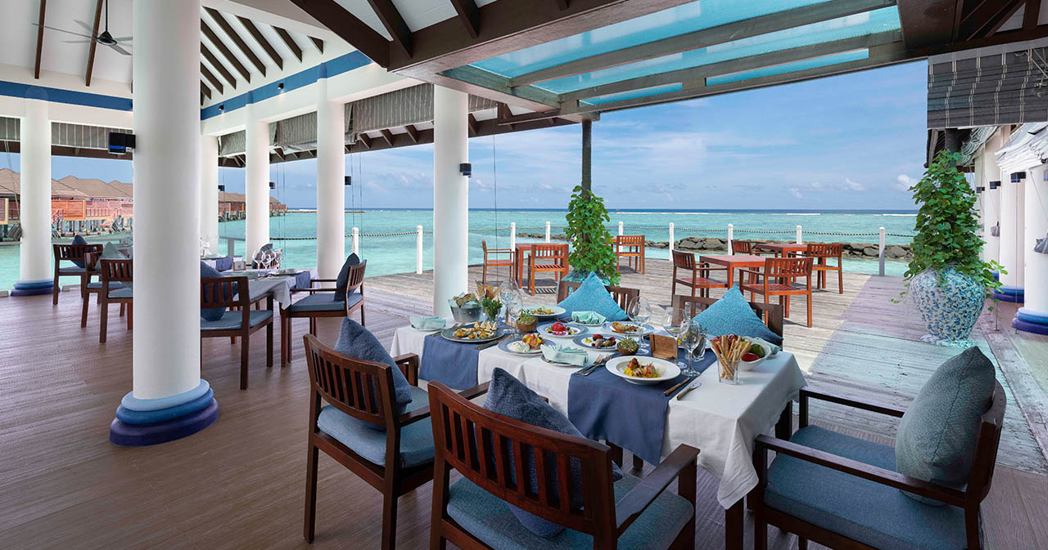
VARU BY ATMOSPHERE

Slide 40
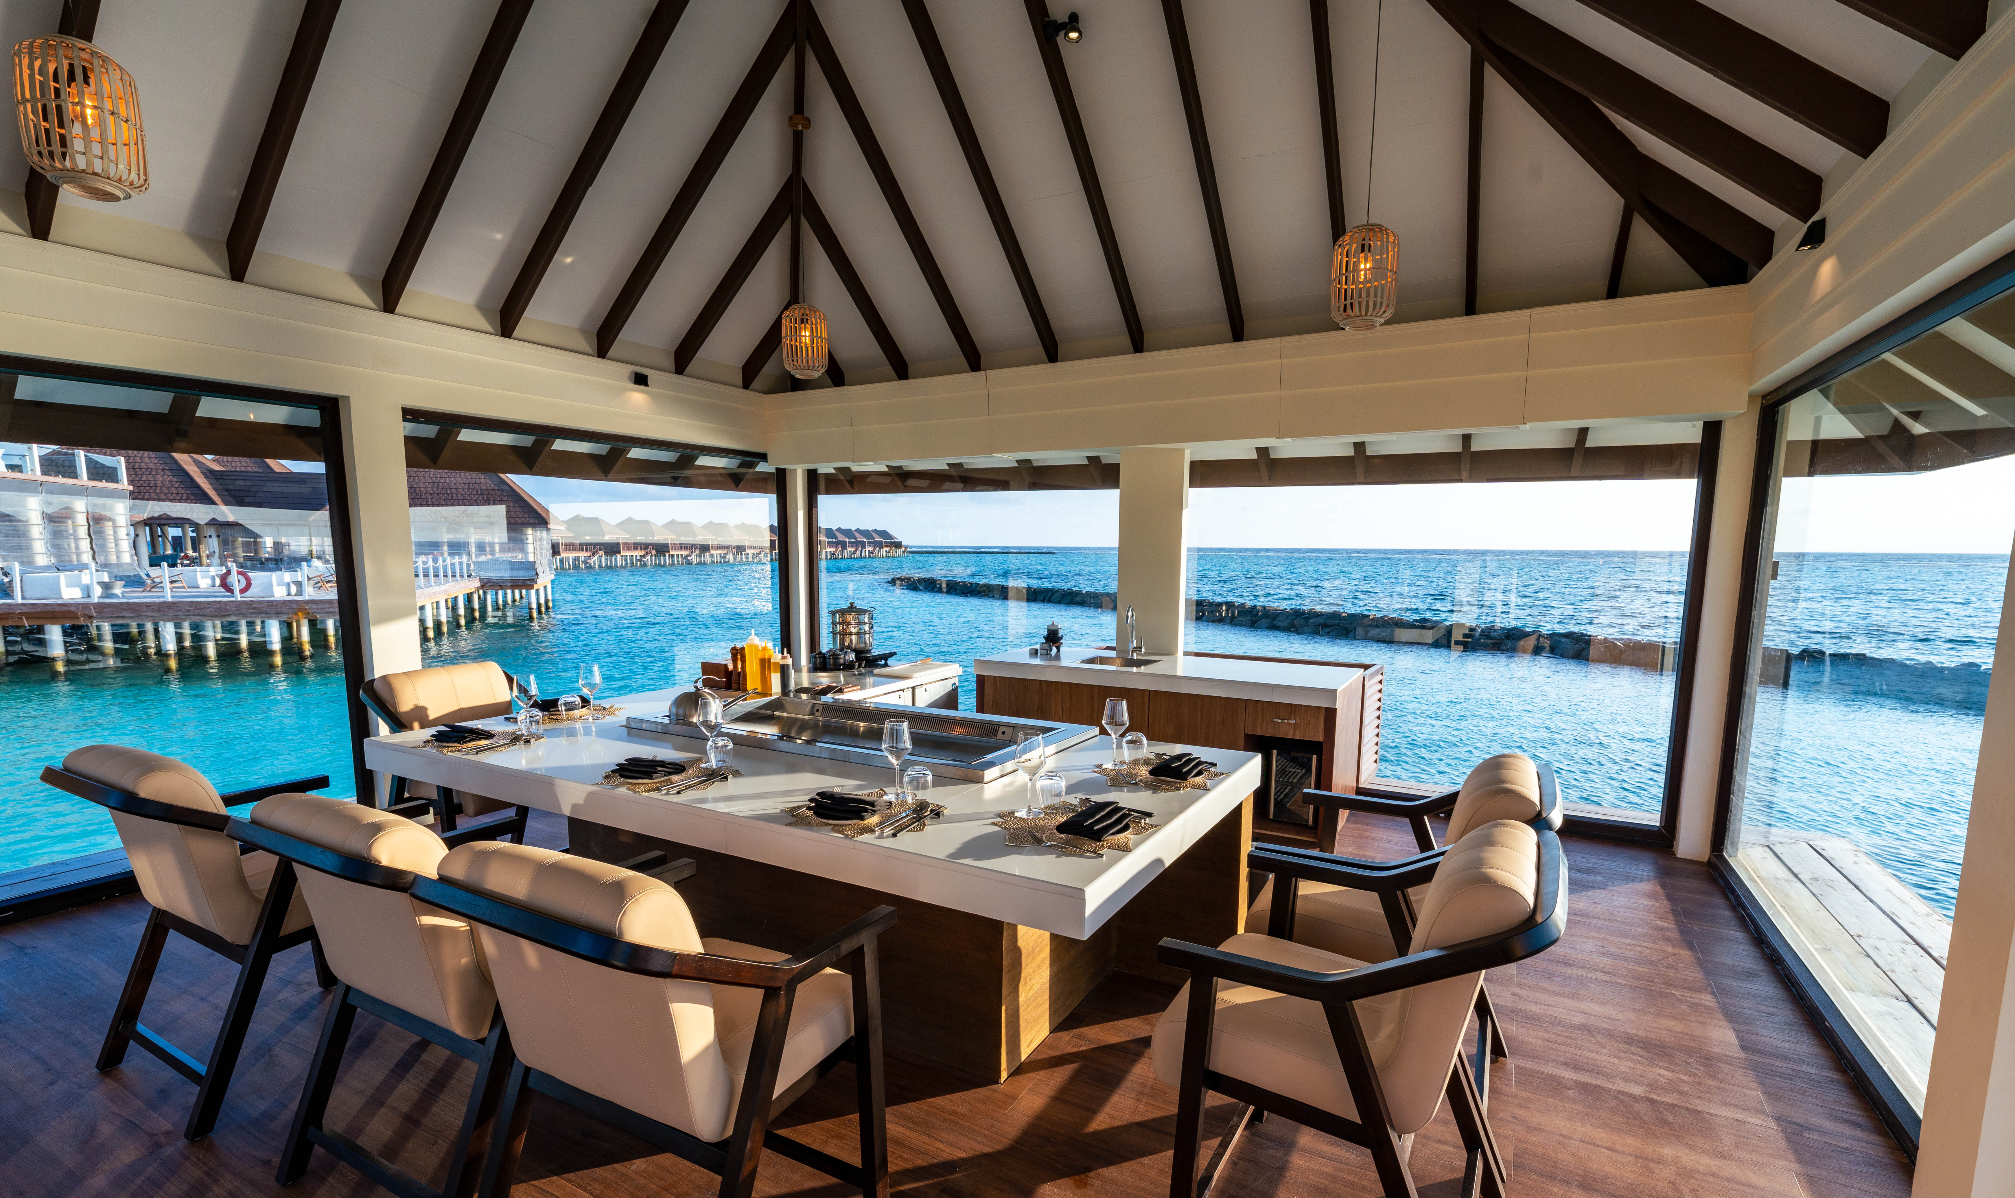
VARU BY ATMOSPHERE

Slide 41
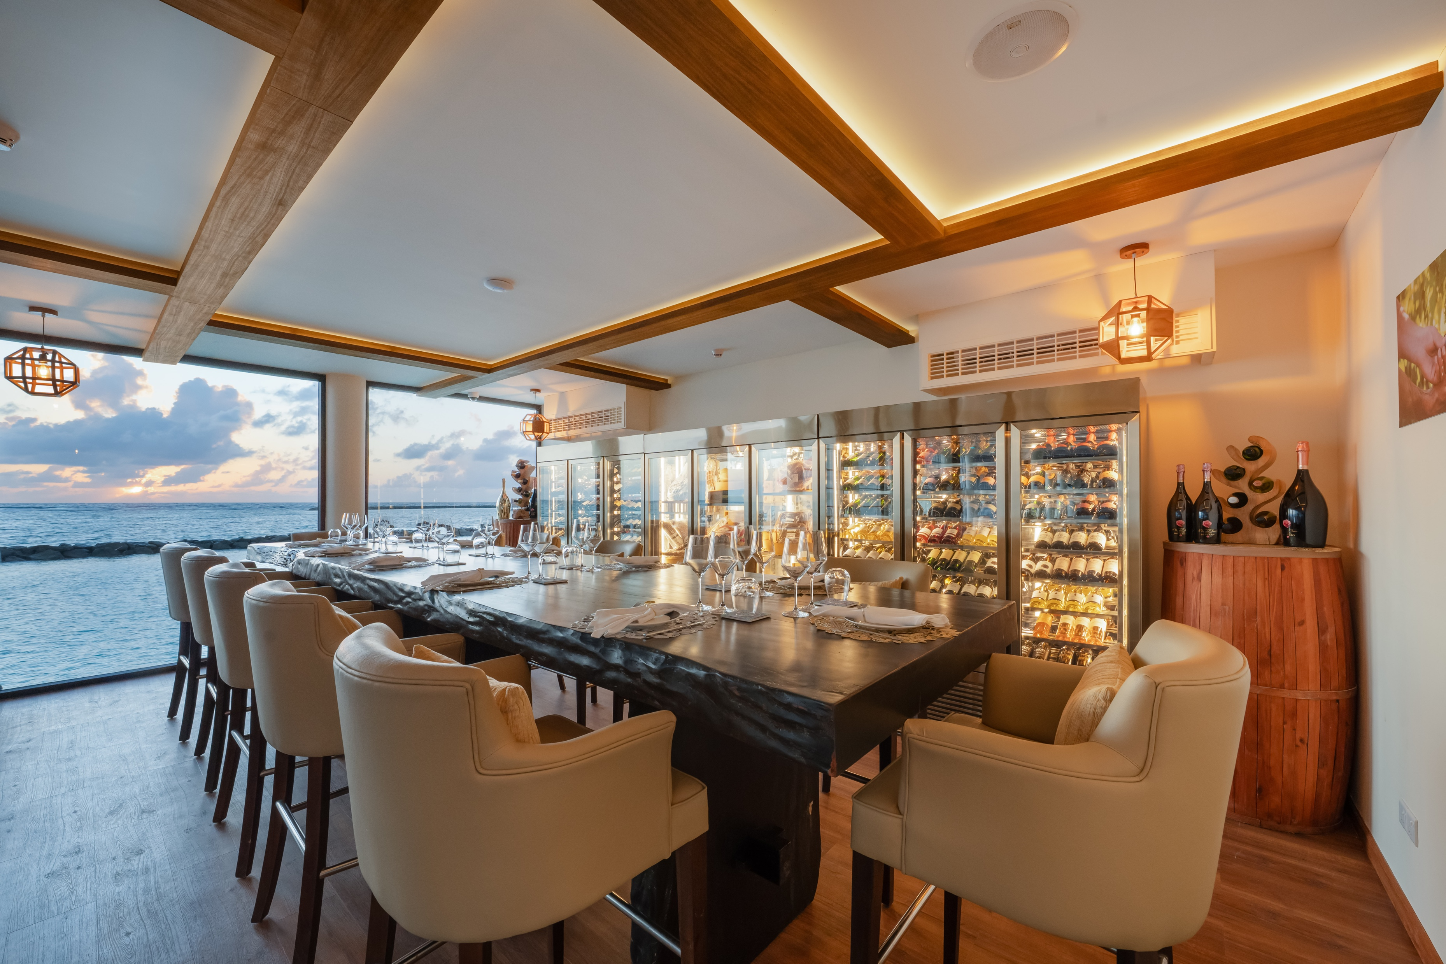
VARU BY ATMOSPHERE

Slide 42
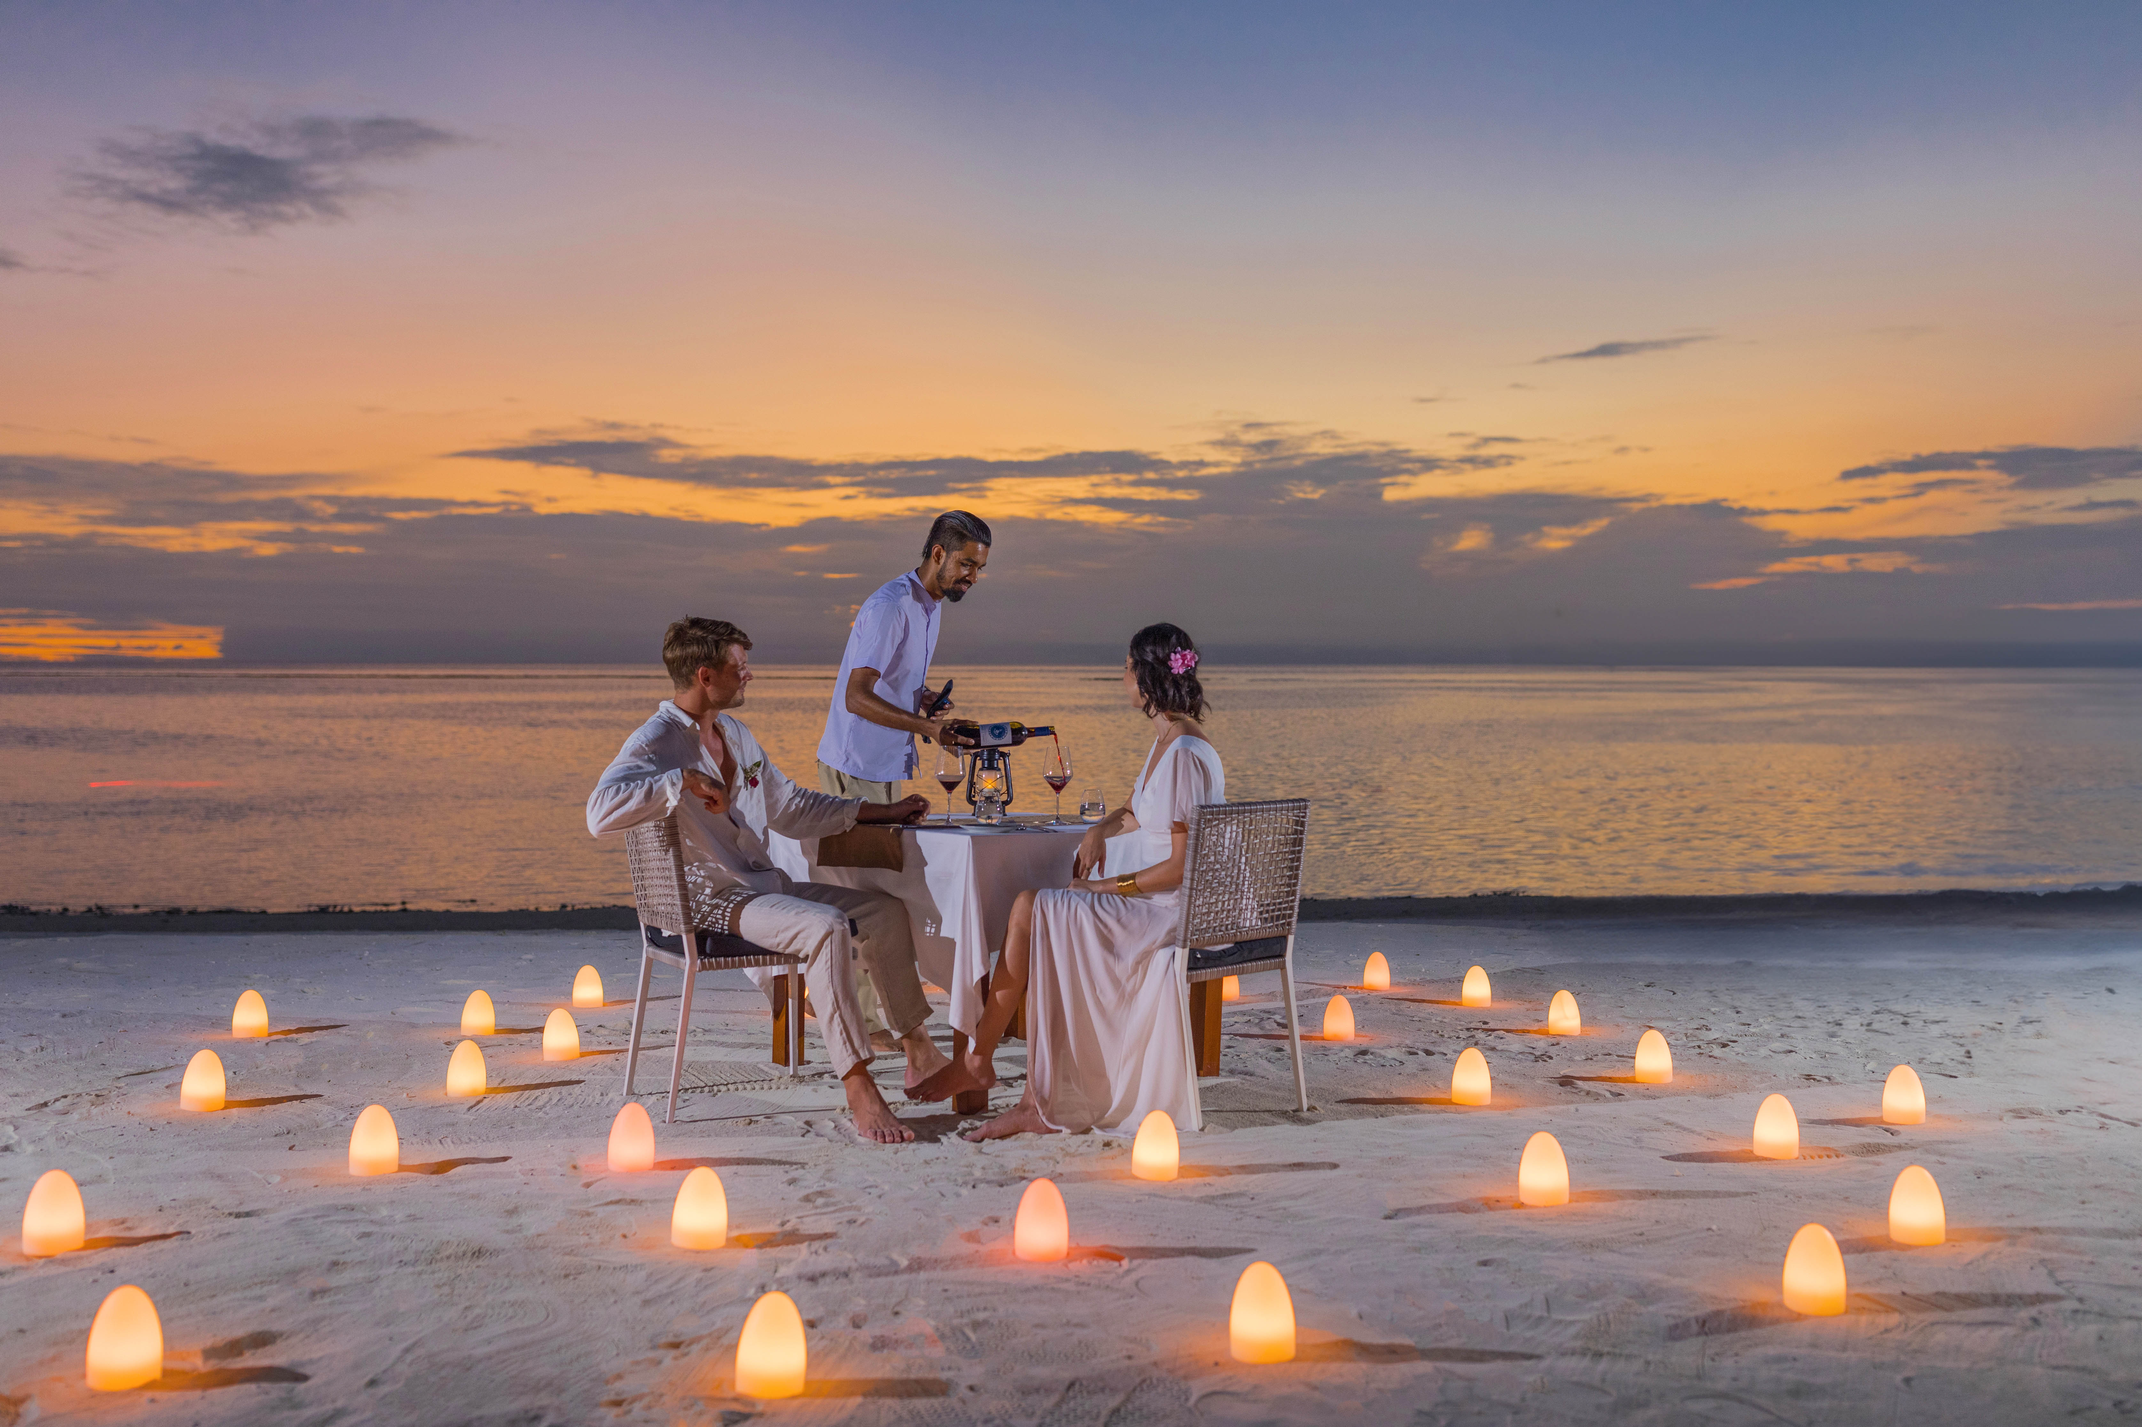
VARU BY ATMOSPHERE

Slide 43
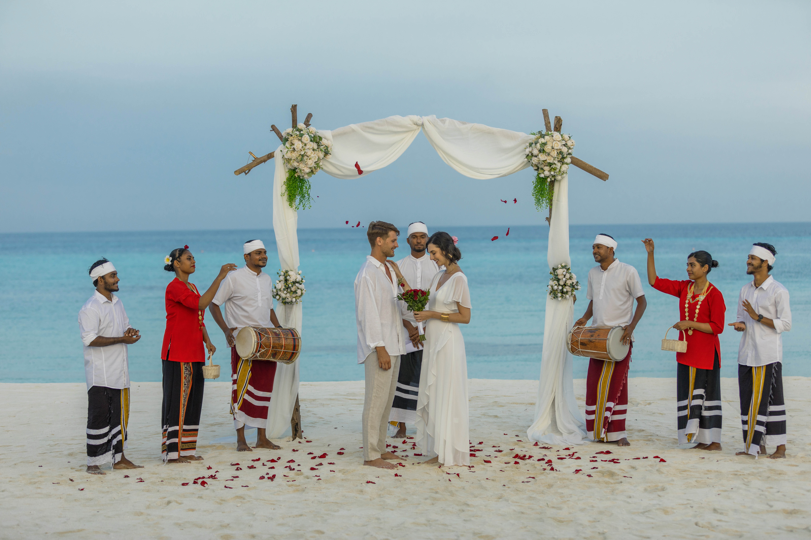
VARU BY ATMOSPHERE

Slide 44
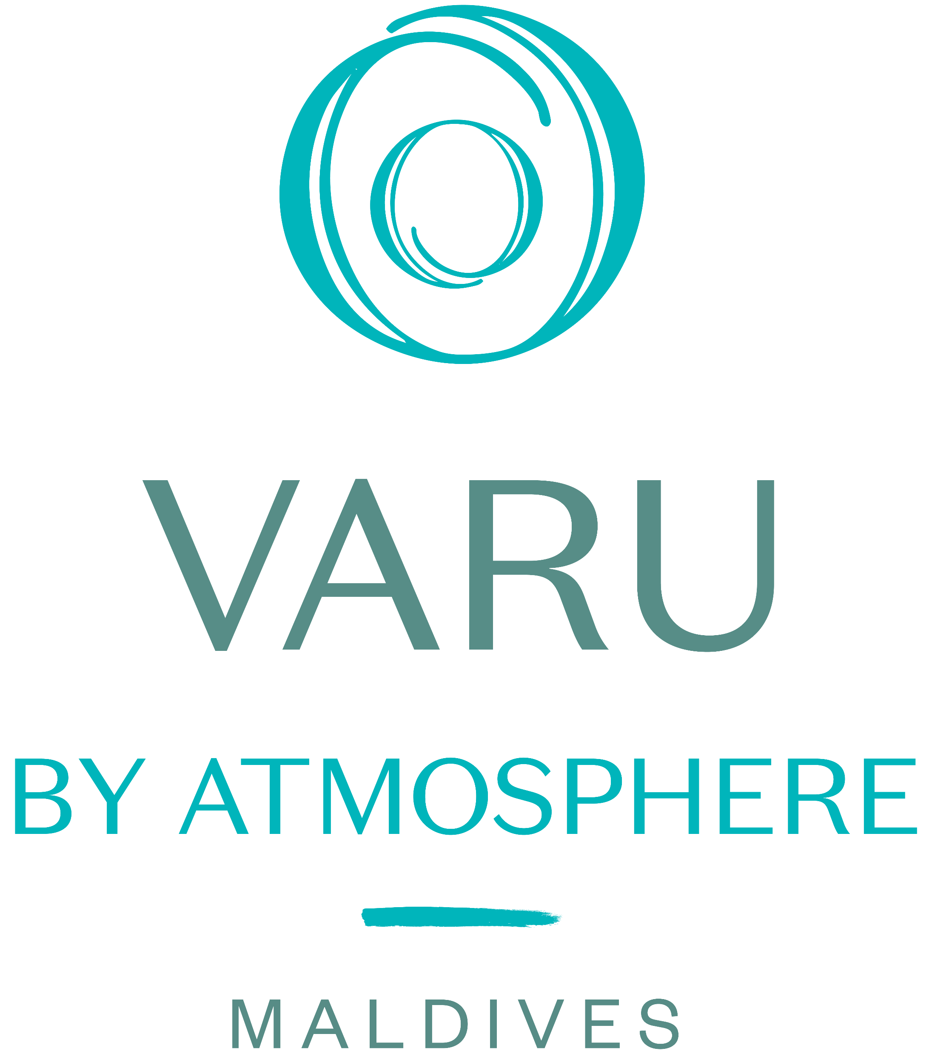

More Information
Thank You!
VARU BY ATMOSPHERE

